Slide 1

Vyacheslav (Slava) Gutyr
Team Captain
Eric Stevens
Assistant Captain

Slide 2
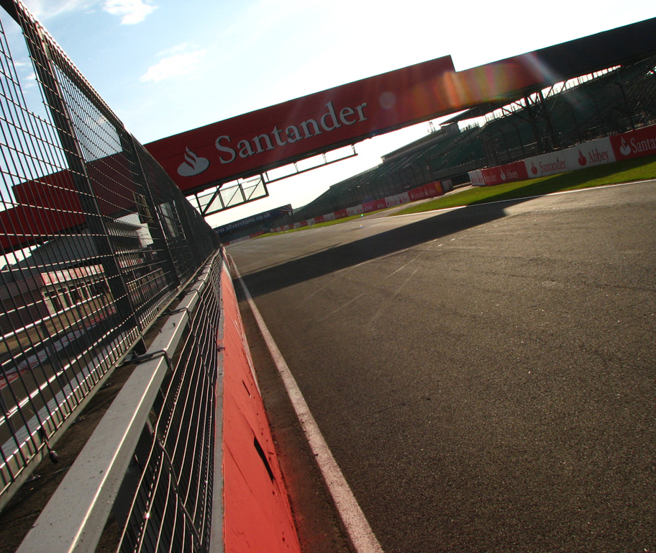
What Is Formula SAE?
Worldwide competition hosted by the Society of Automotive Engineering (SAE)
Consisting Of:
1. Static Challenges
2. Dynamic Challenges

Slide 3
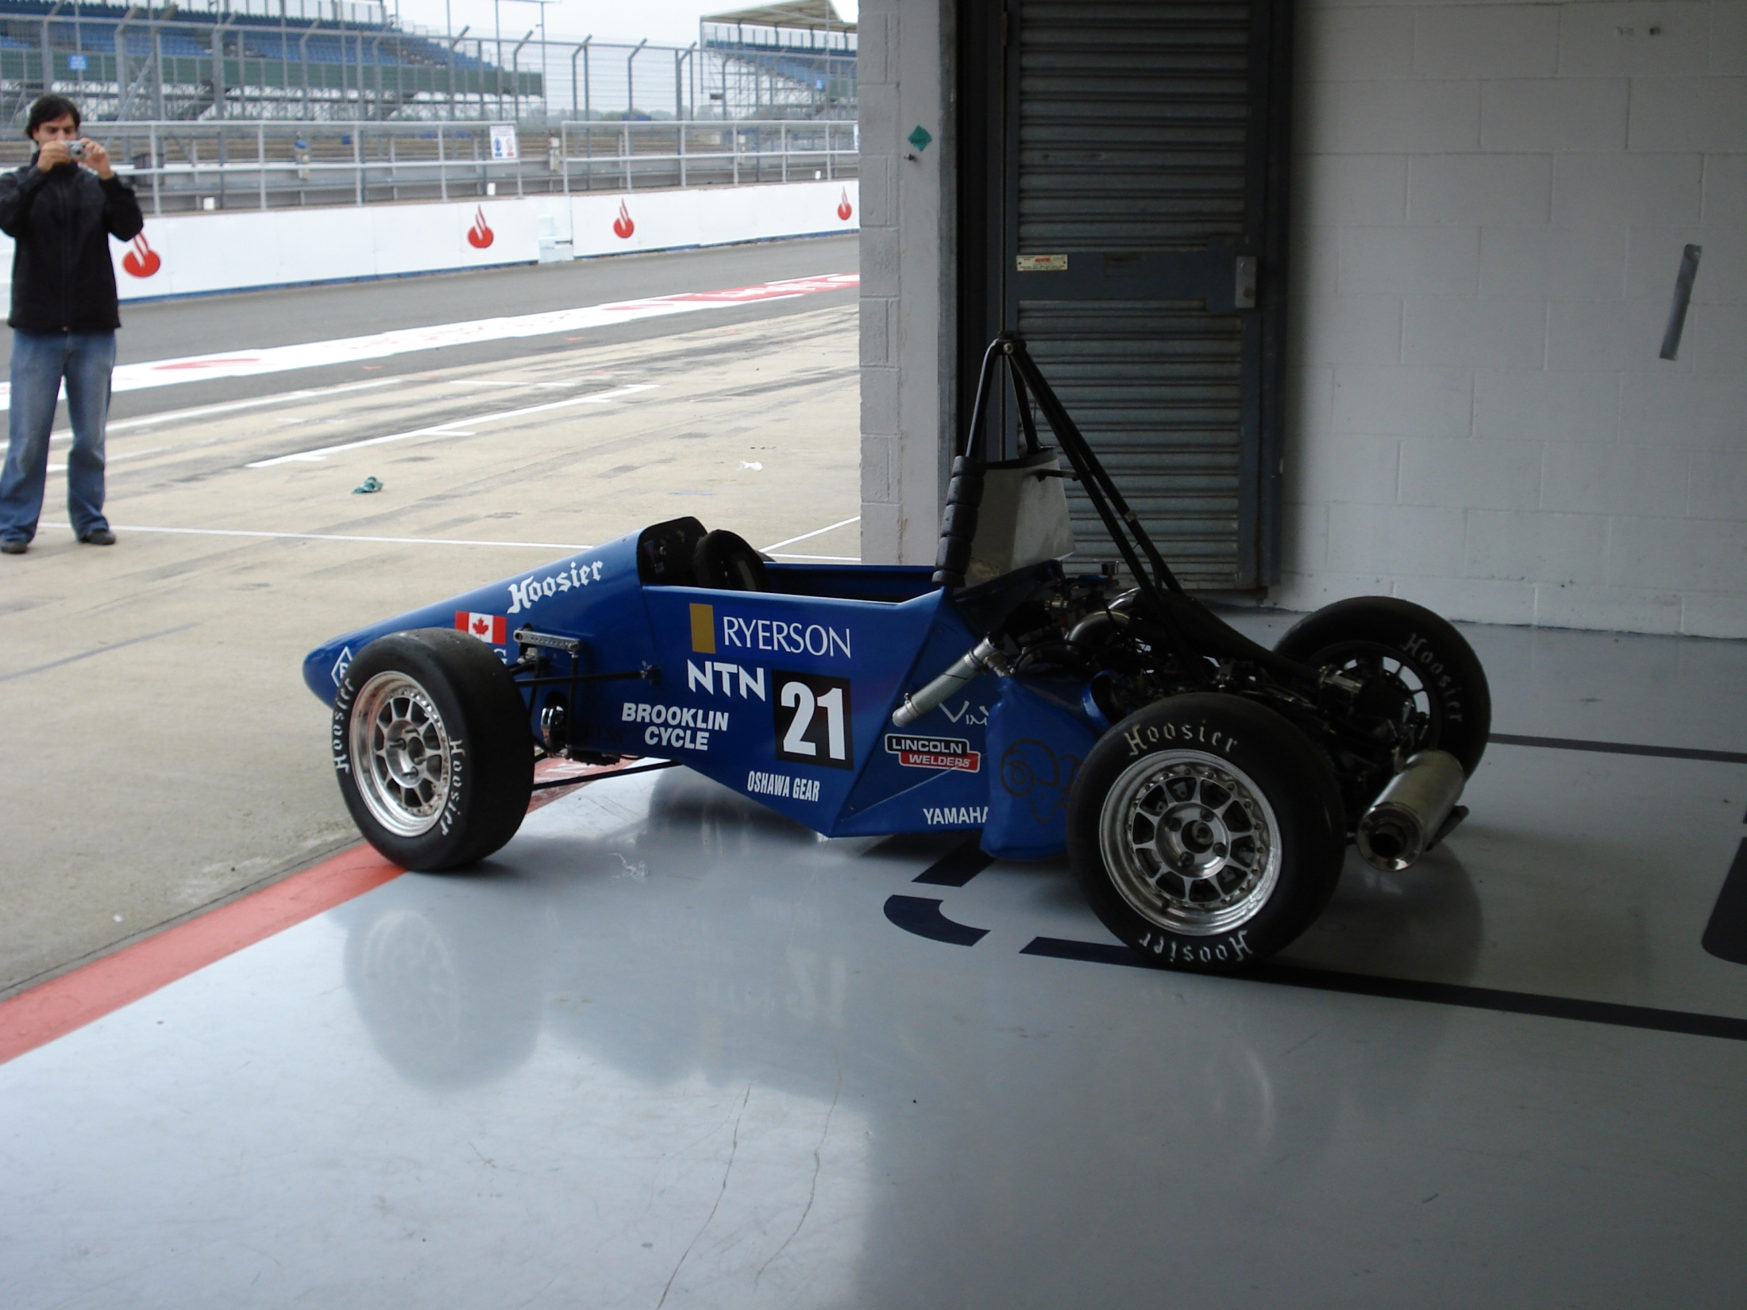
Our Objective:
The team is responsible for building a small format formula style race car
Once a car has been entered in a competition it cannot be entered again, therefore a new car must be created each year

Slide 4
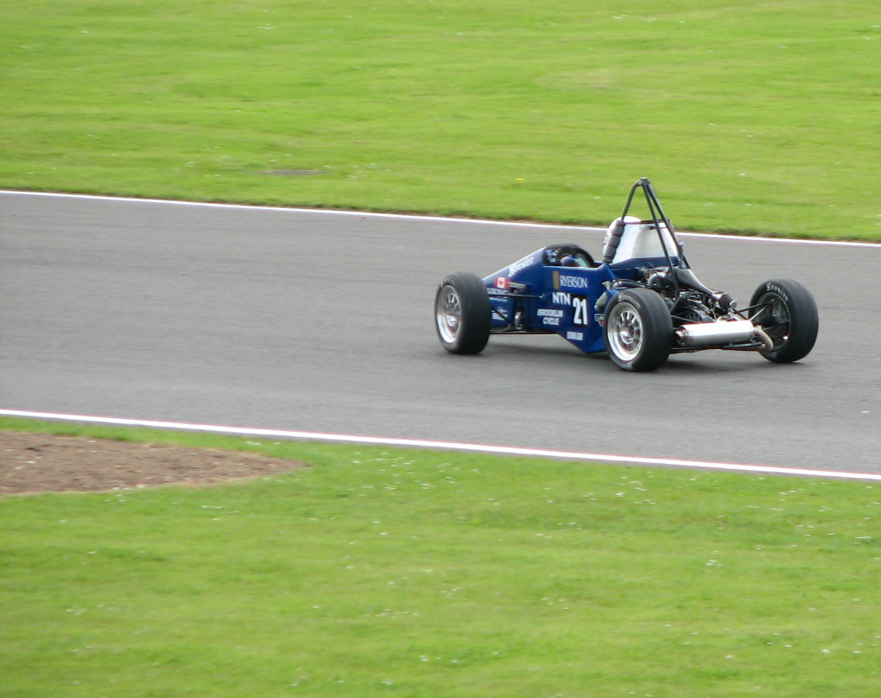
Ryerson Formula SAE (RFSAE) History
The RFSAE Team was started in 1997
RFSAE has fielded seven cars in that time
Top finish was 10th of 122 teams in 2005

Slide 5
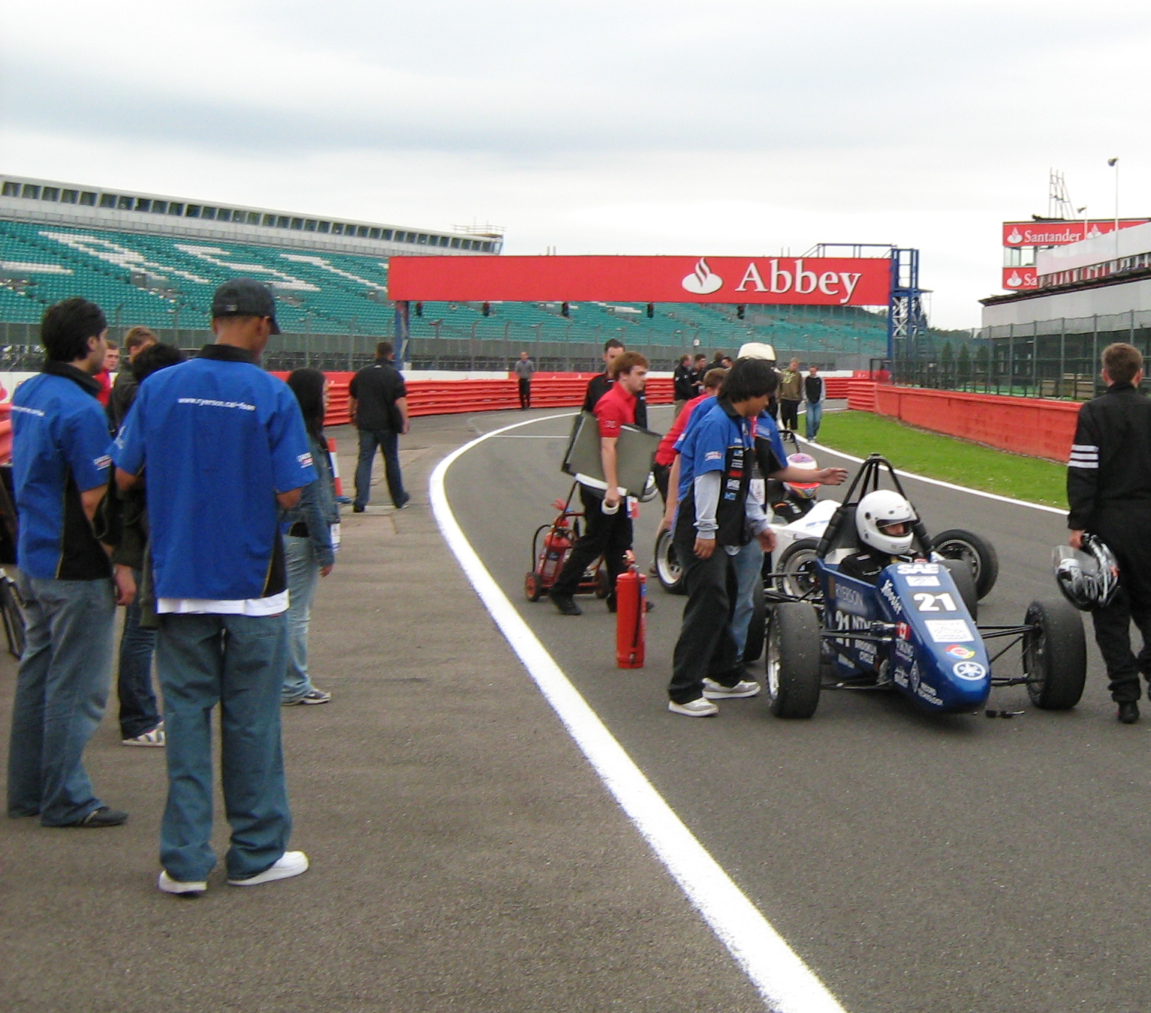
The 2008 Team
Team Captains
Business Team
10 System Managers
New Members

Slide 6
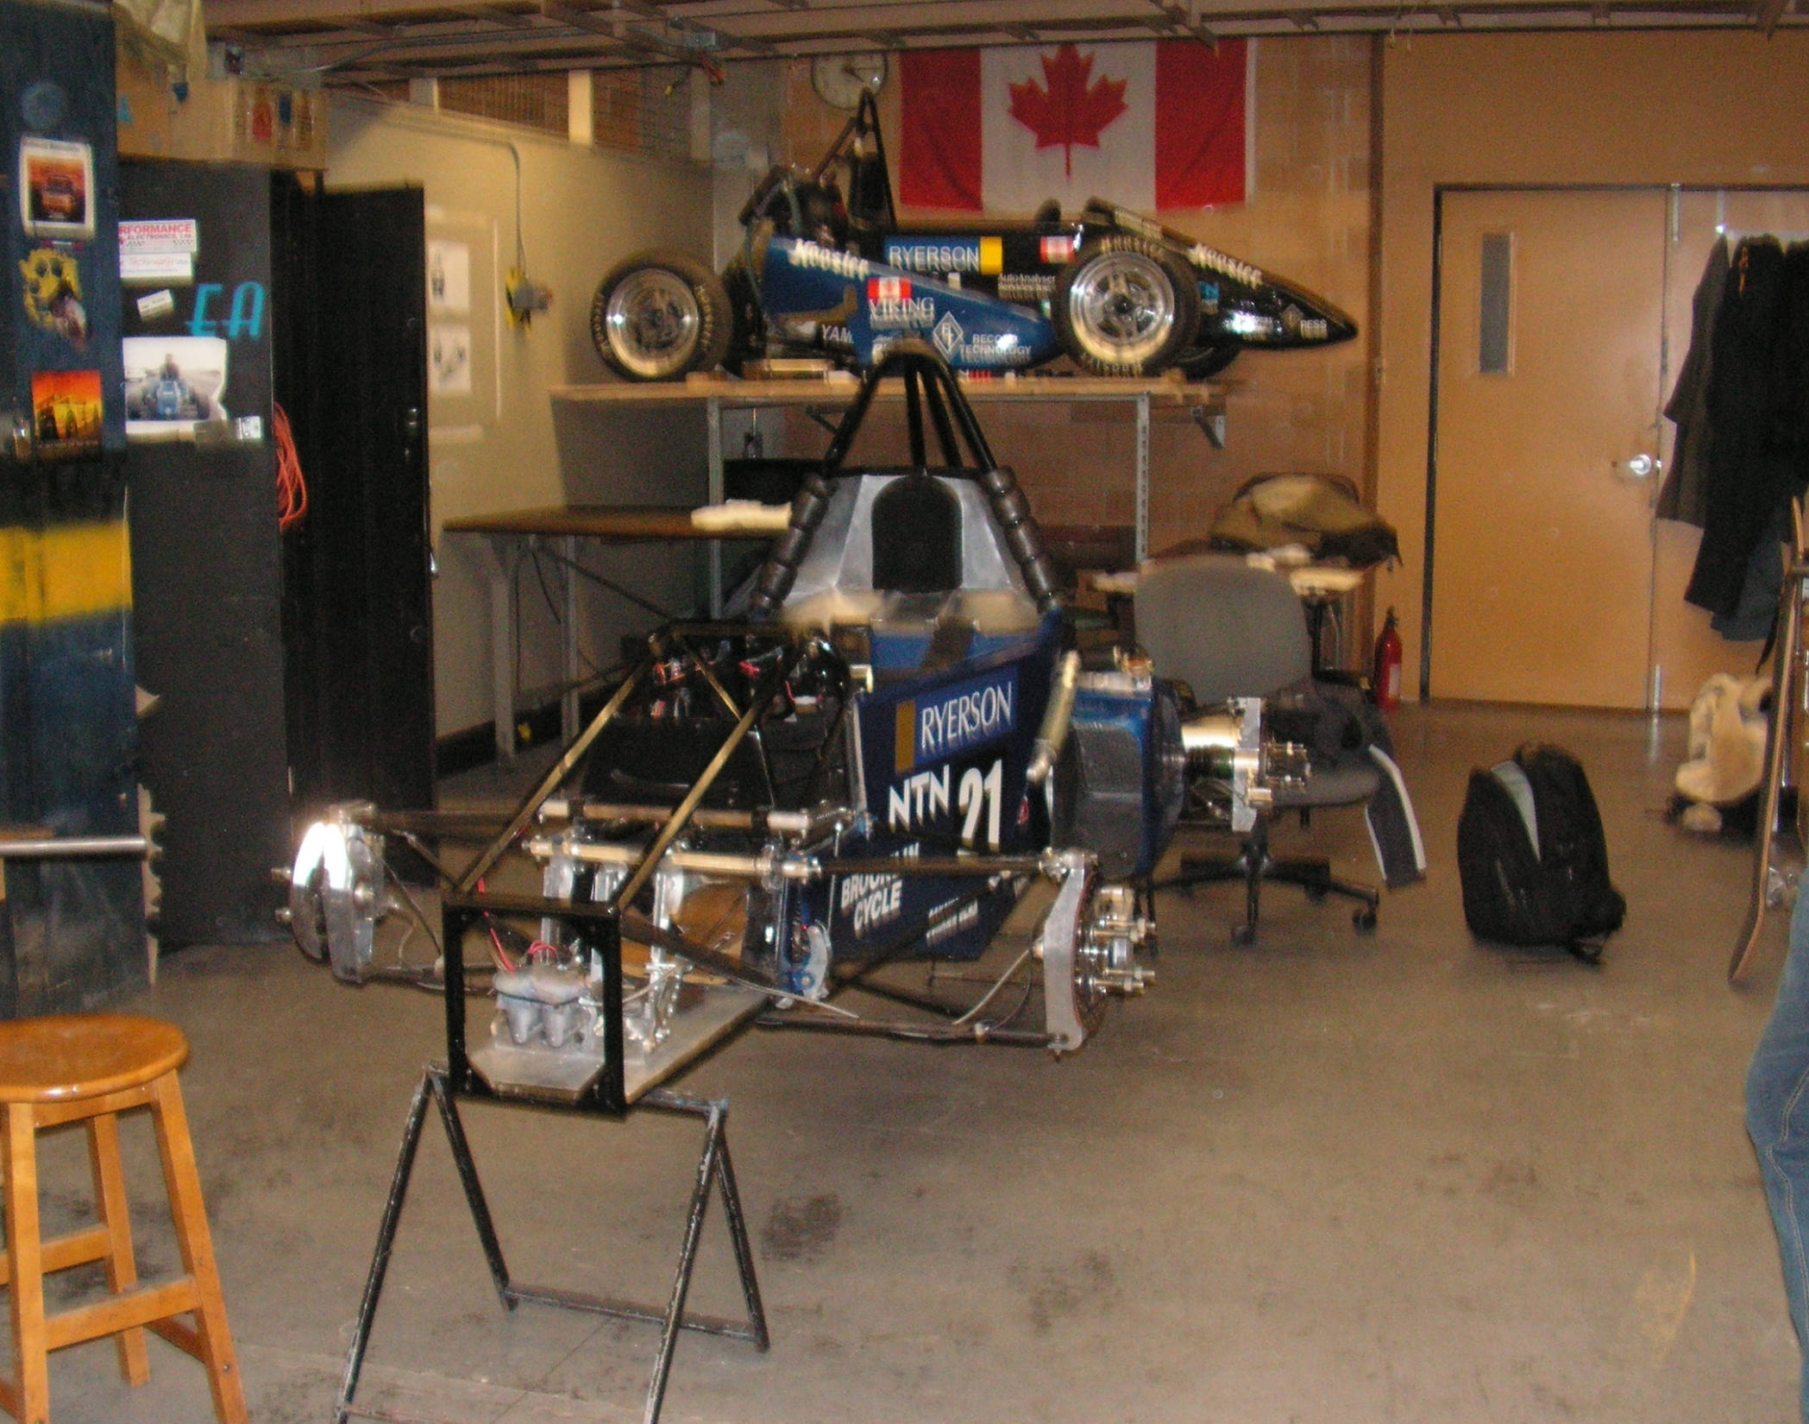
The Race Shop
Over 90% of the car is designed by our team members
Over 80% of the car is build right here on The Ryerson Campus

Slide 7
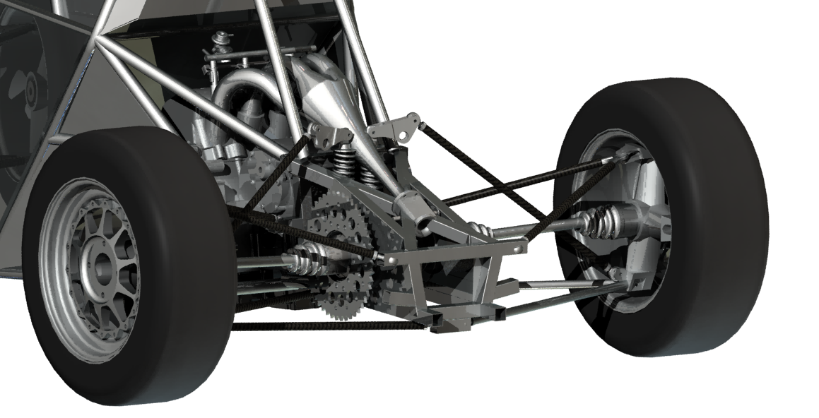
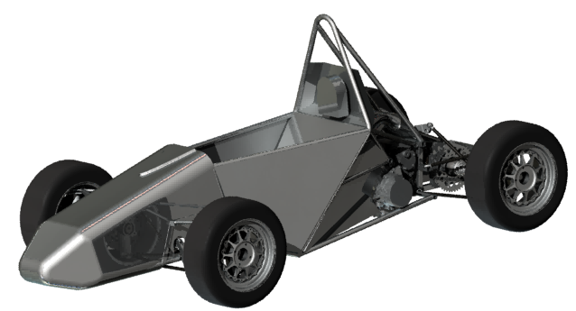
Designing the Race Car
Putting what we learn to work!
Building a race car is a great answer to: “What does an engineer actually do?”
With the aid of CAD software, the entire car is designed on computer before building commences

Slide 8
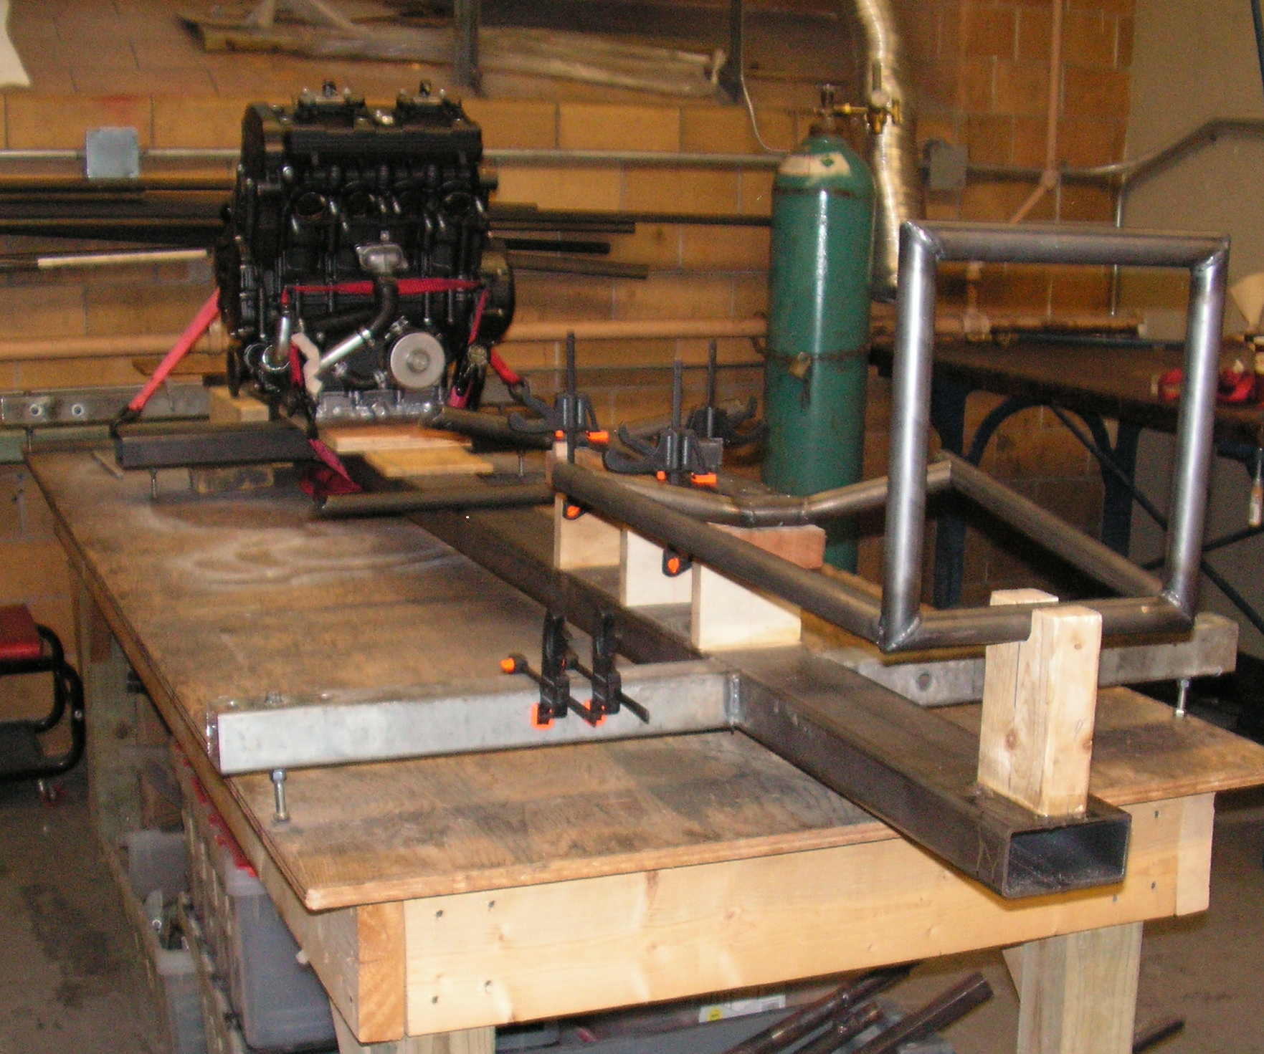
Building the Race Car
The car is created through the use of jigs like the one shown here to ensure accuracy

Slide 9
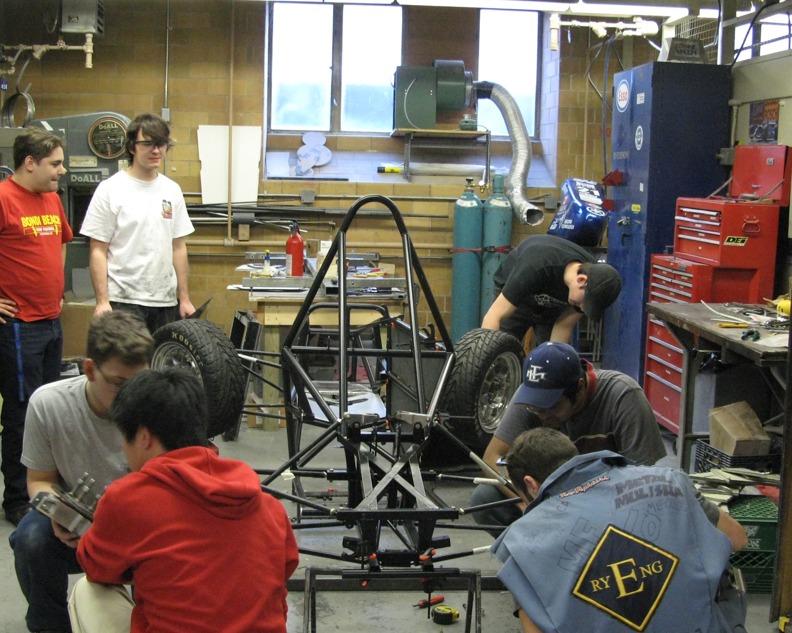
Building the Race Car

Slide 10
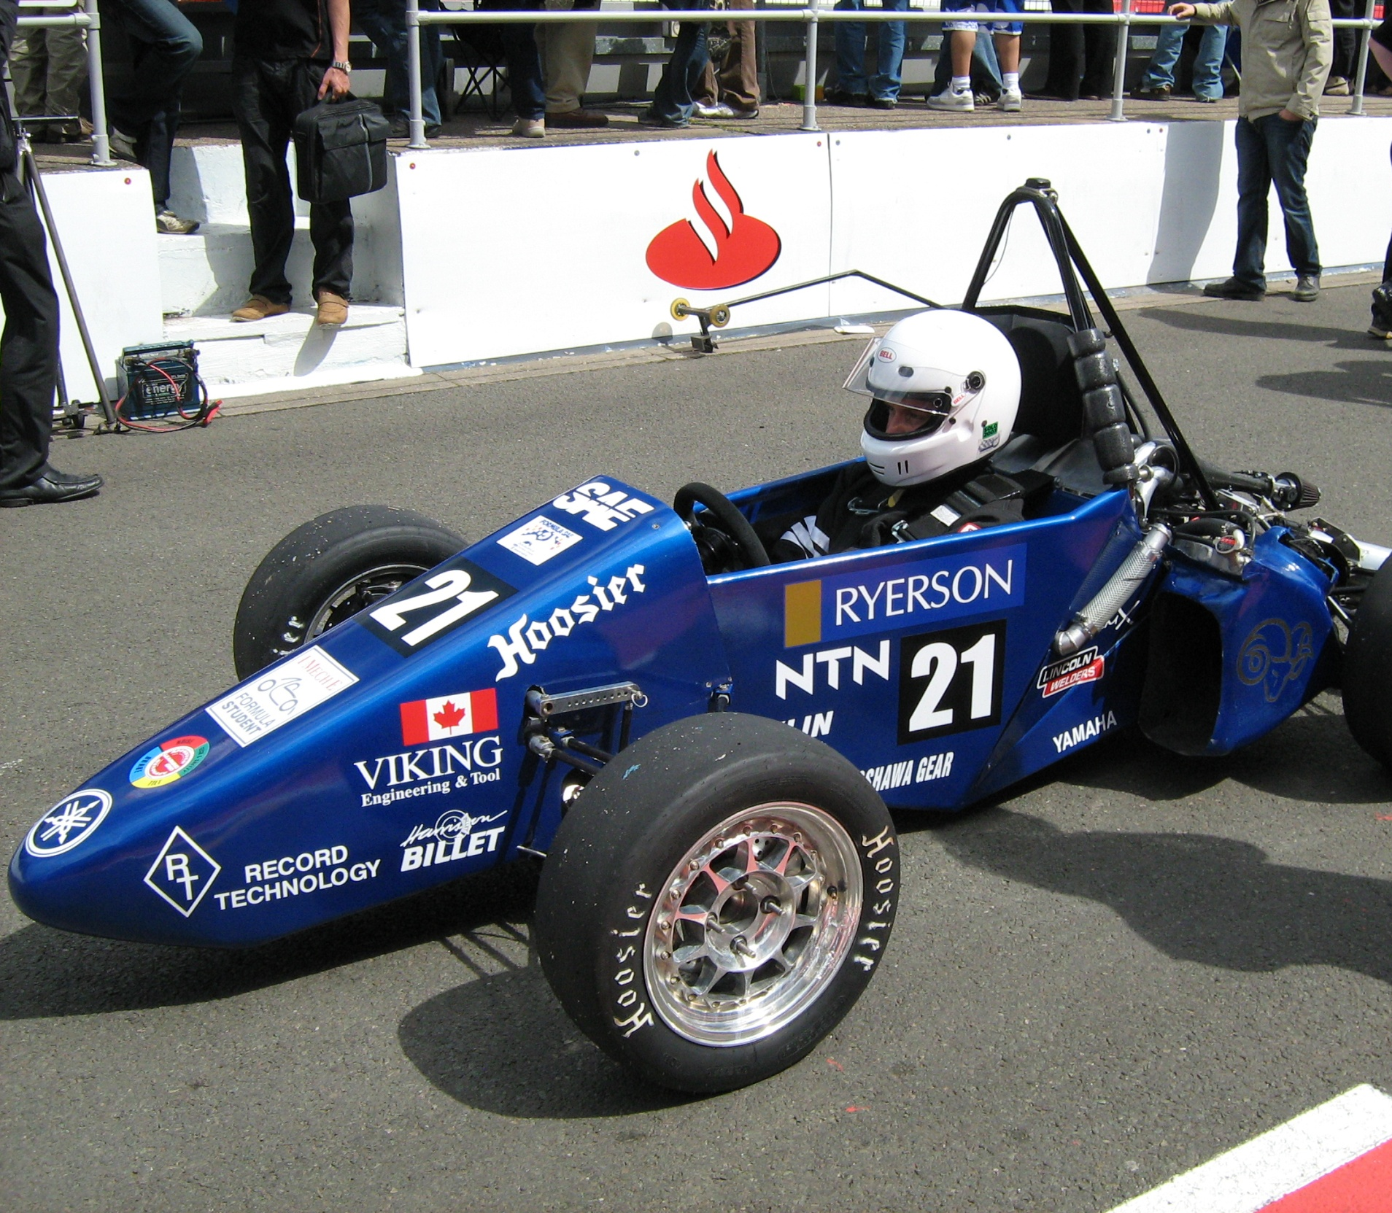
Testing the Car
The car must be completely tested before a race, this includes driver training and car setup

Slide 11
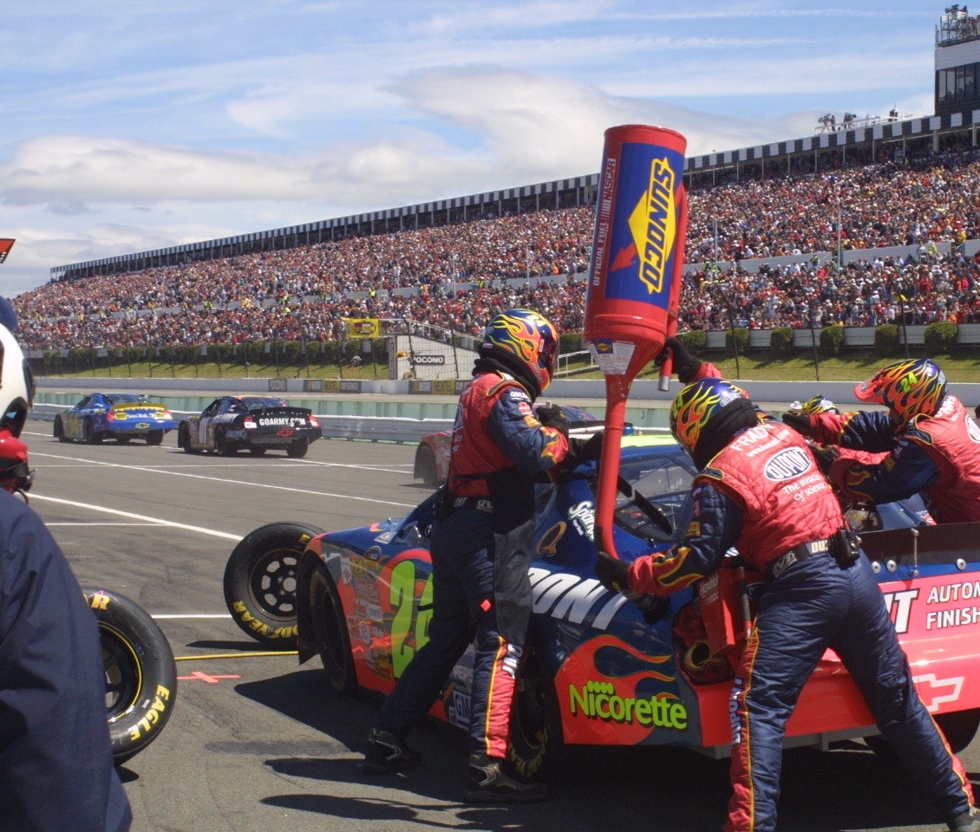
2008 Formula SAE
Michigan International Speedway
May 2008

Slide 12
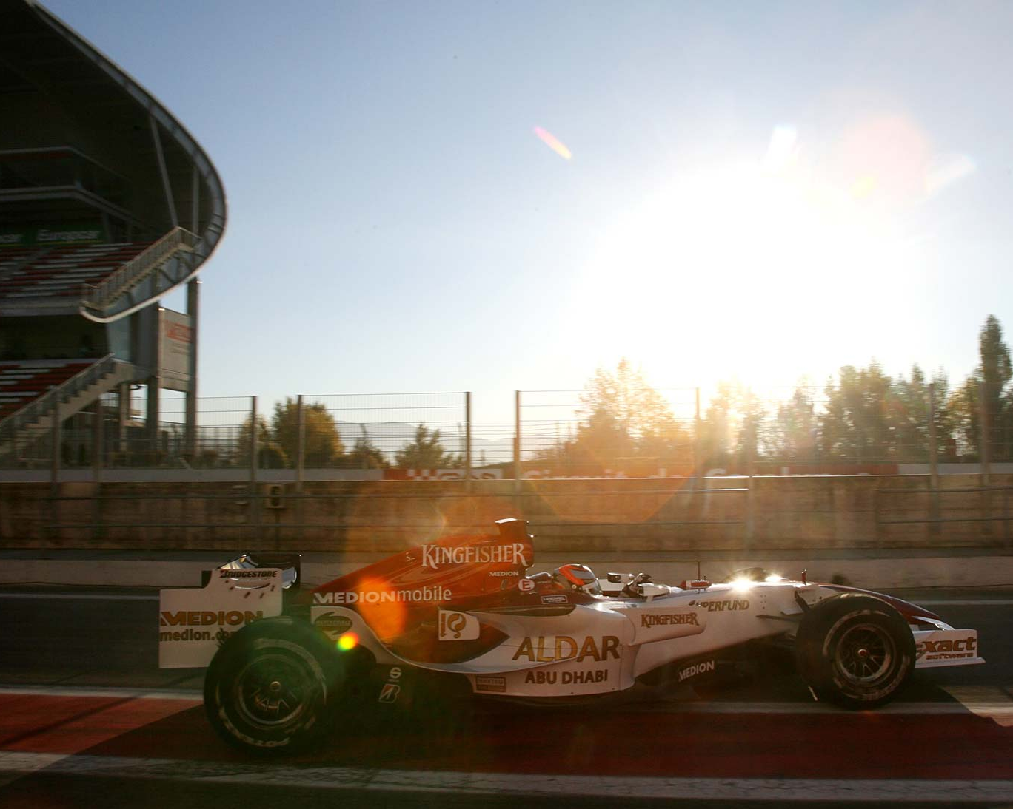
2008 Formula Student
Silverstone, England
July 2008
“Ryerson Formula SAE is proud to announce that we will be representing Canada in the 2008 Formula Student Competition”

Slide 13
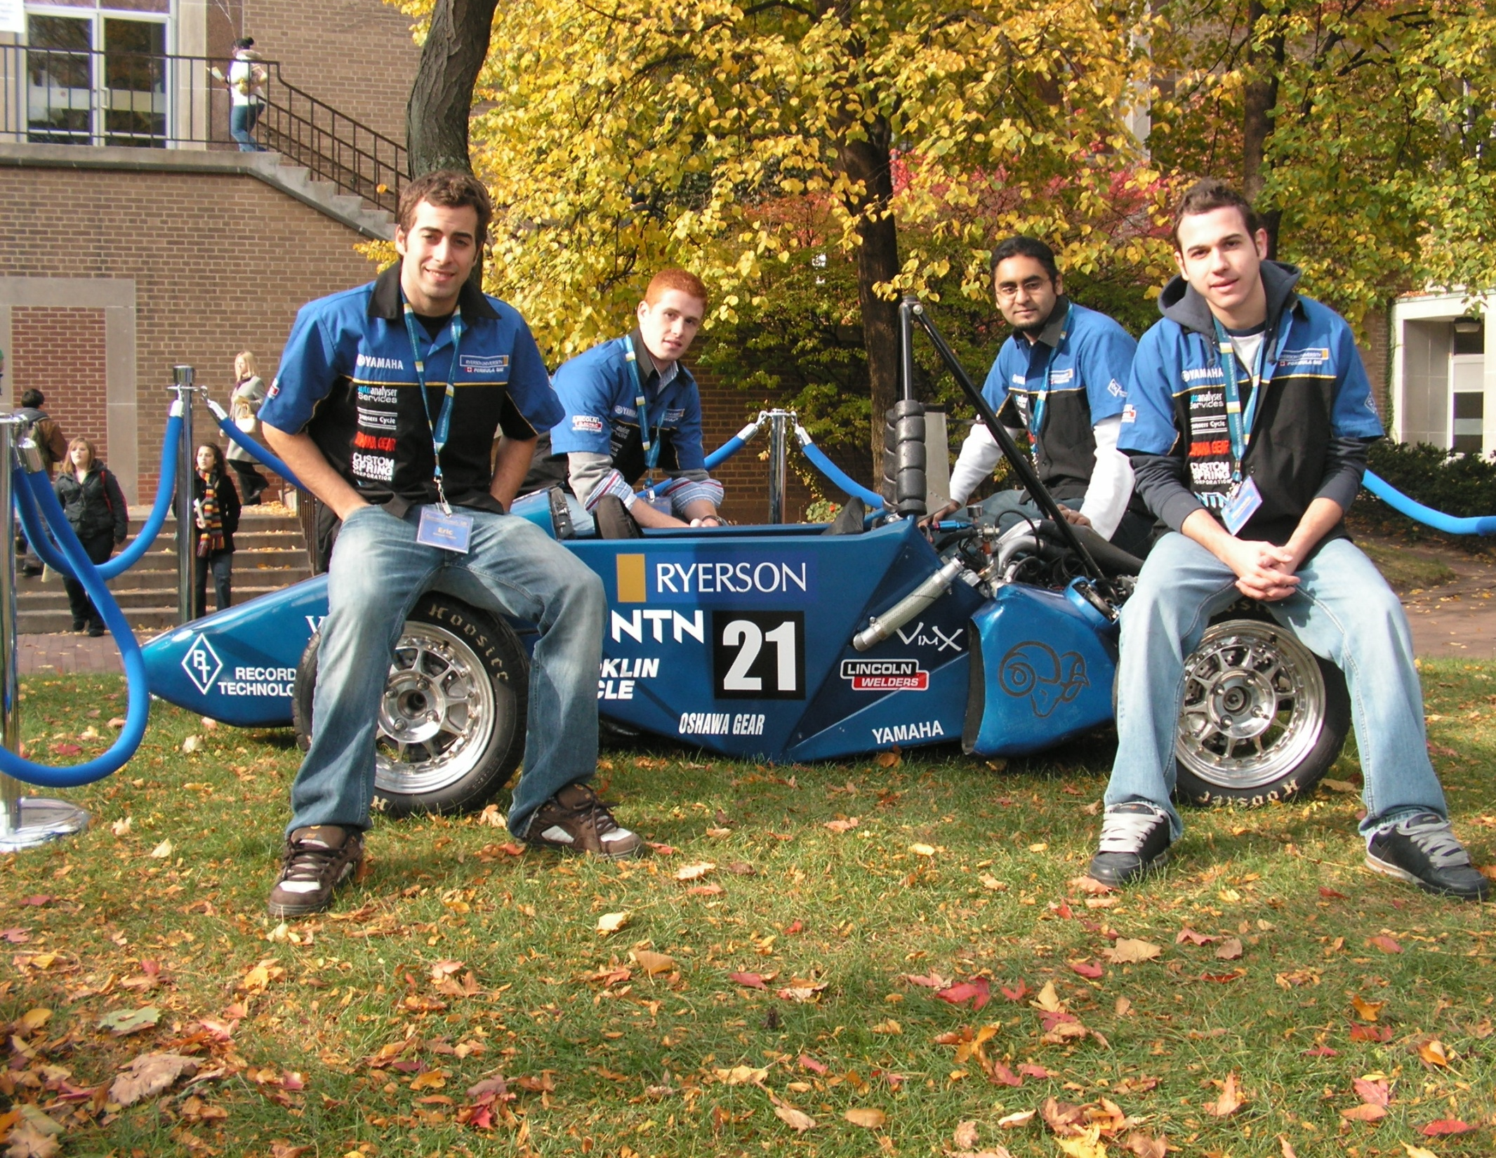
RFSAE on Campus:
We’re always looking for New Members!

Slide 14
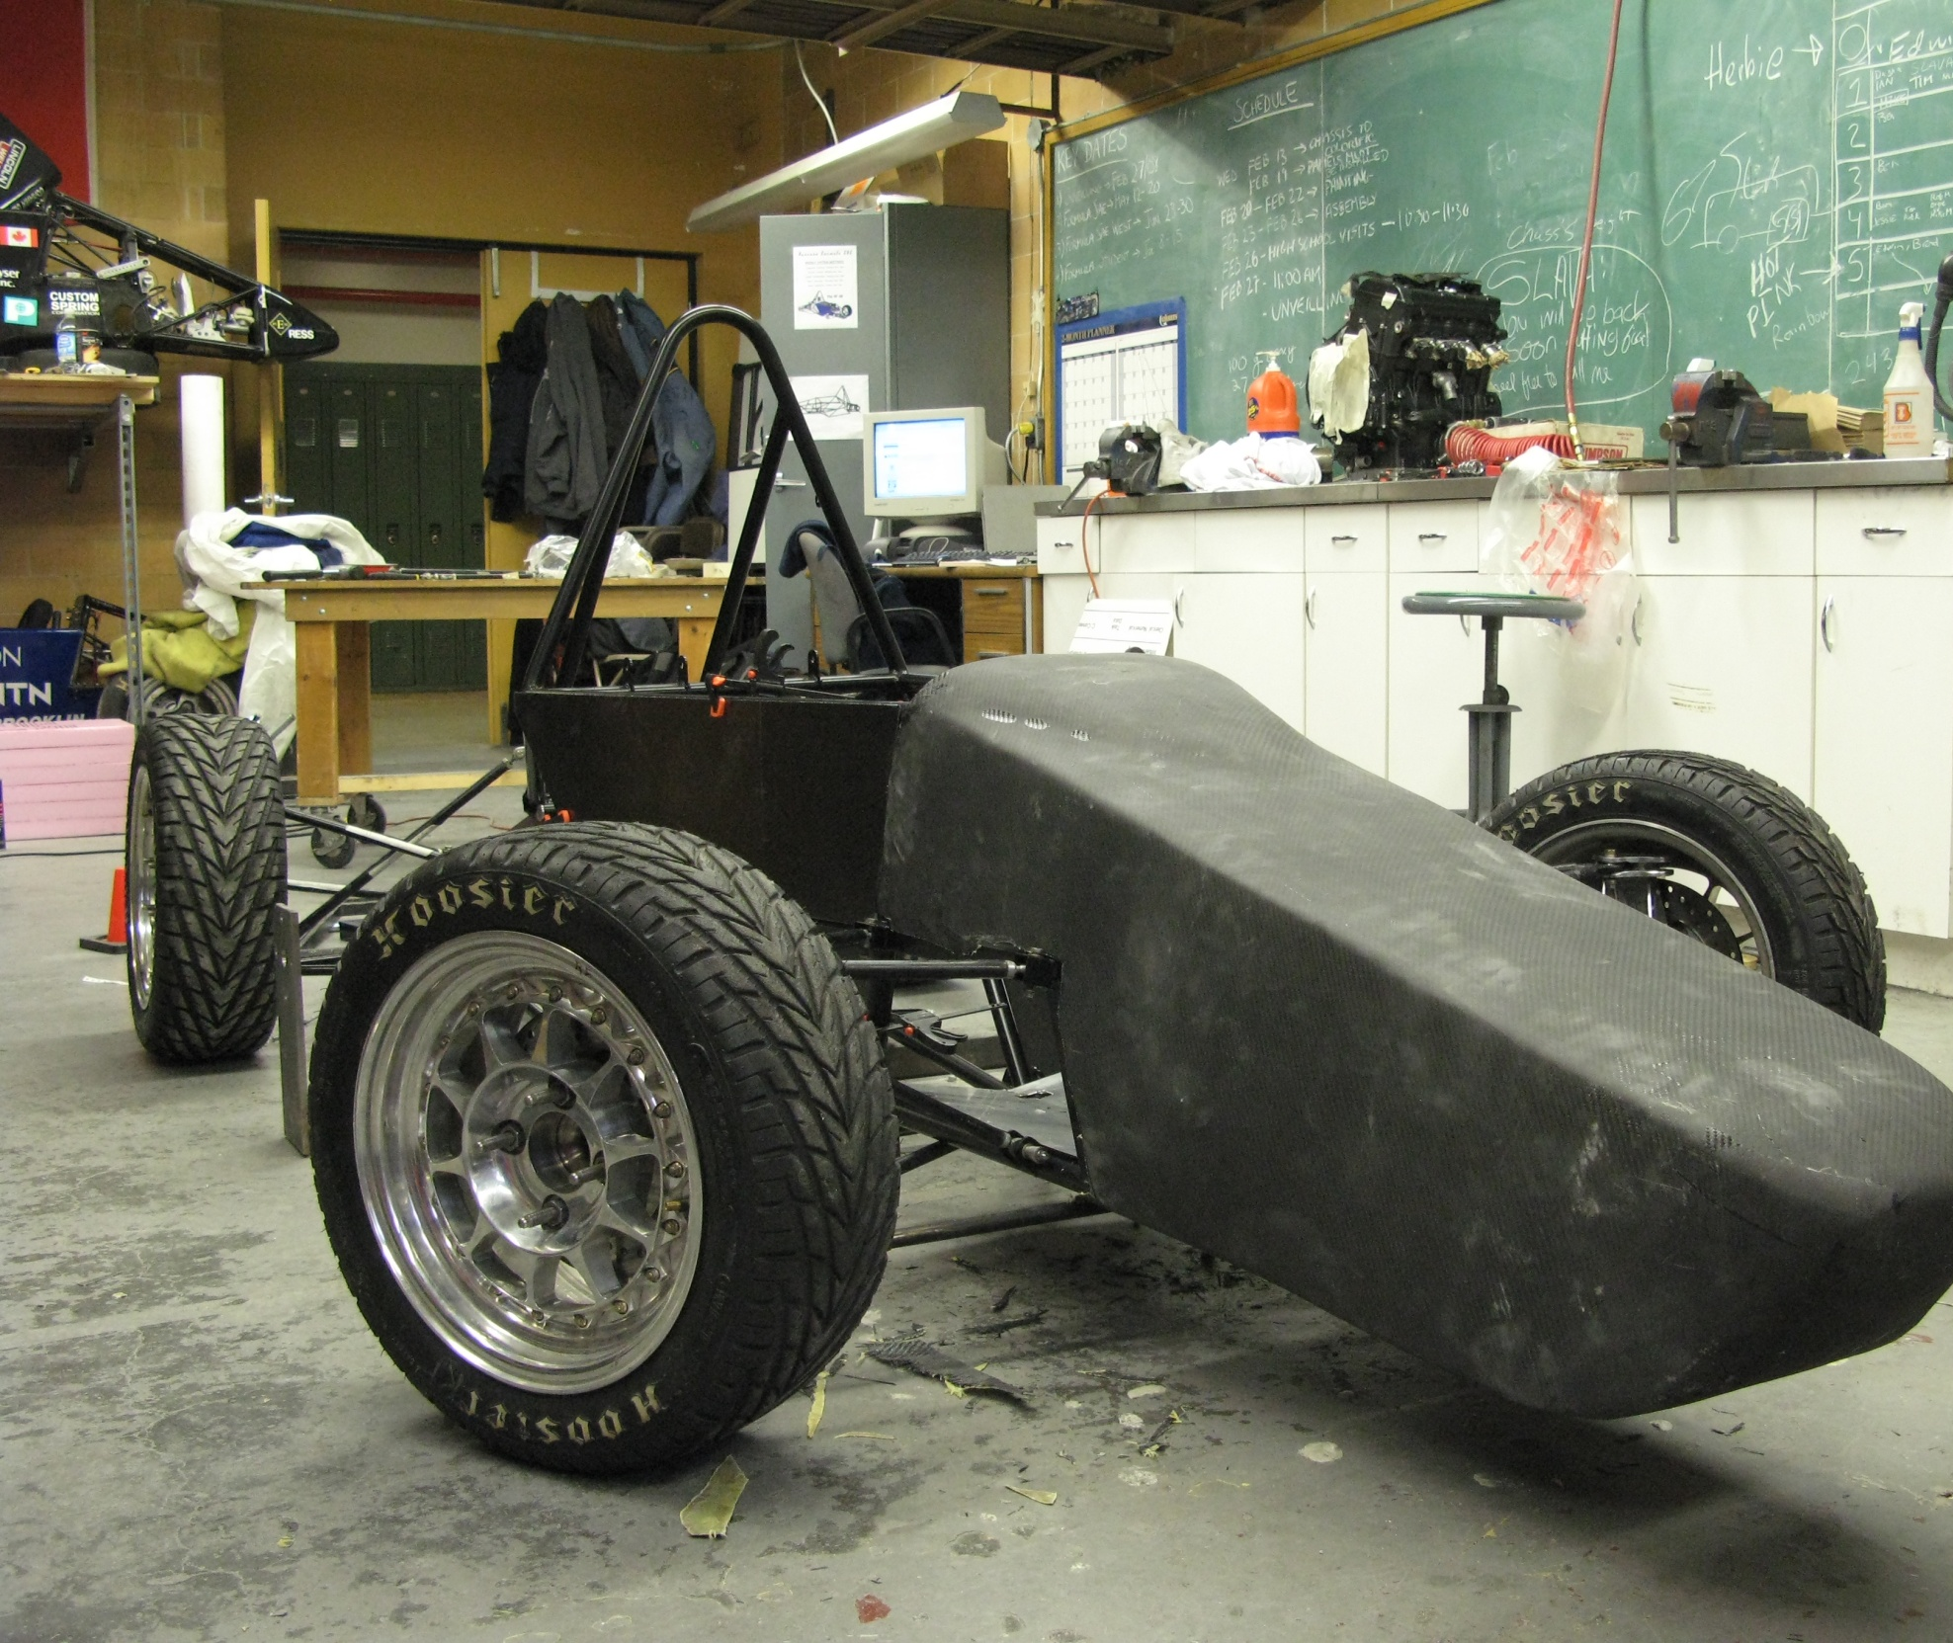
RF-08 Sneak Preview
The Ryerson FSAE Team was started in 1997
RFSAE has fielded seven cars in that time
Top finish was 10th of 122 teams in 2005

Slide 15
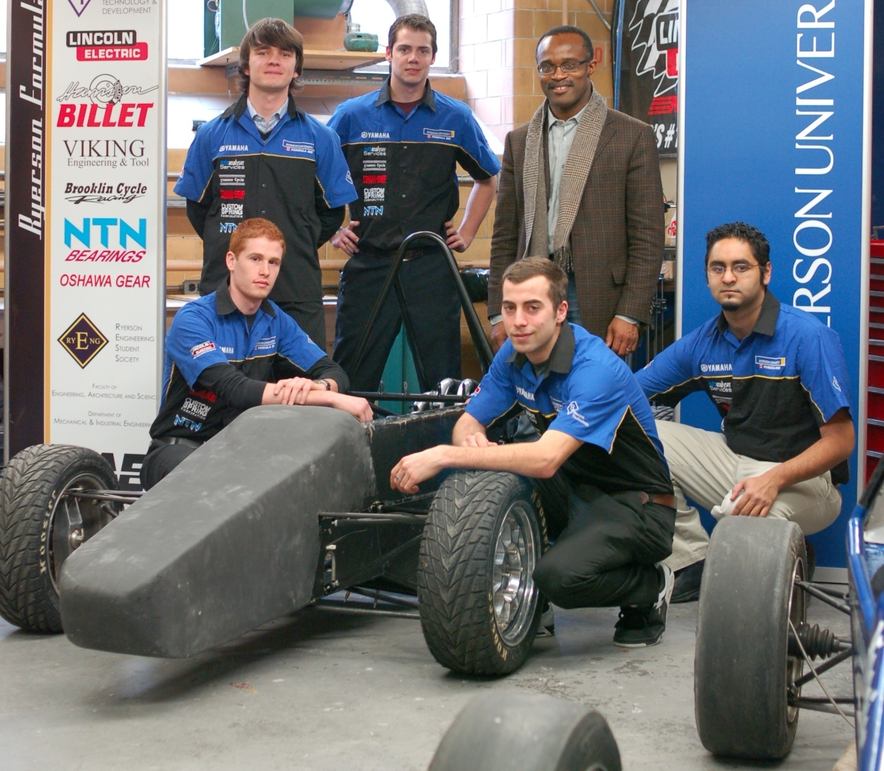
RF-08 Highlights:
-- New Chassis
- New Exhaust
- New Drive Train

Slide 16
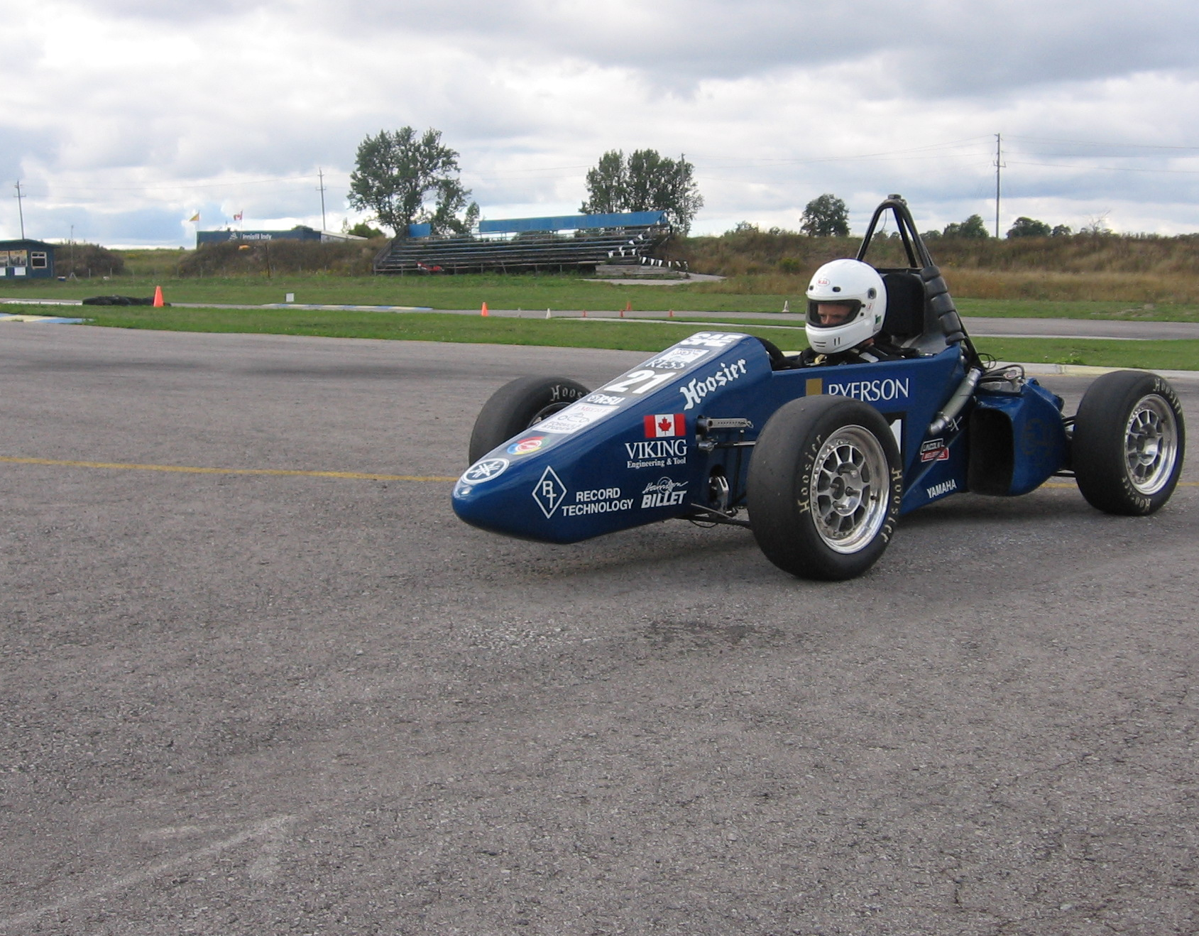
Keys To Success
Strong Leadership
Dedicated Team
Competitive Design
Solid Testing Program

Slide 17
Thank You

