Slide 1
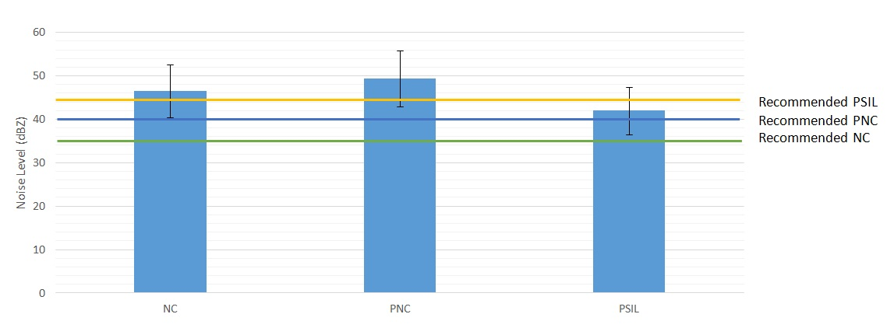
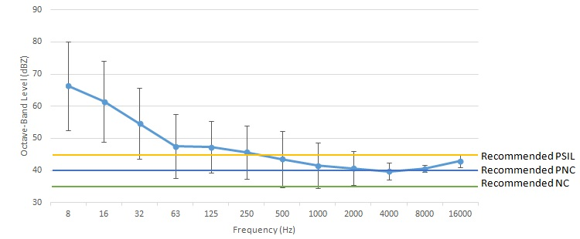
Evaluation of Background Noise and Illumination in Ryerson University Offices
Tsz Ming Suen, Rachel Irvine, Derek Tam, Mohammad Abdoli-E
School of Occupational and Public Health, Ryerson University
Background
Results
Over-exposure to background noise and improper illumination are the two most important physical hazards in office workplaces
Improper lighting in the workplace causes psychological and physiological strain such as fatigue, discomfort and pain from improper sitting posture due to glare¹
Lighting determines the accuracy of visual tasks²
Noise can be a major distraction in workplaces and affect a worker’s concentration and productivity³ with low frequency noise (LPN) marked as especially disturbing in the work environment⁴
Perceived Noise Criteria (PNC-ambient noise in indoor environments), Noise Criteria (NC-relative loudness of a space with a range of frequencies) and Preferred Speech Interference Level (PSIL) are the 3 analytical methods widely used for predicting effects of background noise levels on office workers
Figure 1: Noise Level characterized by PSIL, PNC and NC Noise Criterion
NC levels of all offices were above the standard of 35 dBZ
PNC levels of all offices were above the standard of 40 dBZ
Background noise concentrated more at the low frequency range over the octave band spectrum
51% of offices were below the lighting standard
34% of offices were above the lighting standard
15% of offices were within the lighting standard
Discussion
Results indicated that the average PNC and NC levels obtained from 40 randomly selected Ryerson offices were above OHSA standard recommendations
Average PSIL of the 40 offices is below the recommended level because PSIL is more lenient compared to PNC and NC levels
Results also demonstrated that approximately 85% of the offices did not comply with the IES Lighting Standards
The background noise was found to be dominant at low frequency levels which is known to contribute to workplace fatigue, distraction and productivity loss⁵
In conjunction with Improper lighting or glare, analysis of such occupational stressors on staff musculoskeletal pain/ discomfort should be inquired for the health and safety of Ryerson office staff
Some offices in Ryerson University located near classrooms where students walk back and forth. This may be one of the major sources of the background noise measured
Objectives
Figure 2: Octave Band Analysis characterized by PSIL, PNC and NC Noise Criterion
To determine PNC, NC and PSIL sound levels of the offices so as to evaluate level of background noise and potential effects on the workers
To compare lighting at the offices with Illuminating Engineering Society (IES) Lighting Standard
To correlate the impact of background noise and illumination in the offices with the corresponding workers’ sitting postures
Conclusion
Hypothesis
Reducing background noise is especially important in offices for staff with work that requires high demand of precision and accuracy
Administrative measures include: reallocation of cognitive demanding tasks to the quietest time of day with respect to location, provide awareness of hazardous noise to staff and management; and reduce pedestrian traffic in hallways
Recent studies show that listening to nature sound through headphones was an effective masking technique to protect work performance against distraction of background noise⁵
Further research is needed to identify control measures to reduce distraction from background noise in office environments
Background noise exposure in Ryerson University offices does not meet PNC, NC and PSIL noise level recommendations under OHSA
Lighting in offices vary from the recommended illumination of IES Lighting Standard
Figure 3: Percentage of Office Illuminance Below, At or Above IES Lighting Standard
Methodology
Background noise and lighting level measurements were randomly allocated at 40 Ryerson Staff private offices. Workstations were measured using a sound level meter (LxT2, Larson Davis SoundTrack SLM, United States) and a digital lux meter (AR823). The SLM was held 1 meter from the participant at their sitting workstation to get a true representation of the general noise levels in the office workplace. The digital lux meter was then placed on the keyboard, desk, monitor, window, and cabinets to obtain the luminance and illuminance levels at a range of locations in the workstation. The PNC, NC and PSIL sound pressure levels were determined and compared with the OHSA recommended standards for private office settings. The lighting data collected was compared with the IES Lighting Standard based on each participant's age, speed and accuracy required for the work and surface reflectance. Methodology was approved by University ethics committee.
References
da Silva, L. B., da Costa Eulálio, Eliza Juliana, Souto Coutinho, A., Gonçalves Soares, E. V., & de Lourdes Silva dos Santos, Roberta. (2012). Work (Reading, Mass.), 41 Suppl 1, 5540.
Baron, R. A., Rea, M. S., & Daniels, S. G. (1992). Motivation and Emotion, 16(1), 1-33. doi:10.1007/BF00996485
Banbury, S., & Berry, D. C. (1998). British Journal of Psychology, 89, 499.
Evans, G. W., & Johnson, D. (2000). Stress and open-office noise. Journal of applied psychology, 85(5), 779.
Jahncke, H., Björkeholm, P., Marsh, J. E., Odelius, J., & Sörqvist, P. (2016). Office noise: Can headphones and masking sound attenuate distraction by background speech? Work, 55(3), 505-513. doi:10.3233/wor-162421
Acknowledgements
The researchers would like to thank Lin Yu, Muhammad Shakeel and Wahaj Alam for their contribution in data collection as well as data analysis.

