Slide 1
CGS Awards
(details today refer to SSHRC PhD Awards, but
general ideas apply to Masters-CGS and other PhD Awards)
Wednesday, September 9, 2020
Faculty of Arts
Patrizia Albanese, Associate Dean Research & Grad Studies
Natasha Mills, Coordinator, Scholarships and Awards, School of Grad Studies
Paul Moore, former chair, Ryerson tri-council student awards

Slide 2
Today’s Workshop
Canada Graduate Scholarship (CGS) – focus on SSHRC-Doctoral today
But CGS Masters, and PhD CGS in CIHR & NSERC are similar
For PhD CGS - No difference CGS & “regular” grant
What are the components of an application?
How do you organize and write a good research proposal?
A free-writing exercise (time permitting, at least sketched for you)
Quick overview of other PhD awards:
Vanier Awards (due sooner) – add a Leadership Statement
Fulbright Awards (due November)
Trudeau Fellowships (due late Fall)

Slide 3
Elements of a CGS Doctoral Application (SSHRC, but similar for CIHR & NSERC)
Online Profile (incl. work experience and awards) LINK HERE to portal/instructions.
Research Proposal & reference list (for SSHRC 2 pages + up to 5 pages)
follow instructions carefully! - this is where SSHRC-CIHR-NSERC differ
Transcripts (check with your PA about how to include current registration)
(option) Allowable Inclusions
List of Contributions, Experience, Activities (SSHRC: 2 pages)
Two Letters of Appraisal (at least one by a research supervisor; one may be professional)

Slide 4
If you were at Ryerson ANY TIME in 2020:
Then you apply to Ryerson, and will first be ranked within Ryerson, even if you’re a Master’s student planning to do PhD elsewhere
ALL of the proposal is now submitted online
This includes your reference letters, which must be submitted by the deadline with no exceptions (this is still NEW for some professors)
Inform them “submitted online like CGS-Masters, with no flexibility on deadline whatsoever”

Slide 5
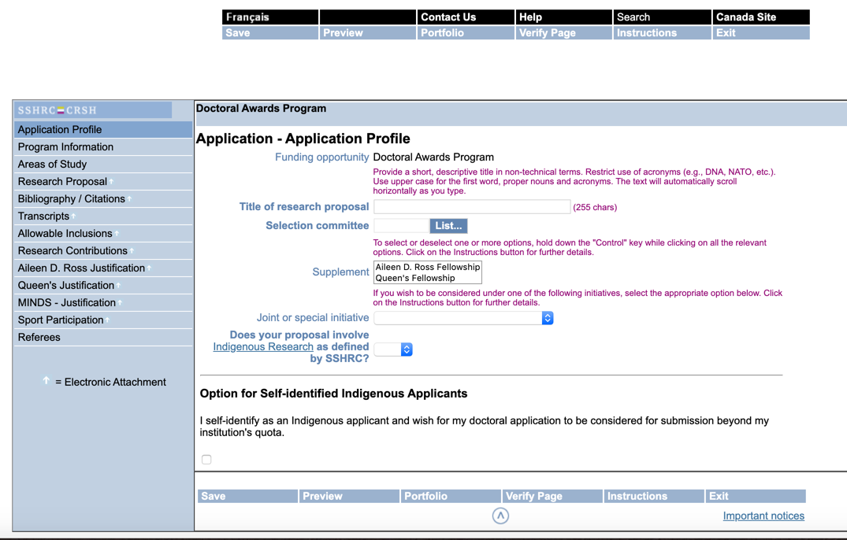

Slide 6
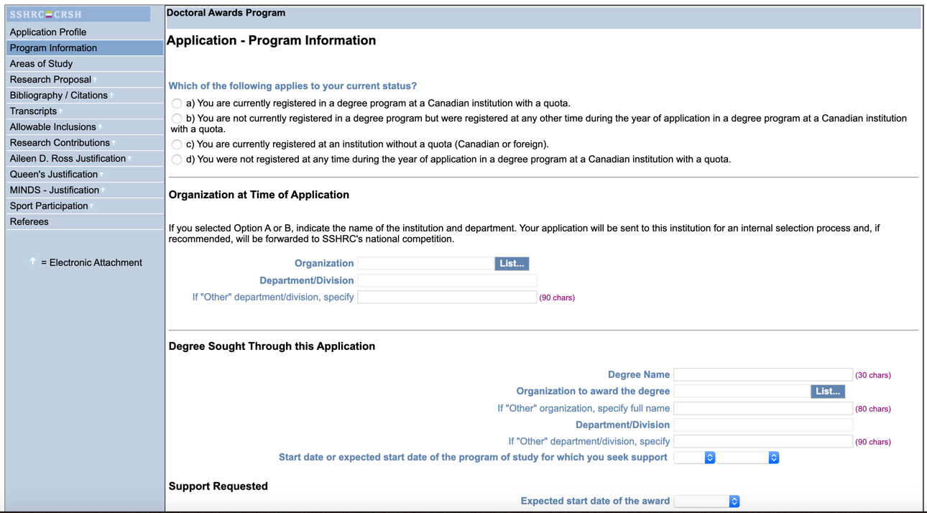

Slide 7
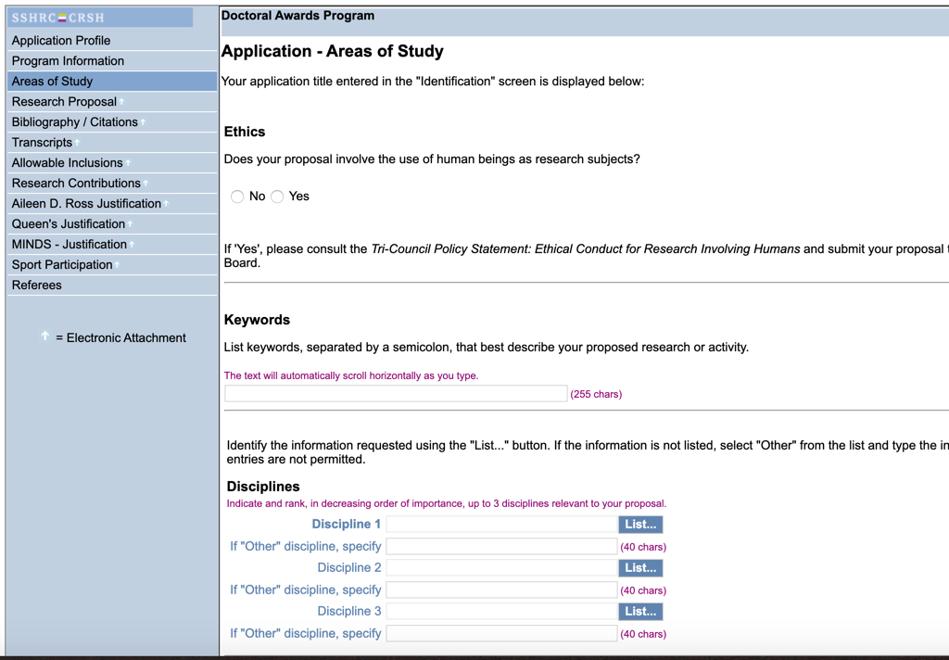

Slide 8
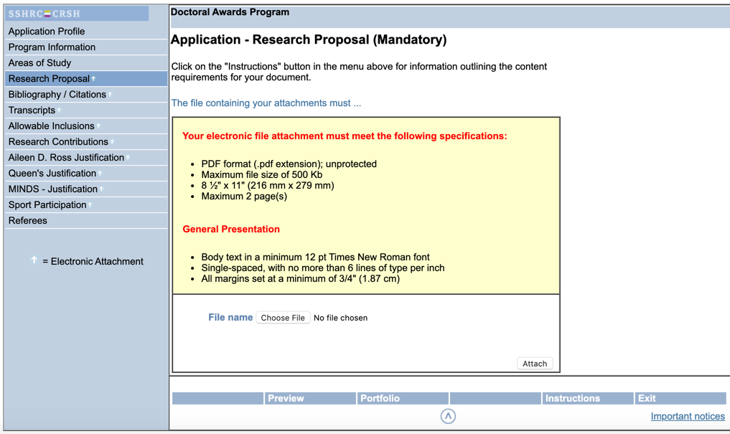

Slide 10
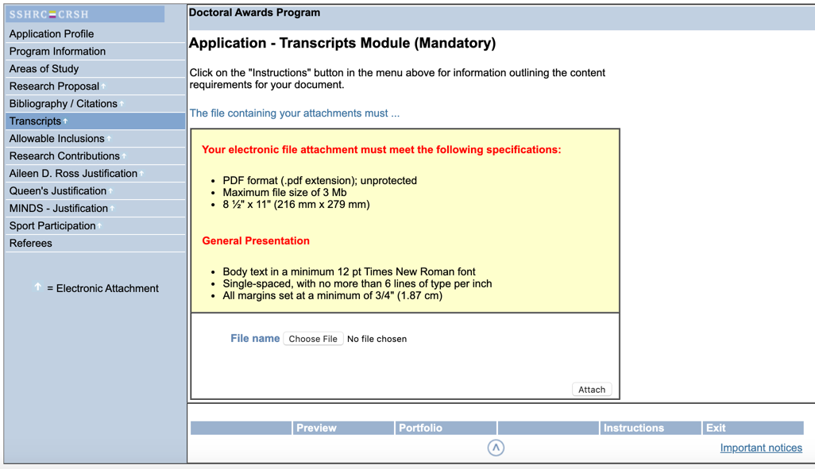

Slide 11
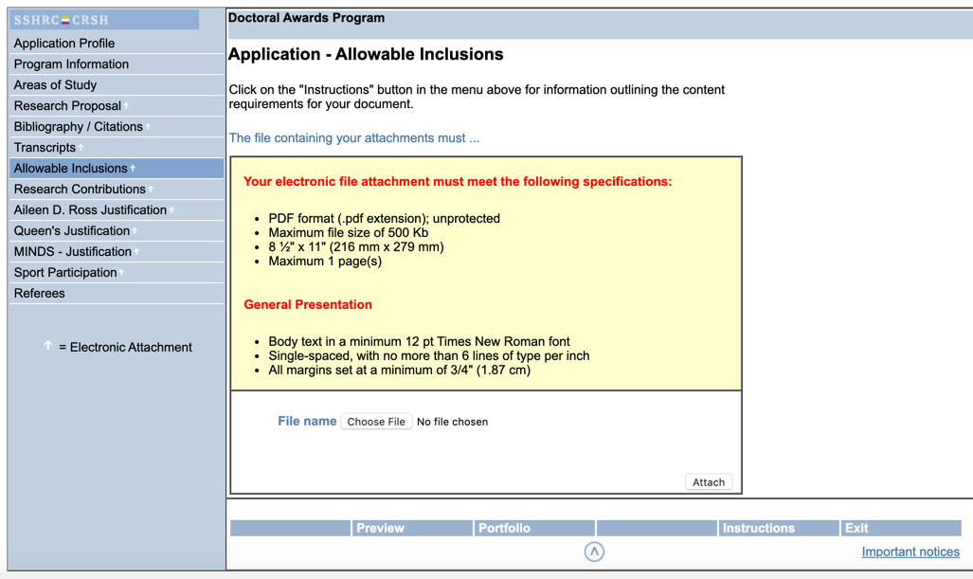

Slide 12
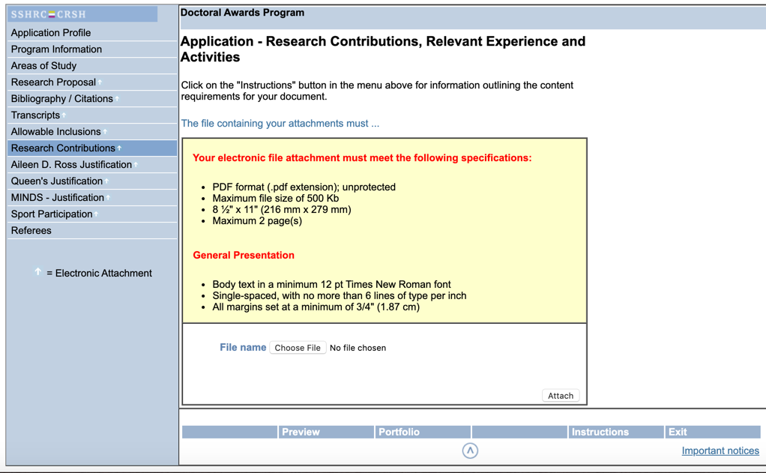

Slide 13
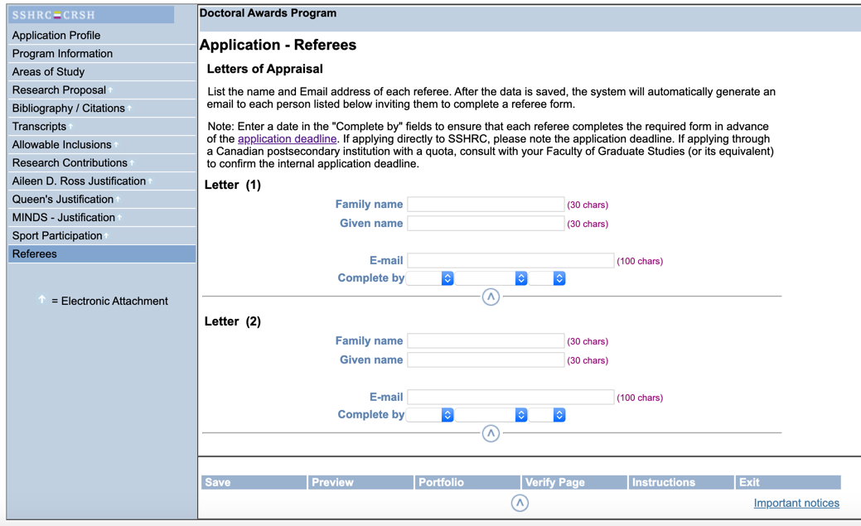

Slide 14
Any questions?
Here’s what coming up next…
What goes on your pages of contributions and experiences?
Brainstorm, thought-experiment to begin first-draft of proposal.
How to organize your proposal (generic advice)?

Slide 15
What’s listed as contributions, experience, activities? See also the official instructions for formal guidelines.
NO SPECIFIC RULES, neither “pad” with trivial things, nor leave empty
Awards Prior scholarships, prizes, awards, accolades
Publications, Refereed means peer-reviewed or juried, others separate
Presentations, Refereed proceedings, non-refereed academic & community conferences, co-authored OK (say so, list the co-authors)
Other kinds of non-refereed publications, reviews, non-juried work
Research Assistantships, list the supervisor, field of work, dates
Teaching & Teaching Assistantships, list the course code, title, dates
Academic / Student Leadership & Service Positions
Other forms of publishing, reports, design, creation
Other forms of academic / student activities, organizing, service
Other forms of pedagogy, community workshops, organizing, service

Slide 16
Applying for CGS Doctoral Awards
You’ll need to compose a research proposal
Even if you don’t end up winning or applying to SSHRC, any work on the proposal can become part of any proposal you may need.
In general, you will continually need to have a research proposal ready and updated for a variety of opportunities and applications
But I don’t know what I want to study?
Do some thinking and a draft “plan of study” for two or more projects, and pick the one that feels right to compose AS IF
This is written in future tense, with certainty, but everyone understands it’s actually hypothetical—we are looking for quality and rigour in argumentation and methodology.

Slide 17
Exercise, before we turn to instructions
Pick a possible research topic, keep it in mind
Write down a possible “thesis statement” or argument about it. What do you imagine your conclusion about it will be?
Seriously… start by articulating, using your imagination, what you think you’ll learn AS IF
HERE IS A LINK to a brainstorm “first-draft” exercise! Just get the first draft down on paper. The art is in the editing in this form of writing!

Slide 18
What is a Research Proposal?
See also the official instructions for formal guidelines.
It is a proposal to start a project, that explains why it is important, how you will pursue it, and why you’re ready to start.
Slight variations in style and format—trust your supervisors!
PROJECT Description & Justification
Brief STATEMENT of Research Questions or Objectives
LIT REVIEW of research related to problem
PLAN of Action or Research Methodology
PREPARATION & Relevant Background

Slide 19
How is a Research Proposal typically organized?
1. State your interest (project, program, argument, “thesis”…)
Describe the thing itself, details and specifics, not just your own opinion or generalization
2. Explain why it is important and interesting, to you and to your reader
Grounded in details that anyone can understand. How have others pursued similar interests? How is your approach distinct?
3. Explain in general what is involved in pursuing it
Outline how you would approach and carry out the project (“method”)
Discuss what you will do, in as much detail as possible
For Masters applicants: Do NOT discuss the application process – pretend you’re in!
4. Explain in some detail how your background has prepared you
Abilities, skills, knowledge? Explain how you obtained them, how they relate to project?
5. Explain in some detail how this plan is the best way forward
What do you still need to learn, where will you find it?
Why is this program the best place? What specialties and opportunities are provided?

Slide 20
How is a Research Proposal typically written?
Keep in mind who is reading…
be aware of the “interpretive community”
the expectations and the standards of your particular goal.
Yet, don’t fall into rigid conventions or clichés.
The point is to show you understand how to achieve the goal, to outline a future plan AS IF you had already finished it.
Bring a stranger along on your plan, help a stranger understand why it’s worthwhile.

Slide 21
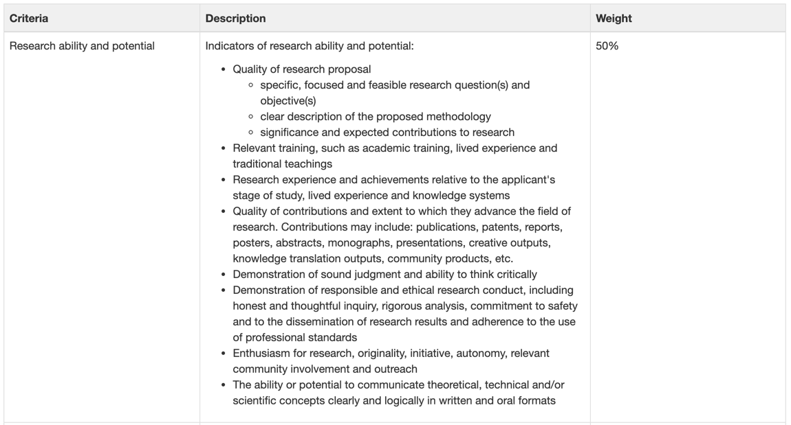

Slide 22
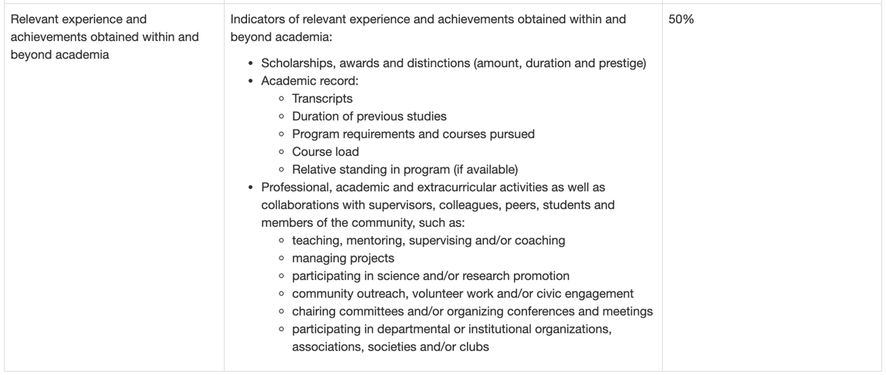

Slide 23
Other Doctoral Awards include:
Vanier Doctoral Awards – just like tri-council, but also a leadership statement, and a third community-based leadership reference
Canada-US Fulbright Awards – for visiting study in the US
Trudeau Foundation Scholarships – for community-engaged research
Don’t forget smaller awards and opportunities: travel grants, methodology workshops, association positions, etc.

Slide 24
Further Questions?
Good luck to you all!

