Slide 1
Part 1:
Fossil fuel reserves reporting & unburnable carbon: investigating conflicting accounts
April 12, 2018
Jan Bebbington, Tom Schneider, Lorna Stevenson & Alison Fox

Slide 2
An empirical conundrum
Fossil fuel reserves are valuable
Expenditure to purchase reserves and resources (on balance sheet)
Notes to the accounts provide physical reserve figures
Reserves indicate future revenue streams & are value relevant
Fossil fuel reserves are not as valuable as you think
Global climate change governance will make some of these unburnable
Disclosures do not convey this information
Carbon Tracker Initiative

Slide 3
The Research Aim & Methods
Aim: document and explain an absence of accounting disclosures about unburnable carbon
Methods:
  LITERATURE REVIEW – energy policy/modeling work … is there unburnable carbon at 2ºC (YES)
  INTERVIEWS – is the idea of unburnable carbon sound (YES) & is there a carbon bubble (NO) … and how will this issue progress?
  GOVERNANCE REVIEW – is there reporting governance that will ensure disclosure when/if there is unburnable carbon (YES & a responsible professional body for identifying it)
  REPORTING REVIEW – is there disclosure along these lines (depends on the disclosure media you look at but mainly NO)

Slide 4
Technical detail re. reserves
Technical (evaluation, classification and disclosure of reserves)
  PRMS (Petroleum Resource Management System)
  CRIRSCO (Committee for Mineral Reserves International Reporting Standards … & member organisations)
  UNFC (United Nations Framework Classification for Resources), includes renewables
  No regulatory force by themselves … but via other regulators (i.e. securities regulators)
  Reserves – resources that are commercially viable (contingent on price, cost, social and environmental conditions) … proved/probable/possible … ie 90%/50%/10% probability of viability

Slide 5
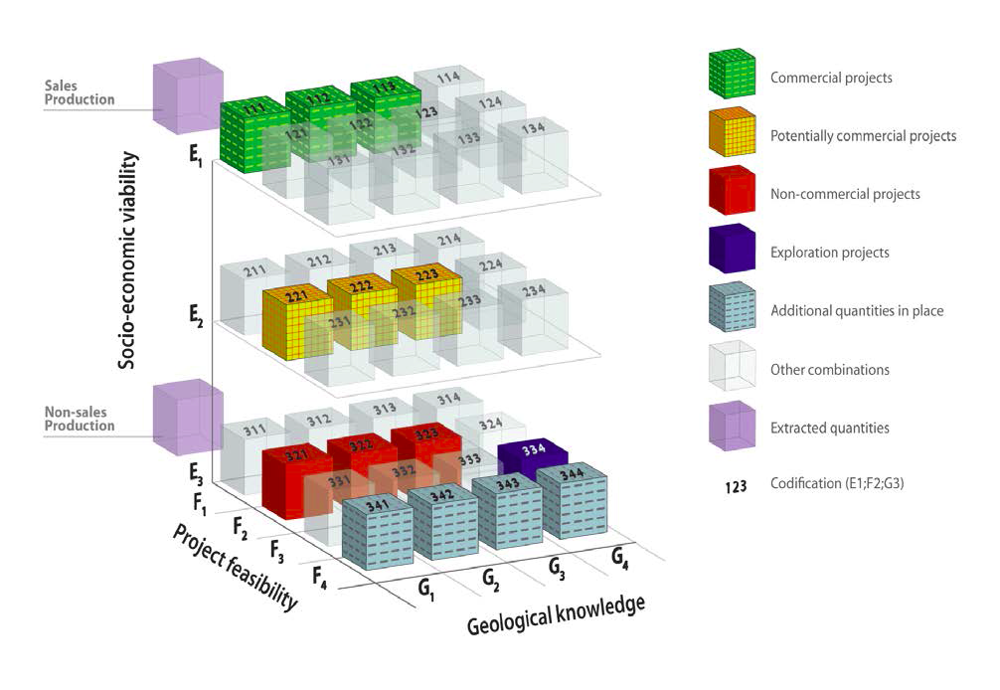
United Nations Framework Classification for Resources

Slide 6

Reserves and resource reporting and carbon constraints
RESERVES
RESOURCES OTHER THAN RESERVES

Slide 7
McGlade & Ekins (2015)

Slide 8
Regional distribution of unburnable carbon (with CCS – McGlade & Ekins, 2015)

Slide 9
Guidance from Securities Regulators?
Canadian Securities Association
  CSA Staff Notice 51-333: Environmental Reporting Guidance (2010)
US Securities Exchange Commissions
  SEC guidance regarding disclosure related to climate change (SEC 2010)
European Union (ESMA)
  The union has numerous regulations specifically targeting climate change which can be found at https://ec.europa.eu/clima/about-us/climate-law_en

Slide 10
Guidance from Securities Regulators?
Classification systems:
“Mining, metallurgical, economic, marketing, legal, environmental, social and governmental factors” – CRIRSCO so-called moderating factors (CRIRSCO, 2013, p. 6)
Reports must be prepared by a “competent person”
  “Competent Persons must discharge their duties with fidelity to the public…… should strive to protect the natural environment” (CRIRSCO)
We contend current regulations are fine and if there is a material risk, current reporting regulations dictate disclosure!

Slide 11
Results of disclosure survey
35 firms with fossil fuel reserves across 7 key fossil fuel countries (Canada, US, UK, South Africa, Australia, Russia, China)
Content analysis of 2011 and 2014 documents (using Nvivo)
Lots of ‘boilerplate’ disclosure regarding climate change risk
Only 2 firms mentioned the concept of stranded assets in any way
  Exxon Mobil and Shell

Slide 12
Results of disclosure survey
“ExxonMobil believes producing our existing hydrocarbon reserves is essential to meeting growing global energy demand. We enable consumers — especially those in the least-developed and most-vulnerable economies — to pursue higher living standards and greater economic opportunity. We believe all economic energy sources will be necessary to meet growing demand, and the transition of the energy system to lower carbon sources will take many decades due to its enormous scale, capital intensity and complexity. As such, we believe that none of our proven hydrocarbon reserves are, or will become, stranded.” ExxonMobil 2014 Corporate Citizenship Report, p. 37. (emphasis added)

Slide 13
Part 2:
The United Nations Framework Classification in the Context of the SDGs

Slide 14
United Nations Framework Classification (UNFC)
Expert Group on Resource Classification
Social and Environmental Considerations Task Force
Sustainable Development Goals Delivery Working Group

Slide 15
United Nations Framework Classification for Resources

Slide 16










UNFC and the SDGs
See: https://www.unece.org/energywelcome/areas-of-work/httpswwwuneceorgenergysereserveshtml/applications/unfc-and-sustainable-development-goals.html

Slide 17
UNFC and the SDGs
Fossil fuel companies will often refer or allude to them
Particularly in the context of the developing World
For example – see previous Exxon disclosure

Slide 18
SOCIAL AND ENVIRONMENTAL CONSIDERATIONS TASK FORCE
Dr. David Elliott (Chair), Canada
Dr. Tom Schneider, Ryerson Univ. Canada
Ms. Kathryn Campbell, UK
Mr. Michael Lynch-Bell, UK
Dr. Julio Claudeville, Argentina
Mr. Julian Hilton, UK.
Mr. John Atherton, ICMM, UK
Mr. Luis Martins, Portugal
Ms. Hua Yang, PetroChina
Mr. Dennis Mwalongo, Tanzania
Dr H G Chong, Malaysia
Ms. Karen Jenni, USGS
Mr. Luis Lopez, Argentina
Ms. Sarah Magnus, S. Africa
Dr. Michael Neumann, EFG
Mr Rodrigo Chanez-Vincente, EU
Mr. Sigurd Heiberg, Norway

Slide 19
Thank-you
tschneider@ryerson.ca

Slide 20
References
Canadian Securities Administrators. (2010) Staff Notice 51-333 Environmental Reporting Guidance. Available at: http://www.osc.gov.on.ca/documents/en/Securities-Category5/csa_20101027_51-333_environmental-reporting.pdf
Combined Reserves International Reporting Standards Committee, (2012). Available at: http://www.crirsco.com/background.asp.
McGlade, C. & Ekins, P. (2015), “The geographical distribution of fossil fuels unused when limiting global warming to 2ºC”, Nature, 517, pp. 187-190.
Securities and Exchange Commission (SEC) (2010) Guidance Regarding Disclosure Related to Climate Change.
United Nations Framework Classification for Resources (UNFC 2009). Available at: https://www.unece.org/energywelcome/unfc-and-resource-classification.html

