Slide 1
Cultural Factors Shaping Institutions: Do Firms Benefit in Public-Private Partnerships?
Dr. Deborah de Lange
Ted Rogers School of Management
Ryerson University
2018

Slide 2
Contents
Background/Rationale
Significance
Research Question
Theory
Hypotheses
Methods
Results
Discussion
Conclusions
Cultural Factors Shaping Institutions: Do Firms Benefit in Public-Private Partnerships?

Slide 3
Background/Rationale For the UN SDGs, we need to know how to manage partnerships
#1 Consider the main effects
Do PPPs benefit firms?: An initial assumption is that a firm in PPPs has lucrative work with the government (Berrios, 2006). So, PPP opportunities would be associated with more success and employment in these firms (larger firms). A firm must hire to satisfy the requirements of PPP work.
However, it is not clear whether PPP involvement is necessarily good for a firm, given a lack of research on this topic.
Do assertive and performance oriented national cultures support firms?: Is an assertive and/or performance oriented national culture associated with larger firms? Some research suggests that these correlated values are associated with business success (Rauch, et al., 2013), but previous research has not specifically tested the relationship in this research.

Slide 4
Background/Rationale For the UN SDGs, we need to know how to manage partnerships
#2 Consider the interactions
National cultural values in a PPP:
We do not know whether national cultural values affect firms involved in PPPs, in general.
Consider assertive and performance oriented national culture values:
Will a firm in this type of cultural environment and involved in PPPs tend to be
larger as a result?
These types of values could be in conflict with the cooperation/patience that is required in PPPs – requiring coordination (O’Leary and Vij, 2012), and/or
PPPs could be inertial institutions that do not respond well to these values - so firms may not do better under these circumstances (Stal, 2015).

Slide 5
Practical Significance For the UN SDGs, we need to know how to manage partnerships
Management of PPPs:
This research informs the management of PPPs, considering national culture variables, and firms’ decisions about whether and/or when to be involved in PPPs.
The success of transportation PPPs, which are reliant on partner firms’ successes, enable SDGs related to infrastructure, cities, responsible production and consumption, and climate action.

Slide 6
Research Question
Do national cultural values of assertiveness and performance orientation which are expected to support a transportation firm, instead diminish the same firm in public private partnerships (PPPs)?

Slide 7
Theory
Combine institutional and international business theories, and inform the literature on sustainable development, PPPs, and transportation.
Posit that national culture enters into institutions: Examine whether national culture affects institutions and firms participating in institutions such as PPPs.
PPPs are institutions made up of partnering organizations from the public and private sectors (Bradford, 2003; Peters, 1998; Samii, Van Wassenhove, & Bhattacharya, 2002).
Institutional theory considers mechanisms leading to isomorphism such as cultural-cognitive, normative, and regulative factors (DiMaggio & Powell, 1983; DiMaggio, 1997).
Culture in a general sense has been part of institutional theory; research has not explored National Culture as an institutional factor.
Institutional factors such as regulatory quality, market openness, ease to start a business, and contract enforcement are determinants of the success of transportation projects (Panayides, Parola,& Lam, 2015), but national culture has not been investigated as one of those factors.

Slide 8
Hypotheses - Explanations
H1a and H1b: Assertiveness and Performance Orientation are expected to be national cultural values facilitative of business so firms operating within national cultures having these values will be larger (Rauch, et al., 2013). Also, some previous research in entrepreneurship implies that performance-focused and assertive cultures may hold back small firms needing social capital support (Stephan & Uhlaner, 2010) thus, larger firms may benefit under these circumstances.
H2a and H2b: PPPs are posited as beneficial for the firms that engage in them because they are lucrative business opportunities working with government actors. Firms will need more employees to work on these large public projects. Variables include PPP = “having a PPP” and Number of PPPs = “increasing number of PPPs”.
H3a-H3d Interactions: Interact national cultural factors with having a PPP(s). National cultural factors normally fostering the independent success of firms (as predicted) may not facilitate partnerships so the combination may negatively affect firm size.

Slide 9
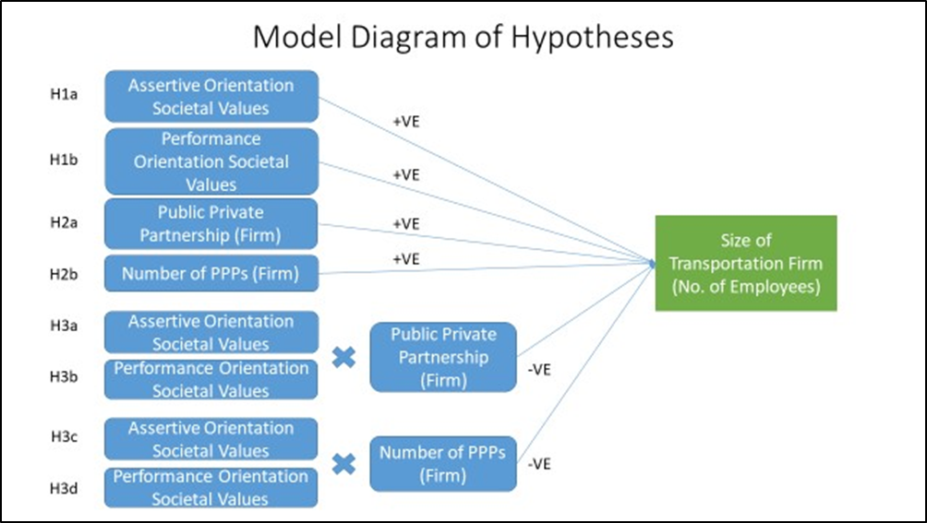
Hypotheses

Slide 10
Methods
Data: International sample of 300 transportation firms from Crunchbase; Firms are in 26 countries across continents.
Context: The transportation PPP setting is opportune for this investigation; transportation firms are often private, but work on public infrastructure with public institutions interwoven with national culture (Robèrt, 2017).
National Culture Dimensions: coding sourced from the GLOBE data on national societal values (House et al., 2004).
PPP data: World Bank report (IBRD, 2017).
DV: Size of a transportation firm - number of employees
IVs: Assertive Orientation, Performance Orientation, PPP, Number of PPPs
Model: Negative binomial re: over dispersion in the dependent variable [Variance >> Mean]
Hierarchical regression with controls (Firm Age, Total Funding Amount; Country Dummy to control for other national factors)

Slide 11
Data Description – Correlations & Basic Statistics
Pairwise Correlations

Slide 12
Results
Models with DV:
Firm Size
Category
PPP | 0.821***
 | -0.224
Number of PPPs | 0.00451
 | -0.0727
Performance Orientation Societal Values | -1.573***
 | -0.488
Assertiveness Societal Values | 0.725***
 | -0.185
Performance Orientation Societal Values X PPP |  | -2.288***
 |  | -0.821
Performance Orientation Societal Values X Number of PPPs |  |  | -0.490**
 |  |  | -0.213
Assertiveness Societal Values X PPP |  |  |  | -0.964***
 |  |  |  | -0.349
Assertiveness Societal Values X Number of PPPs |  |  |  |  | -0.223**
 |  |  |  |  | -0.0932
Observations | 300 | 300 | 300 | 300 | 300
Standard errors in parentheses
*** p<0.01, ** p<0.05, * p<0.1

Slide 13
Results Summary
Hypothesis | Result | Comments
H1a Assertive Orientation | +VE | Supported; assertiveness may be necessary as a firm becomes larger and more inertial
H1b Performance Orientation | -VE | Opposite result; performance orientation matches with smaller rather than larger inertial organizations where it may be futile
H2a PPP | +VE | Supported; Having had at least one PPP corresponds to larger firms.
H2b Number of PPPs | NS | Not supported; the result is non-significant (NS); More PPPs have no relation to size of the firm.
H3a Assertive Orientation X PPP | -VE | Supported; higher significance and larger effect with PPP than Number of PPPs. This becomes negative as compared with H1a and H2a so the combination changes the outcome.
H3b Performance Orientation X PPP | -VE | Supported; higher significance and larger effect with PPP than Number of PPPs.
H3c Assertive Orientation X No. of PPPs | -VE | Supported.
H3d Performance Orientation X No. of PPPs | -VE | Supported.

Slide 14
Results & Discussion
The core proposition that cultural factors can have different effects in and outside of partnerships is supported. E.g., An assertive culture is aligned with larger firms and so is having at least one PPP. However, both conditions at the same time, negatively affect firm size.
Findings are supportive of all of the hypotheses except:
H1b (-ve when predicted +ve)– Performance Orientation is not associated with larger
firms which may be consistent with the entrepreneurship literature (small firms are more
flexible (Bartz and Winkler, 2016) and can respond to a culture of performance).
H2b (non-significant) – more PPPs are not associated with a larger firm. This result needs
further investigation, but it could be that there is a threshold where more PPPs have no more
affect on firm size.

Slide 15
Conclusions
What works for a firm, may not work in a public private partnership.
PPPs are institutions in which national cultural factors affect participant firms.
Given this evidence, studies in institutional theory should consider national cultural dimensions as potentially influencing institutional outcomes.
Particularly, private transportation firms entering into PPPs, influenced by performance oriented or assertive national cultural values may expect to experience some negative effects on size.
Policy makers learn that PPPs do support employment in partner firms when not considering national cultural factors.
The evidence encourages firms to join PPPs but to be wary of some national cultural factors, possibly finding ways to counteract them.
Reducing assertive tendencies and hard pushes for performance may improve partnership outcomes.

Slide 16
Selected References
Aon Hewitt Inc. (2016). Developing Canada’s future workforce: a survey of large private-sector employers, Business Council of Canada, March.
Bartz, W., & Winkler, A. (2016). Flexible or fragile? The growth performance of small and young businesses during the global financial crisis—Evidence from Germany. Journal of Business Venturing, 31(2), 196-215.
Berrios, R. (2006). Government contracts and contractor behavior. Journal of Business Ethics, 63(2), 119-130.
Bradford, N. (2003). Public-private partnership? Shifting paradigms of economic governance in Ontario. Canadian Journal of Political Science/Revue canadienne de science politique, 36(5), 1005-1033.
Crunchbase. https://www.crunchbase.com/
DiMaggio, P. (1997). Culture and cognition. Annual Review of Sociology, 23(1), 263-287.
DiMaggio, P., & Powell, W. W. (1983). The iron cage revisited: Collective rationality and institutional isomorphism in organizational fields. American Sociological Review, 48(2), 147-160.
House, R. J., Hanges, P. J., Javidan, M., Dorfman, P. W., & Gupta, V. (Eds.). (2004). Culture, leadership, and organizations: The GLOBE study of 62 societies. Sage publications.
IBRD (2017). Benchmarking PPP procurement: Assessing government capability to
prepare, procure and manage PPPs. World Bank.
Morgadinho, L., Oliveira, C., & Martinho, A. (2015). A qualitative study about perceptions of European automotive sector's contribution to lower greenhouse gas emissions. Journal of Cleaner Production, 106, 644-653.

Slide 17
Selected References (cont’d)
O’Leary, R., & Vij, N. (2012). Collaborative public management: Where have we been and where are we going?. The American Review of Public Administration, 42(5), 507-522.
Panayides, P. M., Parola, F., & Lam, J. S. L. (2015). The effect of institutional factors on public–private partnership success in ports. Transportation Research Part A: Policy and Practice, 71, 110-127.
Peters, B. G. (1998). ‘With a little help from our friends’: Public-private partnerships as institutions and instruments. In Partnerships in urban governance (pp. 11-33). Palgrave Macmillan UK.
Rauch, A., Frese, M., Wang, Z. M., Unger, J., Lozada, M., Kupcha, V., & Spirina, T. (2013). National culture and cultural orientations of owners affecting the innovation–growth relationship in five countries. Entrepreneurship & Regional Development, 25(9-10), 732-755.
Robèrt, M. (2017). Engaging private actors in transport planning to achieve future emission targets–upscaling the Climate and Economic Research in Organisations (CERO) process to regional perspectives. Journal of Cleaner Production, 140, 324-332.
Samii, R., Van Wassenhove, L. N., & Bhattacharya, S. (2002). An innovative public–private partnership: New approach to development. World Development, 30(6), 991-1008.
United Nations. 2015.
Stål, H. I. (2015). Inertia and change related to sustainability–An institutional approach. Journal of Cleaner Production, 99, 354-365.
United Nations Sustainable Development Goals https://sustainabledevelopment.un.org/?menu=1300

Slide 18
Questions?

