Slide 1
Advancing Sustainability Reporting in Canada: 2017 Report on Progress
Stakeholder Research Associates Canada
October 4, 2017

Slide 2
About SRA
Your Partner in Sustainability Strategy, Stakeholder Engagement, Reporting and Communications

Slide 3
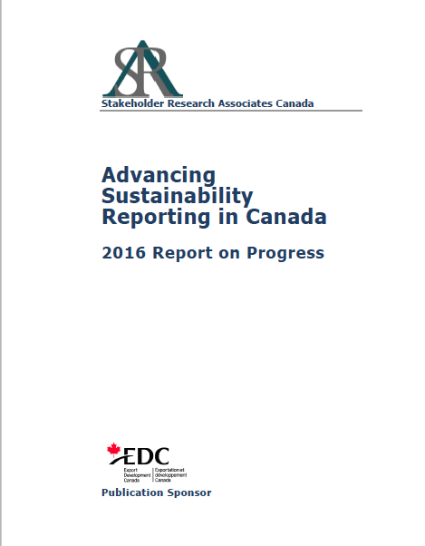
Future Focus

Slide 4
About The Research
2016 In-Depth Review:
234 companies listed on the TSX Composite Index
68 survey respondents
60 in-depth company analyses
1-day symposium
2017 Update:
245 companies listed on the TSX Composite Index

Slide 5
2016 Report Highlights
TSX Composite Index companies
65% release sustainability information
58% “reporters”
40% in ARs
2% integrated reports (7)
50% use or reference GRI

Slide 6
2017 Update
TSX Composite Index companies
66% release sustainability information (65%)
54% “reporters” (58%)
71% in ARs (40%)
1% integrated reports (3) (2%)
42% use or reference GRI (50%)
11 companies report to Standards
17% report on SDGs

Slide 7
Conclusions
Canadian publicly listed companies continue to lag vs international reporting trends
Encouraging to see increase in sustainability information in ARs
While more companies are providing sustainability information, reporting quality is diminishing
Real progress is hindered by the fact that only 40% of reporters report on goals/targets to drive performance

Slide 8
Sustainability Reporting in Canada
Questions?

Slide 9
Stakeholder Research Associates Canada
www.stakeholderresearch.com

