Slide 1
MAC, Mining and Social Responsibility
Ryerson University
March 7, 2018

Slide 2
About MAC
Mining and Host Countries
About TSM

Slide 3
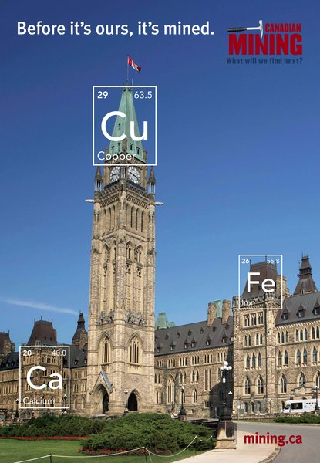
ABOUT MAC
Mining association of Canada
The national voice of Canada’s mining industry.
Advocacy – to advance the business of mining.
TSM Initiative – stewardship and social license.
40+ members in iron ore, gold, diamonds, oil sands, met-coal, base metals, uranium.
50+ members in engineering, environment, finance.
Members engaged in exploration, mining, smelting, semi-fabrication, supply.

Slide 4
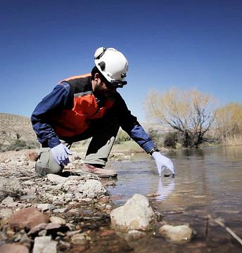
Canadian mining Leadership Abroad
Canadian mining companies abroad are leaders in responsible business practices.
Mining is an economic engine for host communities that drives improvements in well-being and the benefits are inclusive.
While the outcomes are not always perfect, Canadian mining companies work hard to address issues when they arise.
Working in partnership, we can achieve more.
There is significant opportunity to leverage international development resources through the strong social and economic contributions of Canadian mining companies to local communities.
Goldcorp, water testing at the Cerro Negro Mine, Argentina

Slide 5
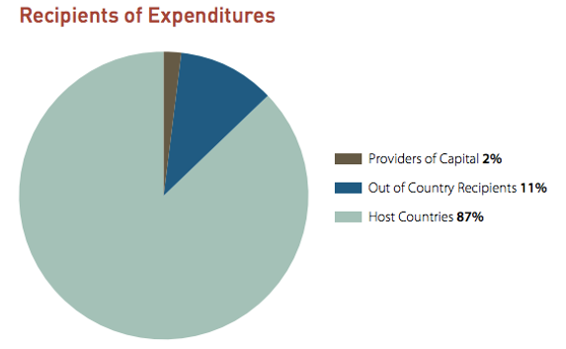
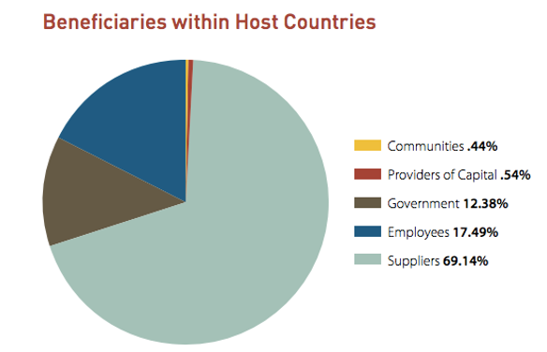

Aggregate MAC member Value Distribution Data:
Beneficiaries within host countries
Notes:
Canada’s mining sector is a global leader and makes significant contributions to raising living standards and poverty eradication.
With over 1,400 companies active in more than 100 countries, the value of Canadian mining assets abroad reached $170B in 2014. This figure is double that of Canadian mining assets at home.
MAC study of its members’ mining activities outside of Canada showed:
MAC member companies spent US$10.7B in host countries, and employed 53,000+ employees and contractors at international operations.
In fact, a 2015 MAC study found that almost 80% of the revenue generated by Canadian mining companies overseas is spent in host country economies.
The positive impact was most clear in non-OECD countries where 8 members operating in 12 non-OECD countries spent $6.2B on in-country businesses, employees and taxes.
When compared to Canada’s entire Official Development Assistance budget of $4.8B in 80 countries, the significant contribution of Canada’s mining sector to international development is apparent.

Slide 6
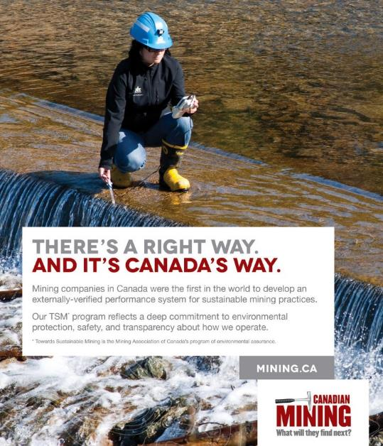
TOWARDS SUSTAINABLE MINING®
About TSM:
Mandatory participation for MAC members.
Improves environmental and social performance in critical areas beyond regulations:
  Environmental Footprint (tailings, biodiversity, mine closure).
  Energy Efficiency (energy use, GHG emissions).
  Community and People (engagement, safety & health, crisis management).
Program Strengths:
Performance measured at facility-level.
Monitored by external Community of Interest (COI) Advisory Panel.
Results are externally-verified.
Encourages excellence and continuous improvement.

Slide 7
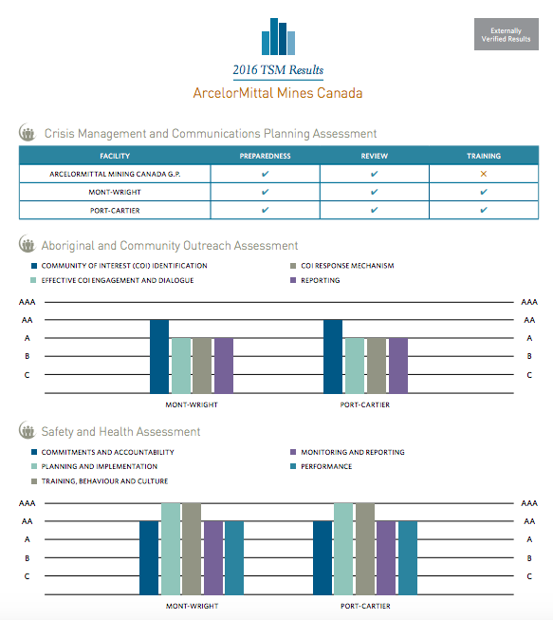
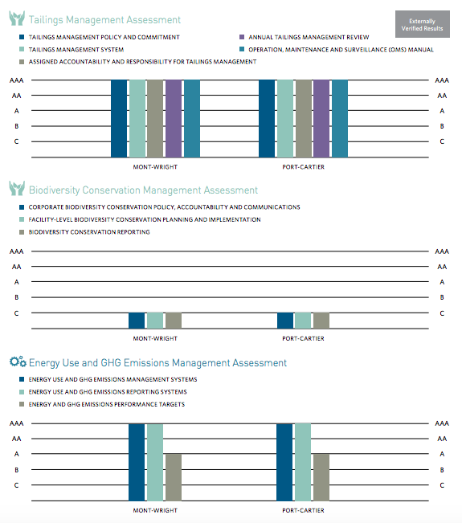
Facility Level Public reporting

Slide 8
2016 Aggregate Results:
Communities & People
Aboriginal and Community Outreach Assessments
Percentage of Facilities at a Level A or Higher 2006, 2015 and 2016

Slide 9

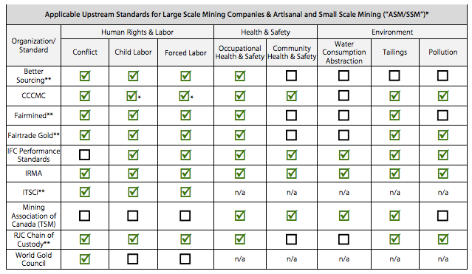
Tsm and responsible sourcing
MAC has integrated Prevention of Child and Forced Labour components into TSM and anticipates that the next version of the Apple Standards will reflect this.
TSM is also an associate member of the Responsible Steel Standards and is working in collaboration on the mining components of Responsible Steel.
TSM is also working with the Responsible Jewelry Council on cross-recognition
19

Slide 10
Growing interest in tsm
TSM implemented nationally:
  Canada
  Finland
  Botswana
  Argentina
  Philippines
  Spain
Additional countries with mines reporting on TSM indicators:
  Burkina Faso
  Mexico
  USA
  Peru
  Suriname
  Turkey
  Australia
Countries with mines implementing TSM, but not yet reporting:
  Australia
  Greece

Slide 11


Core Components for an Association
adopting TSM
TSM consists of seven core components that must be in place:
Guiding Principles
Performance Indicators
Facility Level Reporting
Independent Verification
Public Reporting of Facility Level Reporting
Condition of Membership
Community of Interest Advisory Body
Each implementing association is required to have something in place to meet each of these seven components.
It is left up to the association, in conjunction with their Community of Interest Advisory Body, to decide how best to implement each item

Slide 12

For more information please contact:
Ben Chalmers
Vice President, Sustainable Development
Mining Association of Canada
bchalmers@mining.ca
613-233-9391
Pierre Gratton
President and CEO
Mining Association of Canada
pgratton@mining.ca
613-233-9391
Follow us on Twitter:
@theminingstory

