Slide 1
CSR Standards Navigation Tool
Extractive Sector CSR Counsellor’s Office
Esma Mneina
Sean Cornelissen
Presentation at:
Ryerson University’s Institute for the Study of Corporate Social Responsibility
Toronto, Ontario
March 9, 2018

Slide 2
CANADIAN DEFINITION OF CSR
« Corporate Social Responsibility (CSR) is defined as the voluntary activities undertaken by a company, beyond the minimum requirements imposed by law, to operate in an economic, social and environmentally sustainable manner»
Notes:
The key elements of Canada’s CSR approach:
Not limited to the trade commissioners service/their roles and responsibilities on the ground. It‘ also includes facilitating dialogue towards dispute resolution through canada’s NCP, and also the Office of the CSR Counsellor.
One of the key elements of the CSR strategy, is also promoting and advancing CSR guidance. These are, internationally recognized standards and canadian initiatives.

Slide 3
Office of the CSR Counsellor
The Counsellor - special Advisor to the Minister of International Trade
Office established in 2009
Two mandated functions:
  Advisory – explaining Government CSR expectations to Canadian mining, oil and gas companies
  Review - non-judicial dispute resolution mechanism
Currently guided by the 2014 CSR Strategy, “Doing Business the Canadian Way”
Notes:
Current Counsellor Jeffrey Davidson, previous Counsellor Marketa Evans

Slide 4
From Reacting to Preventing
Being pro-active and preventative
Active promotion of good practice
  Conferences or special event presentations, face to face meetings; small group discussions and dialogues
Early detection of emerging situations
  Office initiated research and monitoring
  Trade Commissioners on Post as CSR advocates and eyes and ears on the ground
Constructive interventions to facilitate solutions and diminish risks of escalation and conflict
  Direct contact with company senior management
  Assessment and advice
Authority to recommend denial or withdrawal of certain government services when companies not operating or interested in operating responsibly
Notes:
COUNTRY TRIPS
Africa, Latin America
Based on need, Canadian presence AND Pre-Emptive factor
Gain a more nuanced understanding of major challenges to companies and concerns of communities
Give advice to companies on the ground
Make communities aware of our existance and support (AND NCP)
Back home, give advice to companies considering entering the region
Engage more meaningfully with civil soceity and with academia
Public report
EARLY DETECTION
Find out about issues when they are still small through contacts, embassies, and desk research.
Fact check information, delve deeper with local news sources, research on history of property/region
Call company to ask them their version of events, how they have approached the issue, suggest actions
Contact aggrieved party, if possible, make them aware of our office and mechanisms available
ADVICE AND INTERVENTION
Community-based water monitoring
Alert systems for specific issues, in ADDITION to grievance mechanism
Bring up other issues, ask if policies are in place, what efforts are made to know this will not happen again
CORE – CANADIAN OMBUDSPERSON FOR RESPONSIBLE ENTERPRISE
The end of the current Counsellor’s mandate is May 2018 (18th)
Announced January 17, 2018
Mandated to investigate allegations of human rights abuses
Empowered to engage in fact-finding investigations (independently OR collaberatively), report, recommend remedy, AND monitor its implementation on human rights abuse allegations
Multi-sectoral: starting with mining, oil, gas and garment sectors – with the expectation that the Ombudsperson will move into other sectors
Creation of a multi-stakeholder Advisory Body to advise the Government and the CORE on responsible business conduct
Will include individuals from business sectors and CSOs
This Navigation Tool will remain relevant to CORE and stakerholders affected by Canadian companies

Slide 5
The 6 International CSR Standards
The UN Guiding Principles on Business and Human Rights
The UN Voluntary Principles on Security and Human Rights
The OECD Guidelines for Multinational Enterprises
The OECD Due Diligence Guidance for Responsible Supply Chains of Minerals from Conflict-Affected and High-Risk Areas
IFC Performance Standards on Social and Environmental Sustainability
The Global Reporting Initiative for extractive sector CSR
Notes:
So, what are the Government of Canada’s CSR expectations?
>The government expects Canadian companies operating abroad to align their practices with the information in these 6 standards
Of course, not every part of each of the standards will be relevant to every company
In fact, some entire standards may not be relevant to a company’s specific situation
The GRI, for example, is not so much designed to give recommendations or guidance, but instead provides a framework for companies to report on so they can compare themselves to industry peers, and to themselves over time
These 6 Standards are the foundation of Canada’s CSR policy, but they are a lot to read. This why we created the CSR Standards Navigation Tool
There are many other guidances/toolkits, not in Canada’s CSR policy:
ISO 26000 (social responsibility standards from the International Standards Organization)
TSM from MAC
Local Procurement Reporting Mechanism from Mining Shared Value

Slide 6
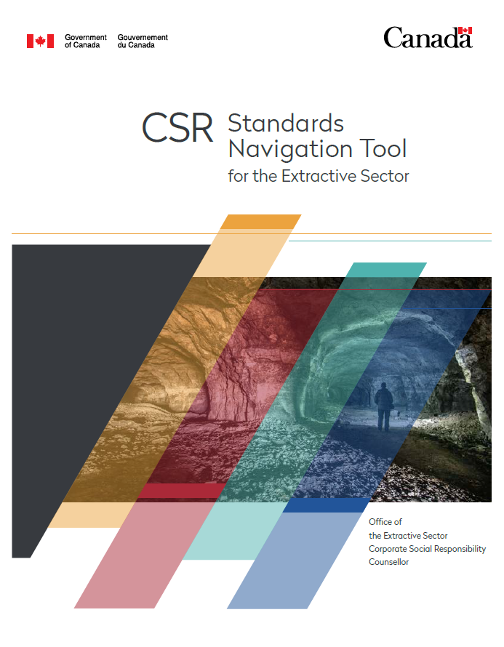
6 International Guidelines + Additional Tools
1 Navigation Tool
Notes:
Enter the navigation tool
English/french/spanish in april

Slide 7
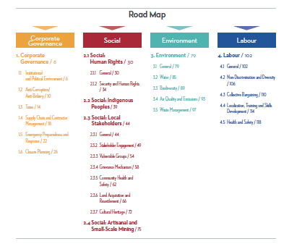
CSR Standards Navigation Tool
Allows companies to more quickly access and understand international best CSR practices
Corporate Governance
Social
Environmental
Labour
Gathering point of tools and guidelines from principle international organizations
Notes:
…according to four themes ..
We are about to open up the tool and look at this more closely, but issues like. … .

Slide 8
Stages of Development
Identifying and Hiring Consultant
Review of Standards
Compilation and Organization of Data
Drafting of Working Document
PHASE 1
Launch of Working Document
Gathering Feedback
Inputting all content-related feedback
Enhancing user experience with PDF + Visual map
Launch of Final Tool
PHASE 2
Notes:
The tool is a product of a few years of work… (elaborate briefly on the tool)
Phase 1 (2016 – 2017) Lindsay McIvor - Khyber Sustainability Services
Terms of reference – identifying and hiring consultant – review of standards and compilation and organization of data – drafting of a working document
Phase 2 (2017 – present)

Slide 9
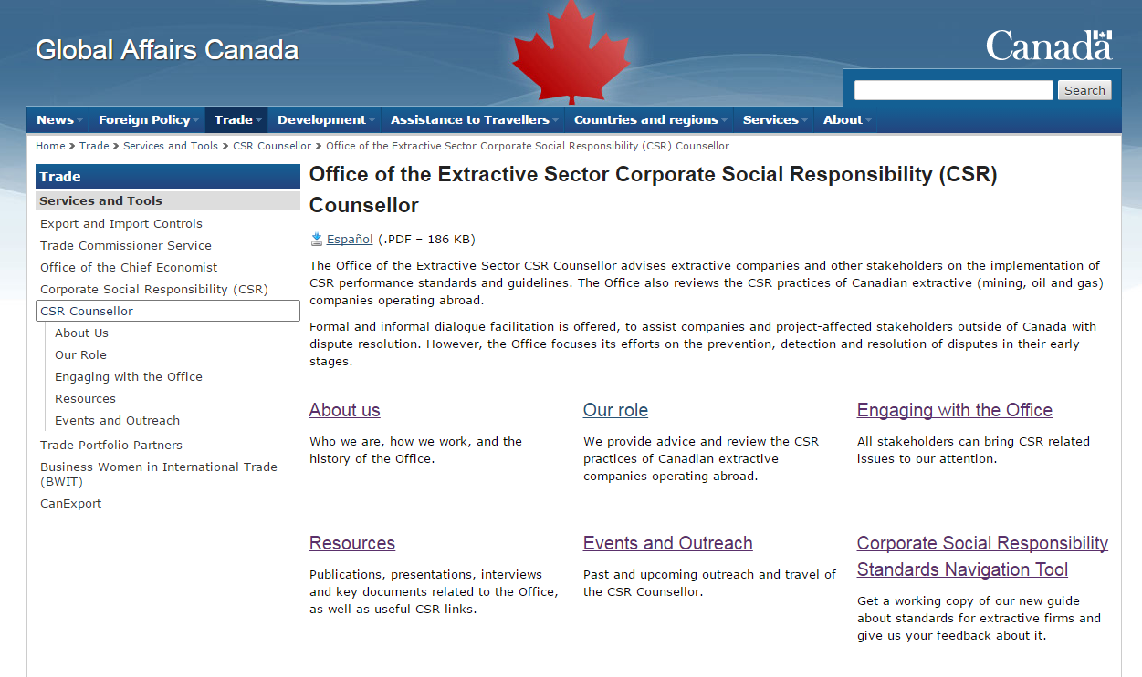
international.gc.ca/csr-counsellor

Slide 10
Stages of Development
Identifying and Hiring Consultant
Review of Standards
Compilation and Organization of Data
Drafting of Working Document
PHASE 1
Launch of Working Document
Gathering Feedback
Inputting all content-related feedback
Enhancing user experience with PDF + Visual map
Launch of Final Tool
PHASE 2
Notes:
The tool is a product of a few years of work… (elaborate briefly on the tool)
Phase 1 (2016 – 2017)
Terms of reference – identifying and hiring consultant – review of standards and compilation and organization of data – drafting of a working document
Phase 2 (2017 – present)

Slide 12
Scenario One - Security
  You are managing a junior company. The drilling team you have contracted to advance your exploration project in Country X, is set to begin work in one week. You hope that this final round of drilling will be sufficient to create a bankable feasibility study and sell the project to a larger company.
  Country X has reputation for having a weak rule of law, and you have just learned that protests have led to violent altercations between locals and state police forces in the area of your project.
Notes:
The Tool was designed to help companies know what the Canadian government expects of them
So, these scenarios are based on the perspective of the mining company
Nevertheless, the Tool can be used by NGOs to gain a better idea of international expectation, host country governments, etc.

Slide 13
Scenario Two – Water and Stakeholder Relations
You are working for a mid-tier company in the exploration stage of a project. While doing a site visit you learn from local indigenous leaders that water becomes very scarce during dry months and there is serious concern that the mine will use up the small amount of water they have, and possibly contaminate it.
They depend on water for subsistence agriculture and have threatened to not provide FPIC and erect a blockade if an exploitation permit is approved.

Slide 14
Contact Info
Sean Cornelissen
Research and Special Projects Officer
Sean.cornelissen@international.gc.ca
Esma Mneina
Stakeholder Liaison Officer
Esma.mneina@international.gc.ca
Download the tool and read office updates:
http://www.international.gc.ca/csr_counsellor
Notes:
Thank you
Hopefully you can use the Tool in practice, let us know what you think, what may be missing
Office closing in May, but Tool will remain relevant > commitment from civil service on the standards and of course the issues

