Slide 1
Developing UNWG guidance on HRDs & role of business
Anita Ramasastry, UN Working Group on Business & Human Rights
March 2018

Slide 2
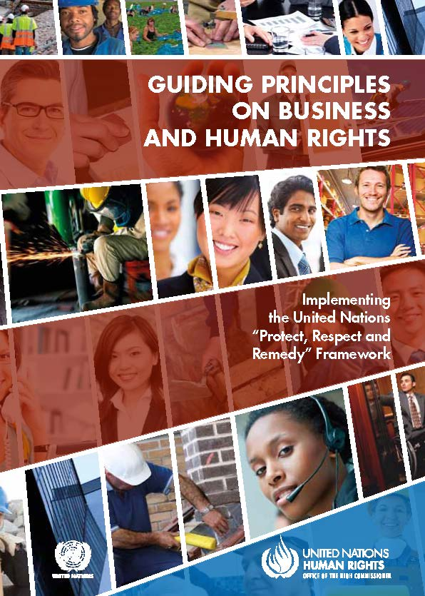
UNWG work on HRD & biz: overview
Aims and outputs
Develop guidance on HRDs and role of biz in line with UNGPs
Facilitate multi-stakeholder dialogue
Help identify and support opportunities for collective action
Methodology
Multi-stakeholder consultations and written inputs

Slide 3
Open call for inputs to UNWG guidance
Overall focus
Clarifying how UNGPs assist governments, biz and civil society to better address how biz can respect HRDs engaged in work relating to biz impacts and corporate accountability
Guidance will address all three pillars of the UNGPs:
State duty to protect
Corporate responsibility to respect
Access to remedy
UNWG asking questions to identify elements of guidance
Ongoing call for inputs
Expected launch: November 2018

Slide 4
Role of states – gaps & opportunities identified in UNWG consultations
SLAPPs and other retaliatory measures that restrict, threaten, intimidate or silence defenders
Policy coherence – e.g. in relation to the ‘enabling environment’ for HRDs in context of investment promotion
Protection of HRDs in NAPs
Legal support to HRDs
Support to multi-stakeholder dialogue and peer learning platform
Role of embassies
Role of “home” NHRIs: untapped terrain

Slide 5
Key message from Human Rights Defenders
See us as partners not as enemies – this will inure to the benefit of companies as well as communities in terms of averting conflict, respecting human rights, and addressing key challenges with respect to the rule of law
Human Rights Due Diligence that includes identifying risks to human rights defenders
Engaging defenders in consultation
Having plans to address adverse impacts

Slide 6
Role of biz – gaps & opportunities identified in UNWG consultations
Many companies don’t understand the issue – risks to HRDs not being managed
Basic good practice HRDD – including meaningful stakeholder engagement and transparency – a major gap on the ground
Too few OLGMs – and OLGMs need to build in engagement with HRDs
Company efforts to silence HRDs or push for legislation that restrict civil society space are contrary to the UNGPs
Inequality of arms in access to lawyers
Opportunity to build on emerging good practice examples and biz leaders recognizing importance of the issue!

Slide 7
Links
UNWG’s thematic page: http://www.ohchr.org/EN/Issues/Business/Pages/HRDefendersCivicSpace.aspx
UNWG note to identify guidance elements: bit.ly/2Cgg2hL
Recent blog on key points from consultation process
Summary note from 30 Nov multi-stakeholder consultation
Contact: wg-business@ohchr.org /
bhrconsultant@ohchr.org
Follow: @WGBizHRs

