Slide 1

Countering the spillover effects of backlash against equity, diversity and inclusion
March 28, 2025
Wendy Cukier, MA, MBA, PhD, DU (H.C.) LLD (H.C.) M.S.C.
Academic Director,
TRSM Diversity Institute
Academic Research Director, FSC
The Diversity Institute

Slide 2

Agenda
Agenda
The Diversity Institute
Backlash
The Case for Equity, Diversity and Inclusion
Driving Change: Responding to Backlash at Different Levels
The Way Forward
Entry one
Sentence case
Matches section headings

Slide 3






The Diversity Institute
25
Years of ground- breaking research and programming
100+
Full-time
research staff
300
Academic, industry, community and government partners
10
Community hubs across Canada
2,000
served by our skills
and job placement programs
We focus on “what works, for whom” so that we can innovate, replicate and scale best practices
Founder and research lead for the Future Skills Centre
Founder for the Women Entrepreneurship Knowledge Hub
Ecosystem partner
in the
50 - 30 Challenge
Notes:
To help frame today’s presentation, we, at the Diversity Institute are grounded in research but we also partner to deliver impactful programs that advance job creation, inclusion and diversity and entrepreneurship. We focus on “what works, for whom” so that we can innovate, replicate and scale best practices, this also applies to our programming so we can mobilize quickly and provide training on in demand skills, both for employers on EDI training, and for upskilling and reskilling training for participants. We also have a national reach with 10 community hubs across Canada.

Slide 4
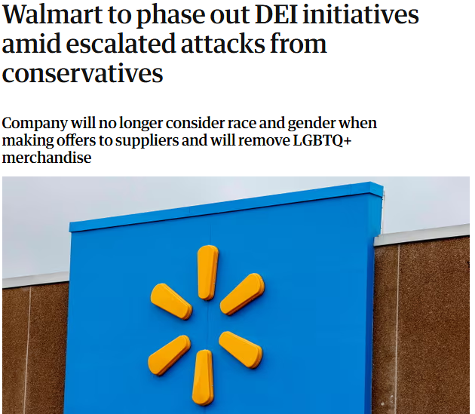




Backlash
After significant progress in advancing EDI, we are seeing a significant shift and push back.

Slide 5

Societal Level – Shifts in the US driven by Courts
Courts
Repeal of Roe versus Wade
Supreme Court overturned Affirmative Action
Legislation
85 Bills across 28 states and the US Congress have prohibited universities and other organizations from implementing EDI-related practices, including:
  Establishment of EDI offices
  Mandatory diversity training
  Use of diversity statements in hiring and promotions
11 states have active laws restricting EDI initiatives
Executive Order - Trump orders dismantling of federal government EDI programs and for all EDI employees to be put on leave and eventually laid off.
Notes:
Source:
Tu, L. (2024, November 1). A new era of EDI work in a turbulent time. American Psychological Association. https://www.apa.org/monitor/2024/11/edi-approach-political-backlash#:~:text=Criticisms%20of%20EDI%20have%20historically,people%20based%20on%20their%20identities
https://www.reuters.com/legal/us-appeals-court-tosses-nasdaq-board-diversity-rules-2024-12-11/
https://apnews.com/article/trump-sex-gender-transgender-dei-order-245350b97e0c4dcc221fefc49ef44699
Ending Board Diversity Reporting Requirements
US Court of Appeals invalidated Nasdaq’s diversity disclosure rule, noting that the EC lacked the statutory authority to approve them.
Rolling Back Transgender Protections
Trump signed executive orders rolling back protections of the transgender community and ending EDI programs within the government.
Trump administration directs all federal diversity, equity and inclusion employees be put on leave: https://www.cbc.ca/news/world/trump-dei-staff-1.7437918

Slide 6
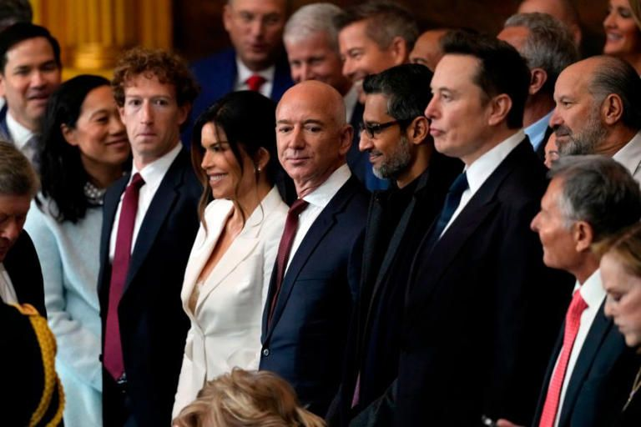




Misinformation and Loud Voices
Loud voices have been outwardly calling for us to revert to pre-EDI period
This is supporting the rise of misinformation and propaganda
Notes:
Scapegoating: https://www.reuters.com/world/americas/backlash-against-immigrants-challenges-canadas-welcoming-image-2024-09-06/
Misinformation: https://www.linkedin.com/pulse/contextualising-dei-backlash-inevitable-resistance-power-menzies-ueapc/

Slide 7
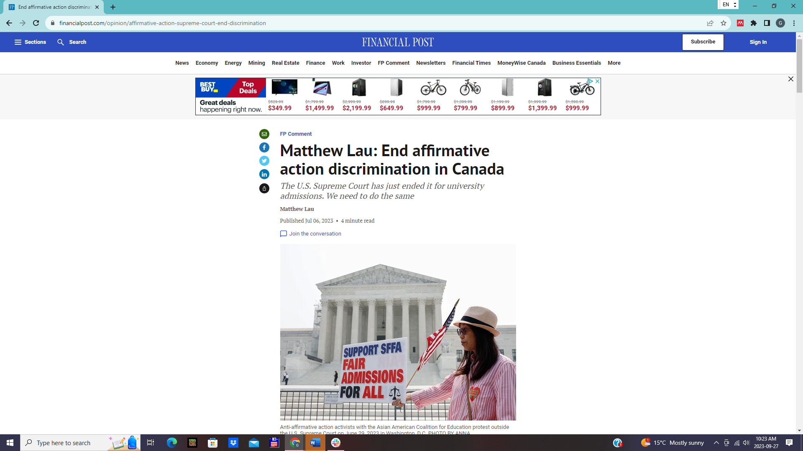
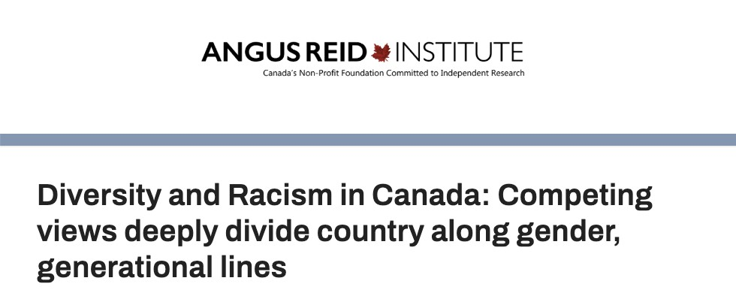
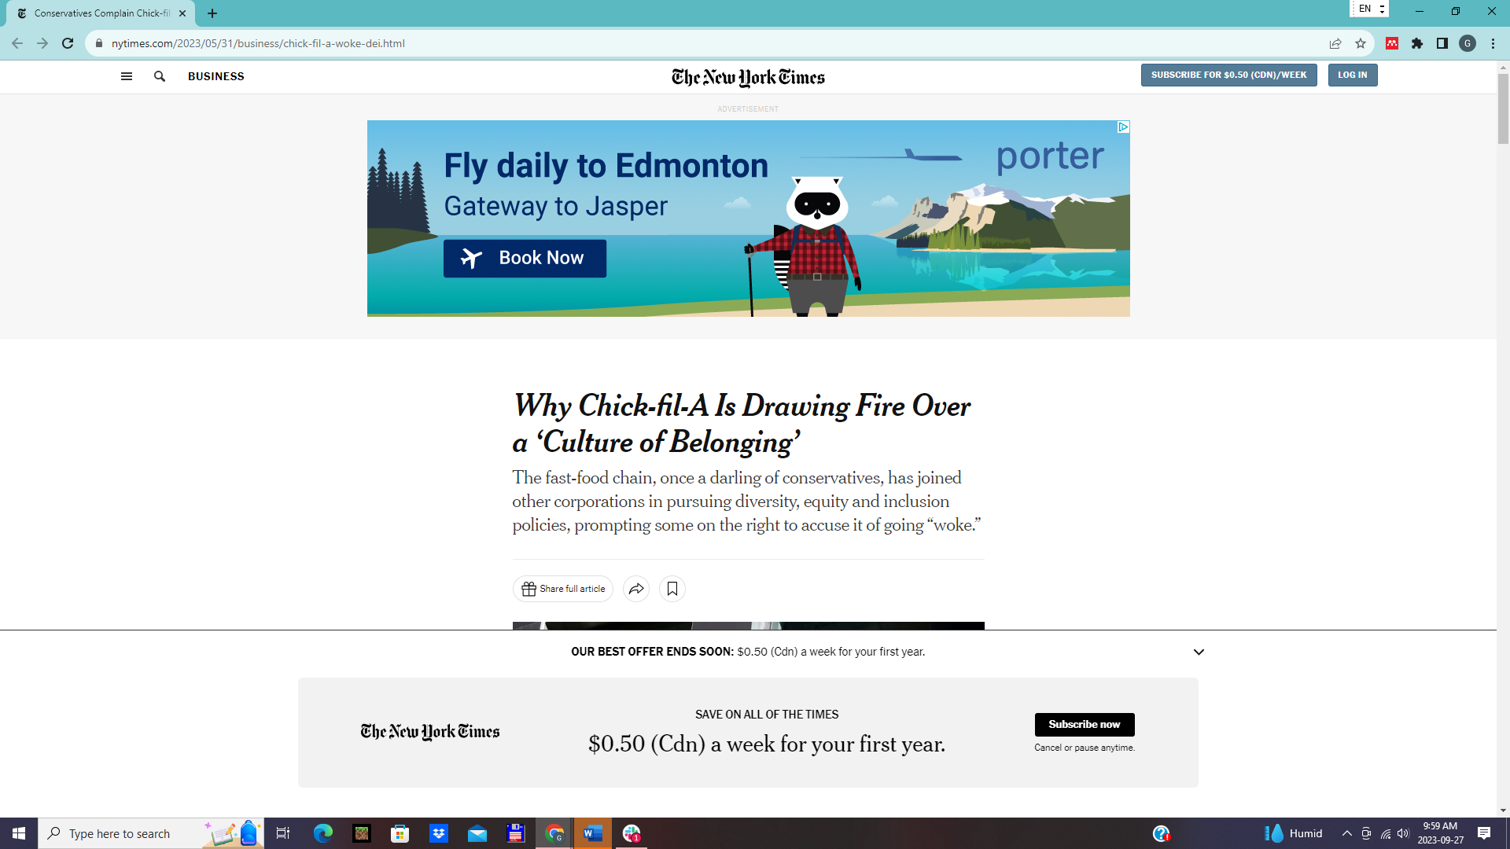
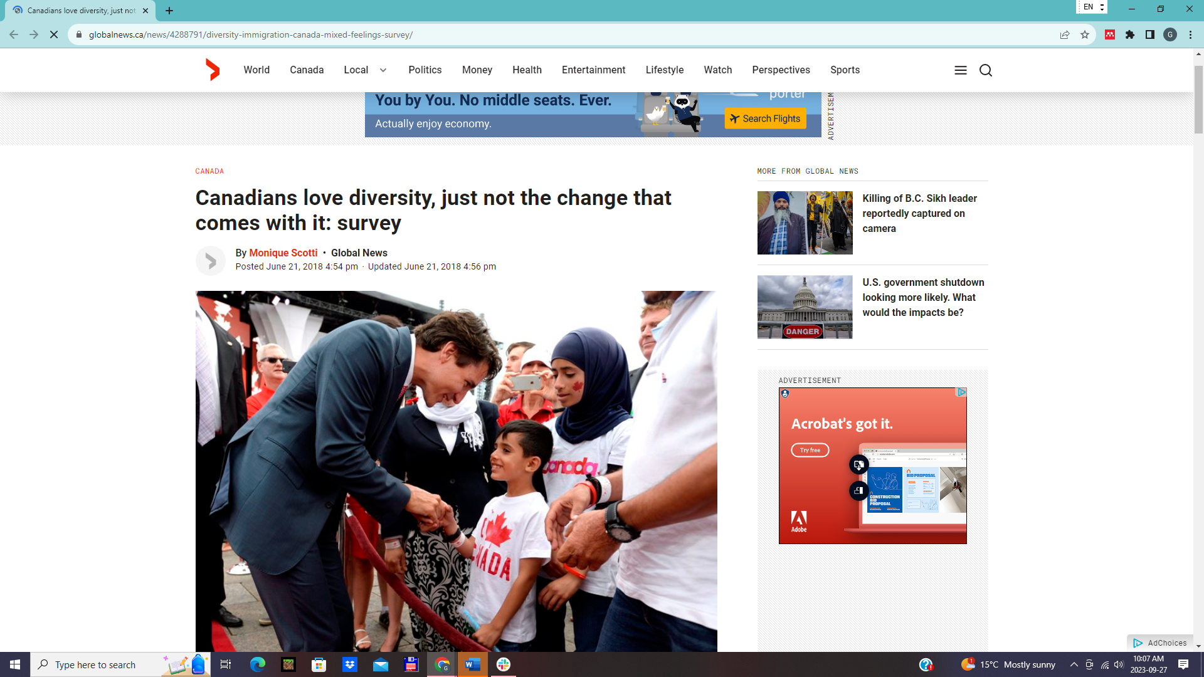

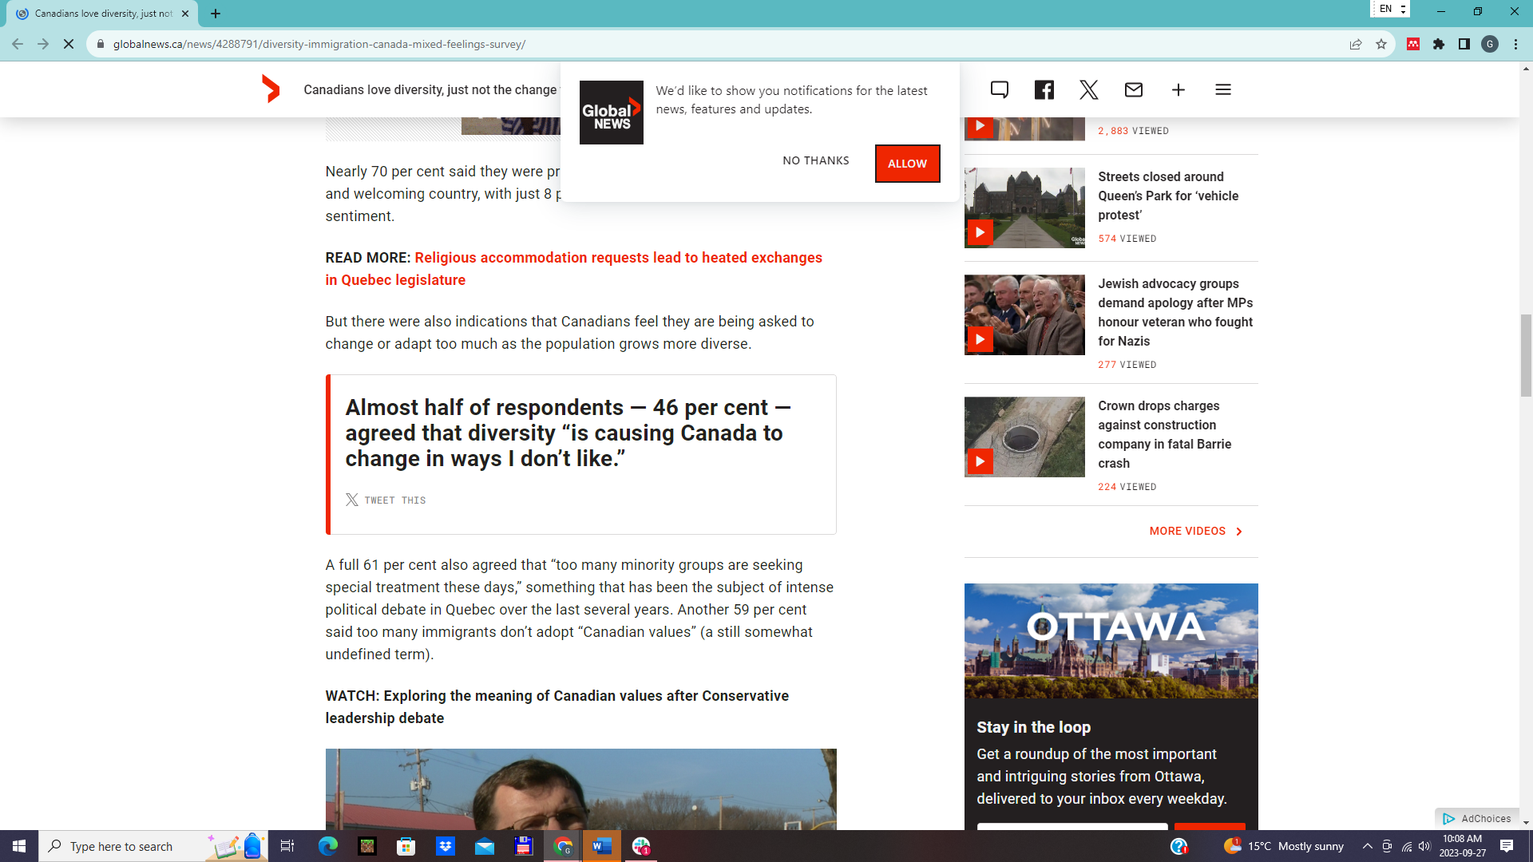

Early signs in Canada
Notes:
Additional Notes:
Sources:
Calgary Anti-Racism Education (n.d.). The Myth of Reverse Racism. Alberta Civil Liberties Research Centre. https://www.aclrc.com/myth-of-reverse-racism
Vogels, E.A., Anderson, M., Porteus, M., Baronavski, C., Atske, S., McClain, C., Auxier, B., Perrin, A., & Ramshankar, M. Americans and ‘cancel culture’: Where some see calls for accountability, others see censorship, punishment. Pew Research Center. https://www.pewresearch.org/internet/2021/05/19/americans-and-cancel-culture-where-some-see-calls-for-accountability-others-see-censorship-punishment/
Thomson, Aly. (2017, March 8). Trudeau's mediocre cabinet a result of choosing diversity over competence: Kevin O'Leary. CBC News. https://www.cbc.ca/news/politics/trudeau-cabinet-mediocre-gender-1.4015580
Wherry, A. (2023). The political brawl over 'woke' is about everything and nothing. CBC News. https://www.cbc.ca/news/politics/woke-trudeau-poilievre-1.6840196
USA: “Supreme Court decision to end affirmative action, race-conscious admissions processes at universities like Harvard and the University of North Carolina.”
-The decision was made based on the US constitution as a “colorblind constitution.”
-The Supreme Court decision will likely have trickle-down effects, such as diversity fatigue for student-run diversity organizations and fuel for anti-EDI policies in institutions, companies, and schools.
USA: “Why Chick-fil-A is drawing fire over a ‘culture of belonging.”
The backlash speaks to the tricky balance between trying to satisfy consumers who value EDI and those who actively oppose it.
Chick-fil-A has been supported by people who oppose 2SLGBTQ+ rights, but in the wake of the organization’s introduction of an EDI department, those same supporters are now expressing outrage at Chick-fil-A.
Canada: “Diversity, equity, and inclusion initiatives do not belong in academia.”
Opinion piece written by an established Canadian psychology scholar.
This article argues that EDI policies are discriminatory because they assume that members of equity-deserving groups need assistance in obtaining and qualifying for jobs.
Canada: “Quebec higher education minister denounces EDI practices in letters to universities”
Quebec education minister claimed that job postings tailored for equity-deserving groups perpetuates discrimination by excluding White men.
Canada: “Diversity and Racism in Canada: Competing views deeply divide country along gender, generational lines”
According to a study by the Angus Reid Institute, 41% of Canadians believe that the bigger issue causing divide in the country is the fact that people see racism where it does not exist.
Canada: “Canadians love diversity, just not the change that comes with it: survey”
According to a study conducted by the Government of Canada, people consider Canada to be a welcoming, diverse country, but also feel that “too many minority groups are seeking special treatment these days.”
Canada End affirmative action discrimination in Canada
“The U.S. Supreme Court has just ended it for university admissions. We need to do the same”
References:
Totenberg, N. (2023). Supreme Court guts affirmative action, effectively ending race-conscious admissions. NPR. https://www.npr.org/2023/06/29/1181138066/affirmative-action-supreme-court-decision#:~:text=In%20a%20decision%20divided%20along,that%20included%20Republican%2Dappointed%20justices.
Jiménez, J. (2023). Why Chick-fil-A is drawing fire over a ‘culture of belonging.’ The New York Times. https://www.nytimes.com/2023/05/31/business/chick-fil-a-woke-dei.html
Soh, D. (2021). Diversity, equity, and inclusion initiatives do not belong in academia. The Globe and Mail. https://www.theglobeandmail.com/opinion/article-diversity-equity-and-inclusion-initiatives-do-not-belong-in-academia/
Cantin-Nantel, E. (2023). Quebec higher education minister denounces EDI practices in letters to universities. True North. https://tnc.news/2023/01/20/quebec-edi-universities/
Angus Reid Institute. (2021). Diversity and Racism in Canada: Competing views deeply divide country along gender, generational lines. Angus Reid Institute.
Scotti, M. (2018). Canadians love diversity, just not the change that comes with it: survey. CBC News. https://globalnews.ca/news/4288791/diversity-immigration-canada-mixed-feelings-survey/
Lau, M. (2023) End affirmative action discrimination in Canada. Financial Post. https://financialpost.com/opinion/affirmative-action-supreme-court-end-discrimination

Slide 8
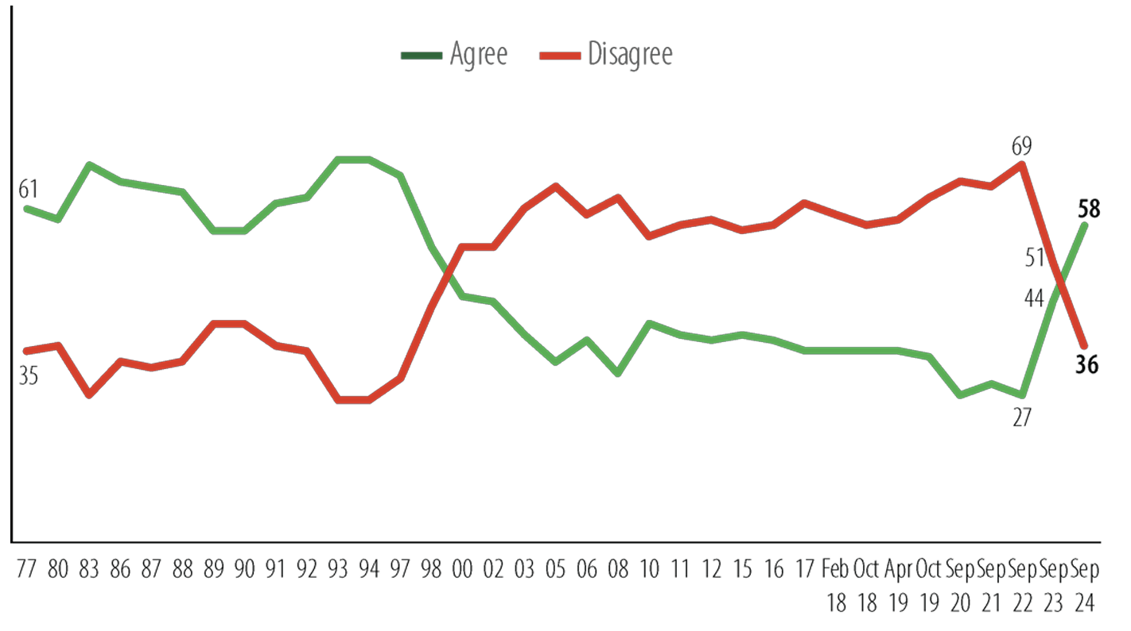
Attitudes shift quickly
Overall there is too much immigration to Canada 1977 - 2024
Notes:
From Environics Century Initiative report, Canadian Public Opinion About Immigration and Refugees: https://www.torontomu.ca/diversity/reports/canadian-public-opinion-about-immigration-and-refugees/

Slide 9
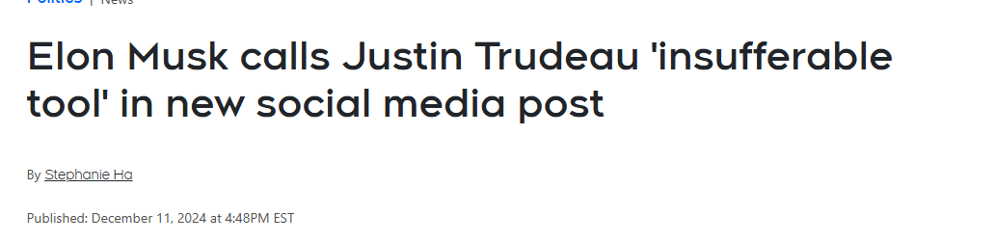


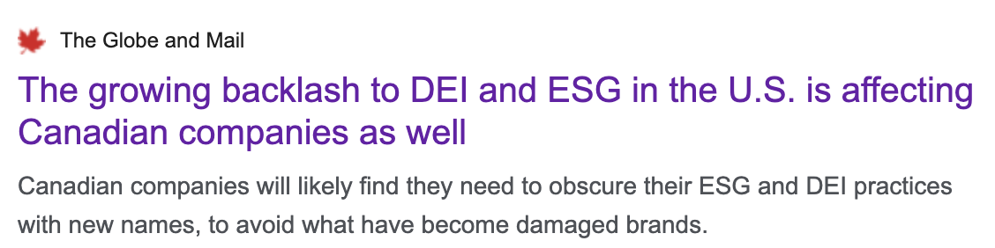
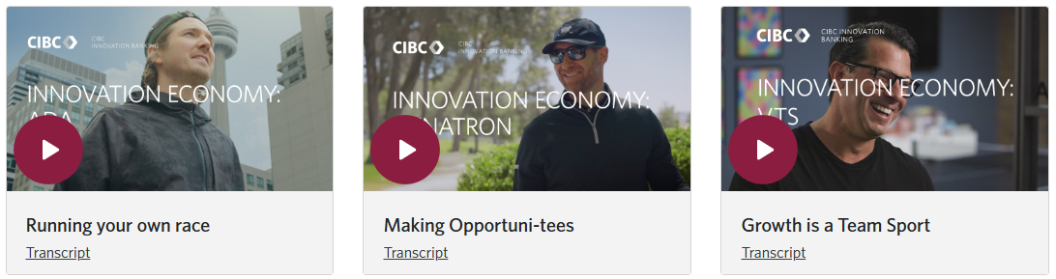
Experiences In Canada
Endorsement from Political Leaders
Spillover from the U.S.
Multinationals Operating in USA
Notes:
NOTES FROM WENDY:
Previously on the slide:
Endorsement from political leaders
Spillover from the US
Multinationals operating in USA
Wendy’s latest comment: Just put a few images as requested. pollievre and petterson, musk calling Trudeau a tool SCREEN SHOTS OF NEWS CLIPPINGS.
Aspiring PM with Jordan Peterson https://www.youtube.com/watch?v=Dck8eZCpglc
spillover https://www.theglobeandmail.com/business/article-dei-esg-backlash-canadian-companies/
More and more advertising with subtle shifts - all men panels, 90% men in advertisements - insert CIBC financial ad
CIBC Financial Ads: https://www.innovationbanking.cibc.com/insight-list-videos

Slide 10



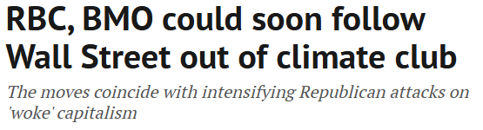
Not just EDI Backlash
Organizations, particularly major banks in Canada and the U.S. have withdrawn from the global climate alliance
The alliance was part of a climate change initiative to achieve net-zero greenhouse gas emissions by 2050
Notes:
5 of Canada’s 6 banks quit global climate alliance - BMO, TD, National Bank of Canada, Canadian Imperial Bank of Commerce, and Scotiabank
⅚ big banks in canada have withdrawn from global climate thing. (first BMO, Bank of Canada, CIBC, now Scotiabank. No word on RBC - I asked)
Jan 13 2025: RBC could soon walk away from the climate alliance // The Royal Bank of Canada and the Bank of Montreal are signalling that they’re reconsidering their membership in the Net Zero Banking Alliance
From: https://www.theenergymix.com/rbc-bmo-expected-to-quit-global-climate-finance-alliance/
Sources:
Karim, N. (2025, January 17). Five of Canada’s Big Six banks quit global climate alliance. Financial Post. https://financialpost.com/fp-finance/banking/bmo-first-canadian-bank-leave-un-climate-alliance
The Canadian Press. (2025, January 20). Scotiabank leaves net-zero climate alliance, joining other major banks. https://www.thecanadianpressnews.ca/environment/scotiabank-leaves-net-zero-climate-alliance-joining-other-major-banks/article_6407ca83-e804-51f1-89d8-477fd34dec60.html
Bickis, I. (2025, January 17). BMO becomes first Canadian bank to withdraw from banking climate alliance. Investment Executive. https://www.investmentexecutive.com/news/industry-news/bmo-becomes-first-canadian-bank-to-withdraw-from-banking-climate-alliance/
Marsh, A., & Dobby, C. (2025, January 8). RBC, BMO could soon follow Wall Street out of climate club. Financial Post. https://financialpost.com/fp-finance/banking/rbc-bmo-wall-street-climate-club

Slide 11



Standing Firm
“
”
Costco has reaffirmed the importance of EDI has crucial for the consumer shopping experience
Rejects the call from conservative think tank National Center for Public Policy Research (NCPPR) which called for Costco to do a financial risk analysis of their EDI efforts
Costco refutes the backlash, claiming that EDI is legal and crucial for long-term success

Slide 12
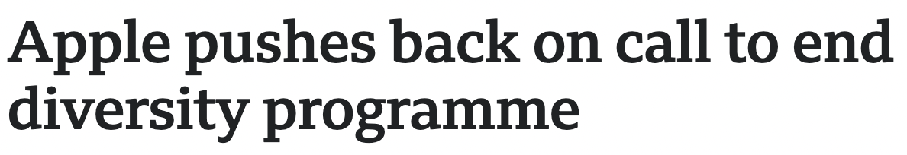
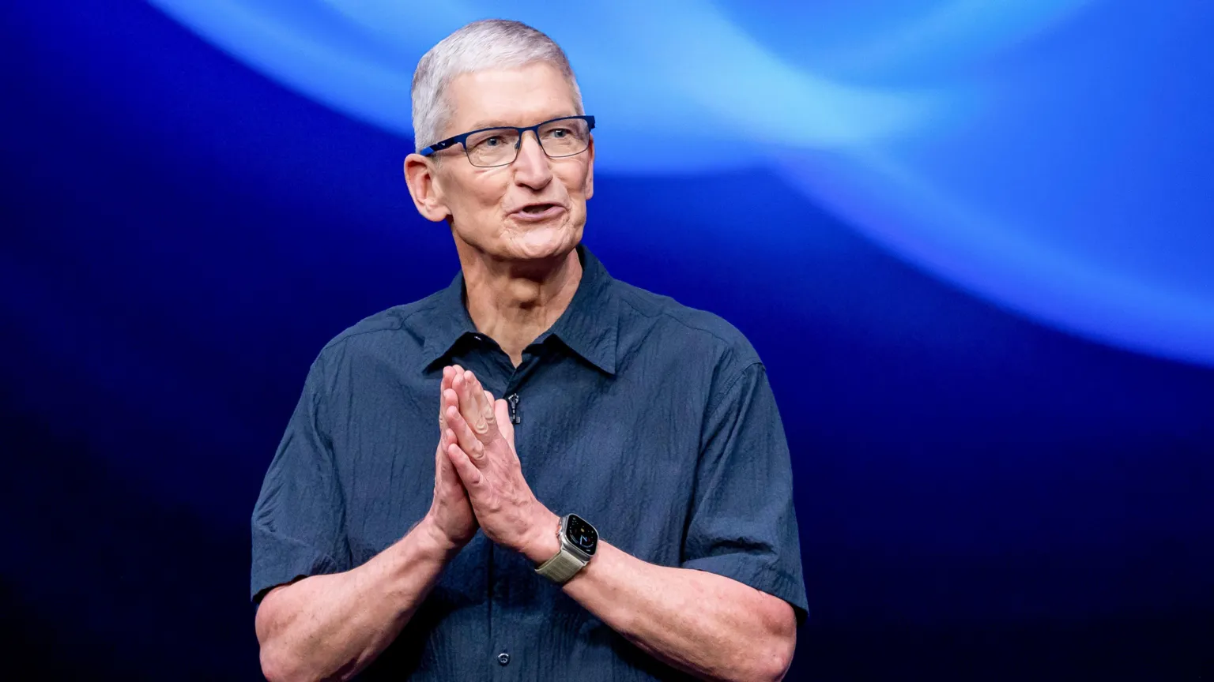

Apple Pushes Back
Apple’s board of directors recommended investors vote against a shareholder proposal to abolish the company’s EDI programs
Apple stated it had a well-established compliance program and the shareholder proposal was an inappropriate attempt to micromanage its business strategy

Slide 13


Walmart Shareholders Fight Back
“
”
In December 2024, Walmart began reviewing existing EDI efforts particularly geared towards supporting the 2SLGBTQ+ community
In response, Walmart shareholders who manage $266 billion in assets, shared a letter of solidarity with EDI efforts to the Walmart CEO, calling scaling-back efforts concerning
Notes:
Speaking notes Point 1:Olaniran, C. (2025, January 14). Group of attorneys general urge Walmart to reconsider ending DEI initiatives. CBS News. https://www.cbsnews.com/baltimore/news/walmart-dei-policies-meta-mcdonalds-ford/
Point 2: Gibson, K. (2025, January 16). Investors urge Walmart not to “give into bullying” on diversity. CBS News. https://www.cbsnews.com/news/walmart-dei-costco-diversity/
Speaking Notes (Additional context on Walmart):
A coalition of 13 attorneys general has written a letter urging Walmart to reconsider its plans to back away from EDI initiatives, stating these actions risk undermining important social progress and anti-discrimination efforts
Dozens of Walmart shareholders representing $266 billion in assets urge the company not to “give into bullying” by anti-EDI groups

Slide 14
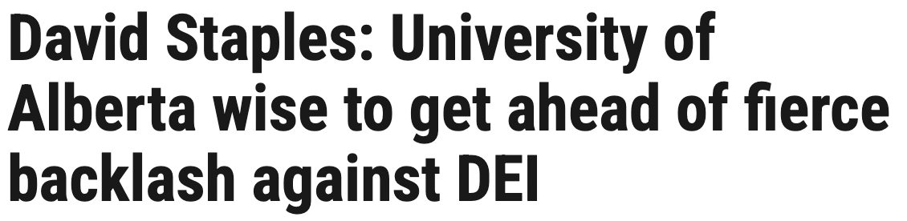


Reframing EDI Efforts
On January 5, 2025 policy change at the University of Alberta:
Current terminology of “equity, diversity and inclusion” is being “rebranded” at the University of Alberta
President and Vice-Chancellor Bill Flanagan said the current terms are polarizing and new terminology of “access, community and belonging” is being introduced
University states: “This evolution claims to resonate more universally and emphasizes common ground”
Notes:
Speaking notes:
Softening of language by changing EDI terminology is another new trend of how EDI and what it really means and stands for is getting curtailed
There were multiple reactions of disappointment to the University of Alberta’s shift in focus.
University’s rebrand is giving in to momentum against EDI and attempting to build a better relationship with the provincial government
Could signal a diluting of accountability by the university
Rebranding diversity programs is trending in Canada in response to what is happening in the US (a wave of diversity offices on American campuses in Republican states have shut down). According to Bill Flanagan, President of the University of Alberta, other Canadian post-secondary institutions are also considering a rebranding
Flanagan stated that this was done with consultations with the community and the University of Alberta’s Non-Academic Staff Association (NASA) was also consulted. However, NASA said the consultation involved the University going forward, but asking for their ‘two cents’. The decision was already made. The Association of Academic Staff was not consulted or given a ‘heads-up’ about the announcement
Baig, F. (2025, January 8). University of Alberta rebrands DEI policy to ACT: ‘Time for a refresh’. Global News. https://globalnews.ca/news/10948859/university-of-alberta-dei-acb-diversity/
Provincial Conservative government voted in 2023 and 2024 at their general meeting:
Elimination of diversity, equity and inclusion offices in post-secondary institutions
Elimination of EDI training in the Alberta public service
Wakefield, J. (2025, January 6). Campus groups respond after University of Alberta ditches diversity, equity and inclusion policies. Edmonton Journal. https://edmontonjournal.com/news/politics/university-alberta-dei-diversity-flanagan
Is Canada aligning with academic trend in the US?
On January 9, 2025 in the LA Times:
Political scientist Scott Yenor is appointed to the board of the University of West Florida by Governor DeSantis and argues:
If we want a great nation, we should be preparing young women to become mothers… not finding every reason for young women to delay motherhood until they are established in a career or sufficiently independent
Every effort must be made not to recruit women into engineering, but rather to recruit and demand more of men who become engineers. Ditto for med school and the law and every trade.
Source: Payne, K. (2025, January 9). DeSantis university board appointee says women should pursue motherhood, not careers. LA Times. https://www.latimes.com/world-nation/story/2025-01-09/desantis-appointee-to-university-board-says-women-should-become-mothers-not-pursue-higher-ed
Corporate giants CitiGroup and Coca-Cola say they remain committed to EDI but have made changes. CitiGroup dropped mention of anti-racist practices but says this doesn't reflect shift in policy. Coca-Cola have removed women’s initiative information.
Source: Green, J., & Foxman, S. (2024, March 1). Uber and Citi cut ‘anti-racist’ from corporate vocabulary following DEI backlash. Bloomberg. https://www.bloomberg.com/news/articles/2024-03-01/uber-citi-among-us-companies-dropping-anti-racist-tag-with-dei-backlash?leadSource=uverify%20wall
Source:
Point 1 & Point 2: Baig, F. (2025, January 8). University of alberta rebrands DEI policy to ACT: ‘Time for a refresh’. Global News. https://globalnews.ca/news/10948859/university-of-alberta-dei-acb-diversity/
Point 3: Wilson, J. (2025, January 6). Canadian university moving focus from EDI to ‘access, community, and belonging’. Canadian HRReporter. https://www.hrreporter.com/focus-areas/diversity/canadian-university-moving-focus-from-edi-to-access-community-and-belonging/390501
Point 5: Wakefield, J. (2025, January 6). Campus groups respond after University of Alberta ditches diversity, equity and inclusion policies. Edmonton Journal. https://edmontonjournal.com/news/politics/university-alberta-dei-diversity-flanagan

Slide 15
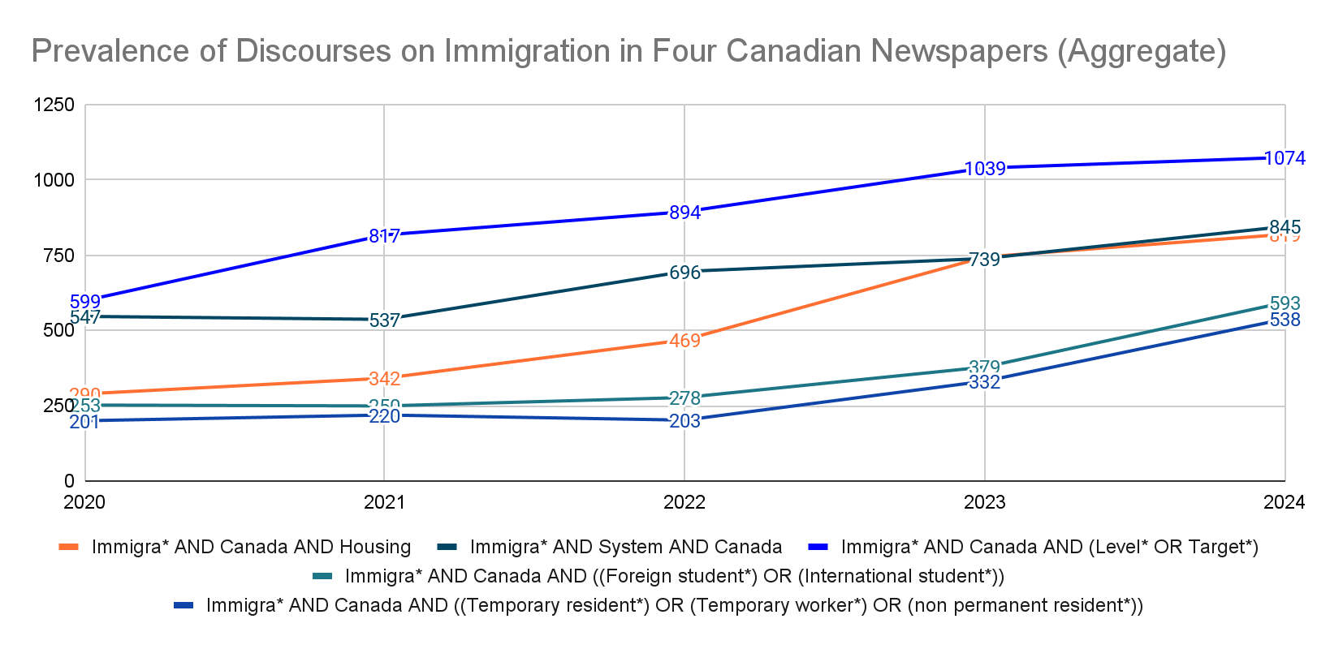
Content analysis - Across four newspapers

Slide 16
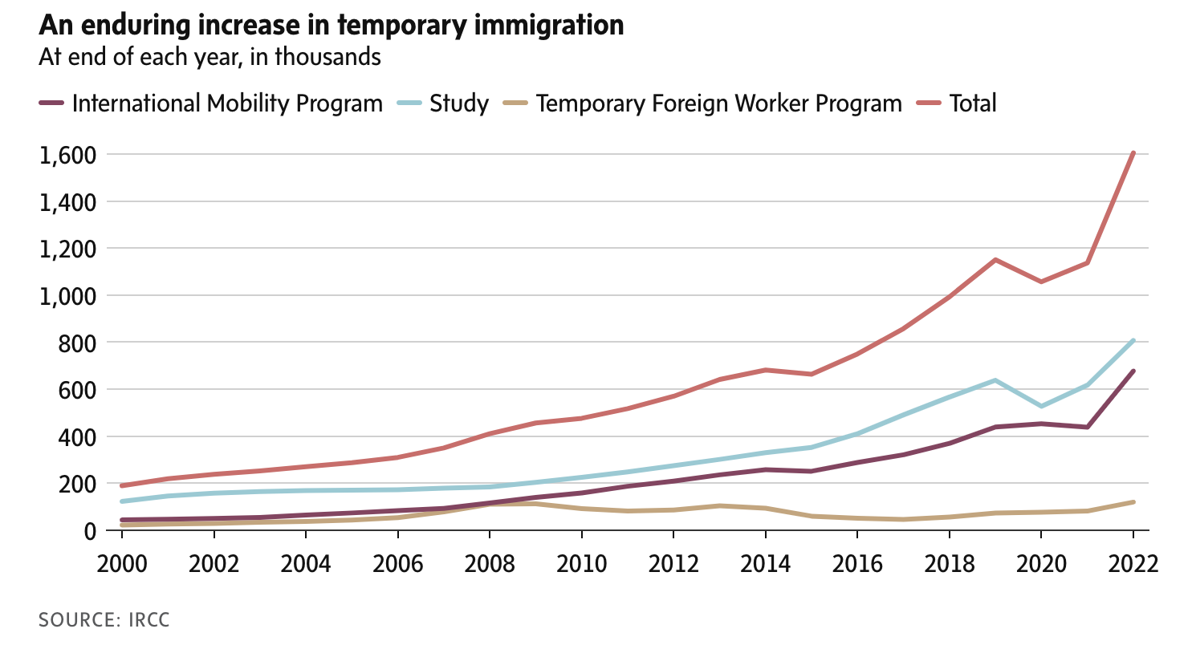
Tony Keller, The Globe and Mail (July 27, 2023)
“One of the negative consequences is that the national housing squeeze has been made worse, with a big jump in post-pandemic arrivals pushing high prices higher and low vacancy rates lower. It’s not political. It’s just arithmetic.”
Notes:
Source: https://www.theglobeandmail.com/business/commentary/article-its-time-for-canada-to-take-its-foot-off-the-immigration-gas-pedal/

Slide 17
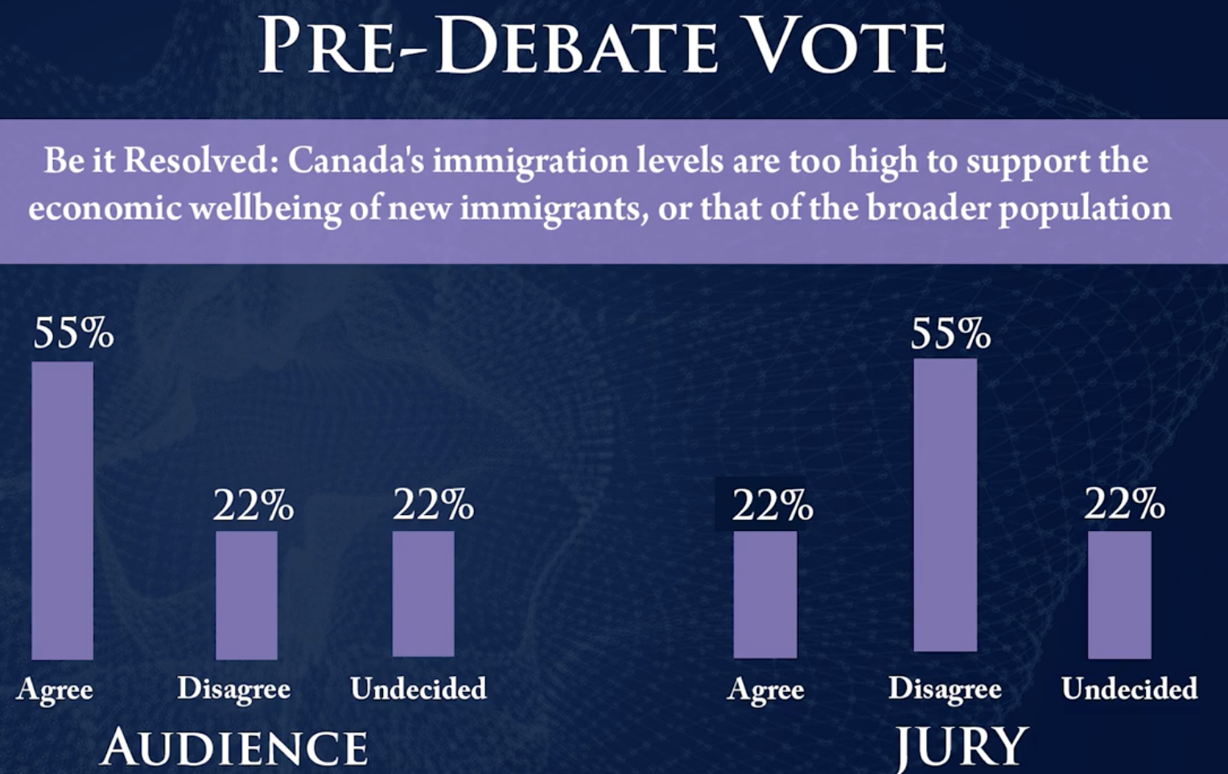

Evidence and Dog Whistling - CD Howe Debate
Jason Kenney: “We should not rely on immigrants, we need to be more pro-natal”
Mitzie Hunter: “I’m arguing not against immigration…but I’m arguing for the supports that immigrants need to be successful in this country.”
Notes:
Source: https://www.youtube.com/watch?v=v47gtxv3TFM&t=1182s (Transcript)
Transcript here: https://docs.google.com/document/d/12y52CDThcIaY8NybWcSr_3juW4PT46DKVbRDgsbeEzE/edit?tab=t.0

Slide 18
Too Little, Too Late - Business Response
“The Canadian Chamber of Commerce recognizes the government’s efforts to strengthen and ensure our immigration system is sustainable. We are pleased to see that approximately 62% of total permanent resident admissions will be dedicated to the economic class. However, the significant reduction announced today for the 2025–2027 Immigration Levels Plan is disappointing for businesses across the country that, in recent months, have had to deal with abrupt and constant changes to immigration policy. Significantly decreasing our labour pool will impact thousands of these employers across Canada struggling to find the workforce they need to operate and grow. Today’s announcement will also reduce Canada’s capacity to attract foreign direct investment.
Immigration is a key driver of economic growth and our only source of workforce growth in the near future. It is more imperative than ever in the context of the aging of our population, low fertility rates and current wave of retirements. The future of Canada depends on getting immigration right. We can do better.”
Diana Palmerin-Velasco, Senior Director, Future of Work, Canadian Chamber of Commerce
Notes:
Source:
https://chamber.ca/news/canadian-chamber-statement-on-immigration-targets-cuts/?doing_wp_cron=1741821926.5893640518188476562500

Slide 19
Strong [negative] impact on SMEs
Michael Aitken, co-owner of El Mariachi Tacos and Churros in Mississauga, Ont. (October 30, 2024 as quotes in the Financial Times)
“We rely heavily on the foreign worker program because we cannot find the right cooks here. I tried hiring cooks locally in my first year and it didn’t work out. Today, I have 14 foreign cooks who are able to maintain the food’s authenticity consistently. Without them, I have to shut down and that will put 60 people, mostly Canadians, out of work.”
Lara Kemps, an assistant general manager at a resort in Ucluelet, B.C. (October 30, 2024 as quotes in the Financial Times)
“I think the government does not separate statistics on the location. [...] The West Coast is different. It’s harder to get workers out here.” [About their heavy reliance on TFWP]
Melody McLorie, the director of human resources at the Wickaninnish Inn, a 75-room hotel. (October 30, 2024 as quotes in the Financial Times)
“We won’t have enough cooks, servers, and we will have to roll back services. [...] Such as the picnic that we organize during summers. We may not do that. We won’t be able to clean all our rooms because we won’t have enough room attendants. They won’t be sellable.”
Notes:
Source:
https://financialpost.com/feature/businesses-say-unfairly-targeted-foreign-worker-cuts

Slide 20

Backlash is not new
EDI backlash has historically emerged around:
Racial equity and social movements - e.g., the civil rights movement
Its assumed ineffectiveness
Concerns over advancing certain political ideologies
Consequences of dividing individuals based on their identities
What is new is the legitimation of hate and discrimination
Active laws and policies, including anti-EDI bills that restrict EDI initiatives
Powerful people reinforcing extremism
“I’ve learned that if you’re hunting bear, you have to think like a bear. And I’ve had to understand people’s fears. I’ve had to understand their anger in order to make it my friend.” - First Nations Elder cited in Hankivsky, 1996
Notes:
Asare Gassam, J. (2023, July 13). The History of DEI Resistance In America. Forbes. https://www.forbes.com/sites/janicegassam/2023/07/13/the-history-of-dei-resistance-in-america/
Tu, L. (2024, November 24). A new era of EDI work in a turbulent time. American Psychological Association. https://www.apa.org/monitor/2024/11/edi-approach-political-backlash#:~:text=Criticisms%20of%20EDI%20have%20historically,people%20based%20on%20their%20identities.

Slide 21
Reasons for Backlash at Different Levels
Societal Backlash
Organizational Backlash
Individual Backlash
US shifts in courts and policy
Misinformation and lack of champions
Policies that flag EDI as discriminatory
Changing socio-economic conditions, housing shortages
Competing values and religious views on some issues
Performative policies
Lack of structural change
Threats to established power relationships and resources
Weaponization of EDI
Poor implementation of strategies
Lack of performance metrics
Ignoring or silencing questions
Hard times
Feelings of being excluded or blamed
Fear of unknown
Selective information and lack of understanding
Belief that racism and discrimination has already been solved
“Colour blind” mentality
Notes:
Speaking notes
Evidence of Backlash
US shifts in courts and policy - Senate Bill 17 which bans EDI offices at higher education institutions. Laws passed in Texas in 2021 restricted K-12 curriculum regarding reaching anything about race and or slavery was not popular
Source: Windes, I. (2024, January 10). New laws fueling fear at college campuses, causing some faculty to leave state. San Antonio Report. https://sanantonioreport.org/texas-new-laws-college-faculty-fearful-loss-dei/
Possible sources;
Neck, C. P., Houghton, J. D., & Murray, E. L. (2023). Organizational behavior: A critical-thinking approach. Sage Edge. https://edge.sagepub.com/node/33113/student-resources/chapter-16/learning-objectives
Park, L. & Grensing-Pophal. (2023, August 30). Why DEI backlash exist and what to do about it. https://www.sap.com/resources/why-dei-backlash-exists
Weaponization of EDI: Twisting the meaning of what EDI is to fuel division.

Slide 22


The Case for Equity, Diversity and Inclusion
Broaden the talent pool and overcome skills gaps
Respond to increasingly diverse communities and gain support from diverse stakeholders
Foster innovation, creativity, and diverse thought
Mitigate legal and reputational costs
Increase employee satisfaction and reduce turnover
Notes:
Speaking notes:
Diversity, equity and inclusion are critical components of business success. Promoting diversity can lead to a more innovative and productive workforce, help companies better understand and serve diverse customer bases and improve overall business performance.
Source: Forbes Expert Panel. (2023, May 11). The business case for diversity, equity and inclusion. Forbes. https://www.forbes.com/councils/forbesbusinessdevelopmentcouncil/2023/05/11/the-business-case-for-diversity-equity-and-inclusion/
Without EDI policies, organizations could fall back into patterns that create unhealthy or exclusive work cultures that drive away diverse candidates, employees and customers alike. This directly impacts the bottom line.
Source: Alfonseca, K., & Zahn, M. (2023, July 7). How corporate America is slashing EDI workers amid backlash to diversity programs. abc News. https://abcnews.go.com/US/corporate-america-slashing-dei-workers-amid-backlash-diversity/story?id=100477952
Examples:
Air Canada: Air Canada has several recruitment strategies. For example, through partnerships, they hire First Nations people across Canada. They also work with the First Nations Technical Institute to help young First Nations people become pilots.
Source: Cision. (2019, June 21). Air Canada proudly salutes its Indigenous employees on National Indigenous Peoples Day. https://www.newswire.ca/news-releases/air-canada-proudly-salutes-its-indigenous-employees-on-national-indigenous-peoples-day-897845526.html
Uken Games: Their culture fosters creativity, collaboration, quality ideas, and a data driven mindset. Uken Games’ commitments to EDI include engagement in the act of allyship and commitment to anti-racism and anti-discrimination. They accelerate the equitable development of team members through their career pathing program.
Source: Uken Games. (2024). https://www.uken.com/company

Slide 23
Changing Markets, Talent, Expectations
Women are responsible for 75% to 80% of consumer spending through purchasing power or influence = about $1.2 trillion in 2023
In 2023, racialized people made up nearly one-third of Canada’s workforce
Women are responsible for 75% to 80% of purchasing decisions
According to the 2021 Census, the immigrant population was 8,361,505 and is projected to almost double by 2041
In 2021, 27% of Canadians aged 15 and older reported having at least one disability, a 4.7% increase compared to 2017
In 2021, about 10.5% youth aged 15-24 reported being part of the 2SLGBTQ+ community
41.2% of Indigenous Peoples aged under 25, compared with 27.3% of the non-Indigenous population in 2021
Notes:
Source:
1 Statistics Canada. (2025, January 17). Table 14-10-0438-01 Employment characteristics by visible minority group, annual. https://doi.org/10.25318/1410043801-eng
2 BDC. (2024, March 7). How do women impact the Canadian economy. https://www.bdc.ca/en/articles-tools/blog/how-do-women-impact-the-canadian-economy
3 Government of Canada. (2024, November 21). An immigration system for Canada’s future. https://www.canada.ca/en/immigration-refugees-citizenship/campaigns/canada-future-immigration-system/context.html
4 Statistics Canada. (2024, December 3). Table 13-10-0374-01 Persons with and without disabilities aged 15 years and over, by age group and gender. https://doi.org/10.25318/1310037401-eng
5 Statistics Canada. (2024, January 25). Socioeconomic profile of the 2SLGBTQ+ population aged 15 years and older, 2019 to 2021. Statistics Canada. https://www150.statcan.gc.ca/n1/daily-quotidien/240125/dq240125b-eng.htm
6 Statistics Canada. (2022, September 8). Canada in 2041: A larger, more diverse population with greater differences between regions. https://www150.statcan.gc.ca/n1/daily-quotidien/220908/dq220908a-eng.htm

Slide 24
Opportunities on Business Growth
According to a 2024 US Survey on Business Leaders
82% respondents view diversity initiatives as essential to their business strategies
67% respondents anticipate these efforts will grow in importance in the future
Primary motivations for diversity initiatives:
  Improve business performance (49%)
  Attract better talent (43%)
  Boost creativity and innovation (38%)
Only 2% of business leaders consider diversity initiatives unimportant
Notes:
Walk-Morris, T. (2024, march 5). DEI is a lighting rod for controversy- but the practice isn’t dead. BBC. https://www.bbc.com/worklife/article/20240304-us-corporate-diversity-equity-and-inclusion-programme-controversy

Slide 25

Attracting and Retaining Talent – Generational Differences
According to a 2024 Deloitte survey, 44% of surveyed Gen Z and 40% of Millennials rejected a potential employer based on their personal ethics/beliefs
The same survey shows that 86% of surveyed Gen Z and 89% of Millennials view having a sense of purpose in their job is somewhat/very important for their job satisfaction and well-being
A 2023 North American survey shows that 63% of Gen Z and Millennials would leave their roles if they or their colleagues experienced discrimination
Notes:
Source:
Point 1-2: Deloitte Touche Tohmatsu Limited. (2024). 2024 Gen Z and Millennial Survey: Living and working with purpose in a transforming world. https://www.deloitte.com/global/en/issues/work/content/genz-millennialsurvey.html
Point 3: Robert Walters Group. (2023). Diversity and Inclusion Strategy Report: A Review of Generational Workplace Trends in North America. https://www.robertwalters.us/content/dam/robert-walters/country/united-states/files/2023-edi-report/RW-EDI-Report-Age.pdf?utm_campaign=EDImailer

Slide 26
Discrimination in the Workplace Impacts Performance
According to a 2023 survey of 34,740 Canadians conducted by the Environics Institute in partnership with the Future Skills Centre and the Diversity Institute
26% of women respondents report experiencing discrimination in the workplace based on their gender identity, compared to 12% of men respondents
40% of racialized respondents report experiencing discrimination in the workplace based on race or ethnicity, compared to 9% of white respondents
38% of Indigenous respondents report experiencing discrimination in the workplace based on Indigenous identity
48% of lesbian or gay and 34% of bisexual respondents report experiencing discrimination in the workplace based on their sexual orientation, compared to 9% of heterosexual respondents
Rates are highest in the nonprofit sector, followed by government, and lowest in corporate sector
Experiences of discrimination are linked to mental and physical health, performance, retention, engagement, etc.
Notes:
Source:
Cukier, W., Parkin, A., Saiphoo, A., Borova, B., & Edwards, M. (2024). Gender, diversity and discrimination in the workplace. Environics Institute, Diversity Institute, Future Skills Centre. https://www.torontomu.ca/content/dam/diversity/reports/gender--diversity-and-discrimination-in-the-workplace/Gender,%20Diversity%20and%20Discrimination_EN.pdf

Slide 27
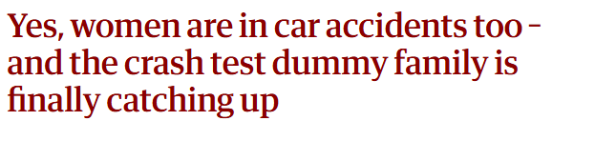
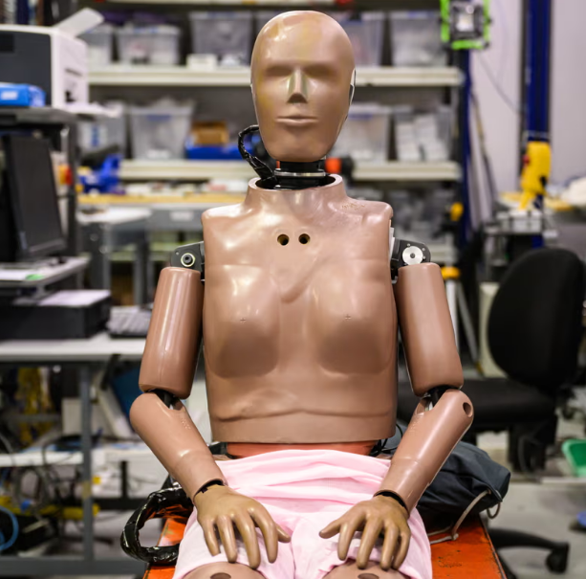
Inclusive Product Design
Evidence has shown a lack of EDI perspective:
Missed market opportunities - e.g., Sheertex
Products that do not work - e.g., Voice recognition and tap sensors
Products that are dangerous - e.g., automobile safety systems are 47% more likely to severely injure women; COVID protective equipment was not designed for women, increasing infection rates
Programs that do not work - e.g. COVID inoculation programs had uneven effects until disaggregated data were used to redesign implementation
Notes:
Bose, D., Segui-Gomez, M., & Crandall, J. R. (2011). Vulnerability of female drivers involved in motor vehicle crashes: an analysis of US population at risk. American journal of public health, 101(12), 2368–2373. https://doi.org/10.2105/AJPH.2011.300275
Standards Council of Canada. (2020). When one size does not protect all: Understanding why gender matters for standardization. https://publications.gc.ca/collections/collection_2021/ccn-scc/Iu81-3-22-2020-eng.pdf
Image from: https://www.theguardian.com/australia-news/2024/apr/01/female-car-crash-test-dummy-model-australia-thor

Slide 28
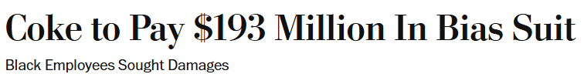

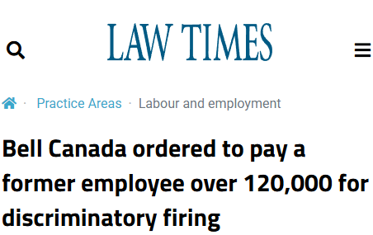
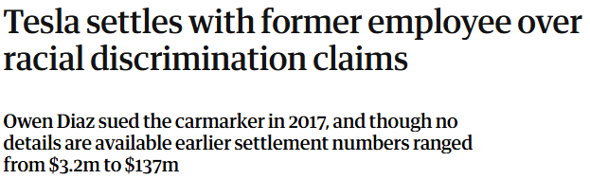

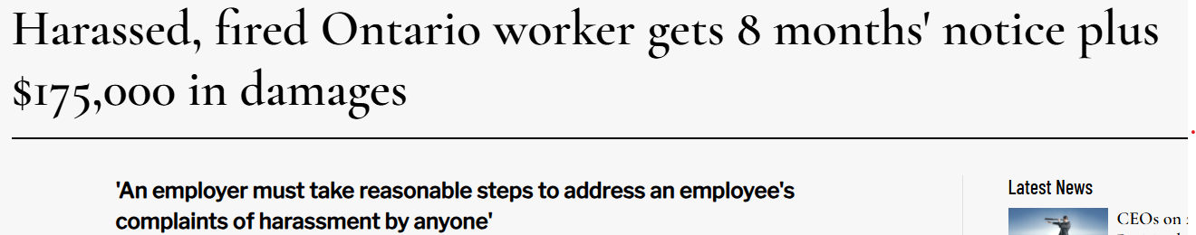

Managing Risks
Notes:
Oromoni, A. (2022, July 25). Bell Canada ordered to pay a former employee over 120,000 for discriminatory firing. The Law Times. https://www.lawtimesnews.com/practice-areas/labour-and-employment/bell-canada-ordered-to-pay-a-former-employee-over-120000-for-discriminatory-firing/368506
https://www.theglobeandmail.com/business/international-business/article-tesla-workers-shared-sensitive-images-recorded-by-customer-cars/
https://www.cnbc.com/2024/03/15/tesla-settles-racial-discrimination-lawsuit.html
https://www.hrreporter.com/focus-areas/employment-law/harassed-fired-ontario-worker-gets-8-months-notice-plus-175000-in-damages/390557?hsmemberId=437227&tu=b321a158-51a3-4bc4-aca7-8ffaeb668719&utm_campaign=&utm_medium=20250109&_hsenc=p2ANqtz-_hxwi9uofGyMll18vagtuUaFN2Jc-6LSdibytttfvcjEab3bdUvKgGI507s_RJYFtnSb6FUtWO-Bv8a4YHDbZNRf3hnA&_hsmi=341815811&utm_content=b321a158-51a3-4bc4-aca7-8ffaeb668719&utm_source=
In 2024, Tesla settled with a Black employee at $3.2 million USD on alleged racial discriminations, including racial slurs and anti-Black graffiti in manufacturing facilities https://www.theguardian.com/technology/2024/mar/16/tesla-settles-racial-discrimination-claims
Coca-Cola Co. agreed yesterday to pay a record $192.5 million to settle a racial-discrimination lawsuit brought by black workers and agreed to make significant changes in the way it manages, promotes and treats its minority employees. https://www.washingtonpost.com/archive/politics/2000/11/17/coke-to-pay-193-million-in-bias-suit/6a43c0c7-dcde-4d8c-a95f-3fe57c508c85/
Harassed, fired Ontario worker gets 8 months' notice plus $175,000 in damages https://www.hrreporter.com/focus-areas/employment-law/harassed-fired-ontario-worker-gets-8-months-notice-plus-175000-in-damages/390557

Slide 29
Employer hiring shaped by attitudes (Atlantic Canada)
Hiring Immigrants and International Students (IIS) Fang, et. al, 2019, n=800 | Employers Who Have Hired IIS |  | Employers Who Have Not Hired IIS
 | Disagree/ Strongly Disagree | Agree/ Strongly Agree | Disagree/ Strongly Disagree | Agree/ Strongly Agree
A multicultural workforce enhances creativity | 5 | 81 | 7 | 69
Immigrants will not take jobs away from locals | 7 | 84 | 9 | 71
Immigrants are harder working than local workers | 21 | 40 | 20 | 25
Language differences make it difficult to communicate | 31 | 31 | 17 | 48
Having employees from other countries can improve our firm's export opportunities | 18 | 30 | 21 | 33
Immigrants will leave for another part of the country within a short period of time | 33 | 26 | 29 | 28
Immigrants are unfamiliar with Canadian Business and workplace practices | 35 | 23 | 22 | 23
Hiring newcomers will require incurring additional training costs | 61 | 15 | 36 | 28
Immigrants will work for lower pay than local workers | 53 | 14 | 30 | 21
Immigrants have unreliable credentials | 72 | 6 | 47 | 8

Slide 30
Driving Change: Responding to Backlash at Different Levels
Societal Level
Organizational Level
Individual Level
30

Slide 31

Societal Level
In Canada, we have a strong, national framework - Charter of Rights and Freedoms, Employment Equity Legislation as well as provincial codes - Human Rights
Need to preserve legislative gains – e.g. childcare, accessibility
Continue to advance infrastructure – access to roads and internet
Tax regime, financing, funding, and incentives
Procurement policies
Regulation - Employment Equity legislation,
Voluntary codes - 30% Club, Black North Initiative, 50-30 Challenge
Challenge stereotypes - “See it, Be it”
33% of women have considered leaving their jobs for childcare
31
Notes:
The response to societal level is activism (as per Wendy’s notes)
Creating nonjudgmental spaces for lawmakers, institutional leaders and other stakeholders to learn about EDI.
Apparent polarization may or may not reflect genuine polarization in your community, but may be amplified by external parties with independent agendas.
Identifying stakeholders that really matter to the organization and understanding what matters to these stakeholders will provide the anchor needed to stay firm.
Most organizations today are global, and every region has a different readiness and susceptibility to this perceived backlash.
In the US and Europe, the phrase “go woke, go broke” has been used to imply – erroneously – that corporations supporting progressive social issues are suffering financially. Understand the real from the imagined conversations and debunk the myths.
Source: Shyamsunder, A. (2023, October 27). Responding (not reacting) to DEI ‘backlash’ concerns. LinkedIn. https://www.linkedin.com/pulse/responding-reacting-dei-backlash-concerns-shyamsunder-she-her--fy3ec/
The below is pulled from FedNor Presentation:
Consider the implications of program design such as - industries targeted, definitions of innovation, framing of challenges and eligibility requirements in relation to the profile of equity-deserving groups
Consult with equity-deserving groups in the development process about their needs
Consider the nature of the instruments being proposed and their impact
Challenge any biases already built into “feeder”, or pre-cursor programs (e.g., IRAP), or financial institutions (e.g., BDC)
Set specific objectives based on information about equity-deserving groups in the target population recognizing this will change with the goals of the programs.
In addition to eroding barriers, continue to develop targeted programs
Ensure plans allow for flexibility and iteration to ensure EDIA goals are met
Ensure funding and resource allocation recognizes greater investments may be needed to overcome barriers faced by equity-deserving groups
Consider the diversity, knowledge and lived experience of program delivery staff
Continue to experiment and encourage innovative pilot projects.
How can we support the implementation of legislation that promotes EDI?
Consider the race-based data collected during the pandemic? We saw clear differences between the experiences of non-racialized and racialized people. Similarly, the government needs to further track the representation of racialized leaders, to inform policy.
The data collected in this report is an important first step, but further efforts need to be made at both the macro and meso levels to make sure that this data is continuously tracked and easily accessible.
Similarly, GBA and GBA+ are important tools help to assess the gender-specific impacts of policies, legislation, and programs on women and men.
Other policies that support diversity legislation, such as the universal childcare policy in Quebec can also contribute to women’s participation in leadership
“Backlash Legislation” can have wide reaching impacts – some examples are:
Texas in 2022 banned companies like BlackRock from doing business with the state because of their work with ESG investing.
the US supreme court struck down affirmative action on June 29, 2023 and set a precedent for other universities and corporations to follow suit
Most notably, President Donald Trump’s Executive Order on January 20, 2025 to terminate all federal diversity, equity and inclusion programs - to take place within 60 days of this order
“terminate, to the maximum extent allowed by law, all DEI, DEIA, and “environmental justice” offices and positions (including but not limited to “Chief Diversity Officer” positions); all “equity action plans,” “equity” actions, initiatives, or programs, “equity-related” grants or contracts; and all DEI or DEIA performance requirements for employees, contractors, or grantees.”
Source:
Kanno-Youngs, Z., Shear, M. D., & Weiland, N. (2025, January 21). Trump’s executive orders: Reversing Biden’s policies and attacking the ‘Deep State’. New York Times. https://www.nytimes.com/2025/01/20/us/politics/trump-executive-orders-list.html
The White House. (2025, January 20). Ending Radical and Wasteful Government DEI Programs and Preferencing. Executive Order. Government of the United States of America. https://www.whitehouse.gov/presidential-actions/2025/01/ending-radical-and-wasteful-government-dei-programs-and-preferencing/

Slide 32

Strategic Impact
Demonstrating how EDI (no matter what it is called) advances organizational goals
Governance, Leadership, and Strategy
Human Resources Processes
Values and Culture
Measuring and
Tracking EDI
Diversity Across the Value Chain
Outreach and Expanding the Pool
Notes:
Speaking Notes:
organizations can approach diversity and inclusion in several areas – in fact, a commitment to diversity requires an orchestrated effort even within the organization
At the Diversity Institute, we understand that many organizations want to make a commitment to improving diversity and inclusion but are not sure how, or even where to start.
We at the developed the Diversity Assessment Toolkit or DAT, to help organizations assess different areas in which they can improve their commitment to diversity and inclusion.
We have included this toolkit at the end of the report
We have already helped many organizations complete this assessment to determine areas of improvement and to develop new programs and policies.
Going through the categories that we mentioned in one of the previous slides, assessments can help organizations decide to:
Leadership and Governance:
establish committee to ensure representation in leadership
HR practices;
consider the importance of experience from outside of the corporate sector,
hiring personnel should engage in training for bias-free hiring
Organizational culture, which reinforces belonging and inclusion;
consider D&I in marketing and communication,
consider the implementation of inclusive social events,
support parents with children
Measurement:
set measurable targets and tracking the effects of policies and practices;
administer engagement surveys which ask for self-reported demographic data, which includes the Black community as a DISTINCT group
Mainstreaming diversity through the value chain,
consider procurement, research, product development, sales, marketing and service;
consider D&I in product development, choice of suppliers, processors, markets and more.
Integrated strategies, which develop the pipeline
include outreach, government relations, and philanthropic initiatives; consider alternative pathways to board memberships, such as recruitment to committees before boards, and ensuring appropriate training.

Slide 33









Benchmarking
Outreach & Expanding the Pool
Example of an Organization with
Level 4 Average
Governance & Leadership
Levels
1
Minimal & Regulatory Compliance
5
4
2
3
Value Chain
2
1
Measurement & Tracking
3
Foundational Demonstration
4
Advanced Implementation
5
Strategic Integration
Culture
HR Practices
Notes:
The Diversity Institute’s Diversity Assessment Tool helps organizations track and measure implementation of diversity and inclusion throughout the organization, helping organizations benchmark their practices.
Advanced implementation (Level 4 average)
Governance and leadership: level 5
HR: 4
Measurement: 4
Culture: 5
Value chain: 3
Pipeline: 4

Slide 34
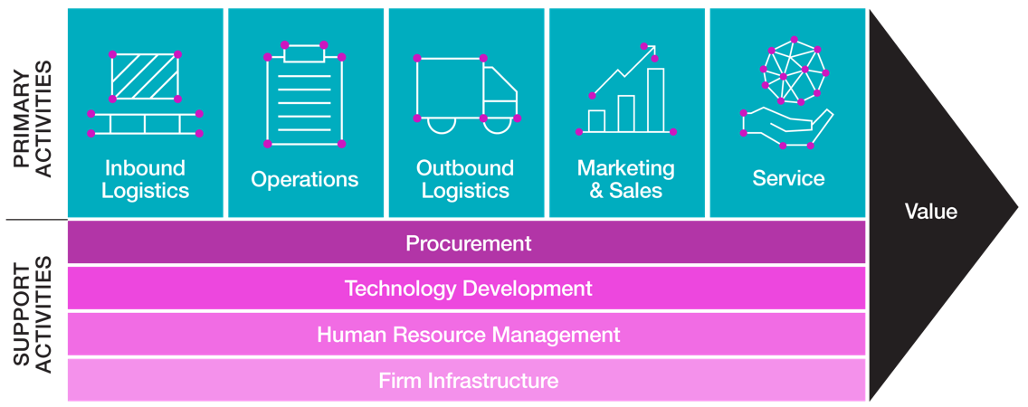
Mainstreaming Diversity through the Value Chain
34
Notes:
Example question: Does the organization incorporate the principles of equity, diversity and inclusion in its marketing programs including messages, images, and channels?
Best practice: Musket Transport is a Canadian trucking and transportation services company founded in 1993. The company believes that it is essential to eliminate gender stereotypes in its advertising and showcase its women drivers and mechanics to attract more women to the industry. To recruit more women and eliminate gender stereotypes, Musket Transport decided to feature its own women drivers and mechanics in advertising campaigns instead of biased stock photography. Focused on recruitment.

Slide 35
Responding to Backlash and Holding Firm
Initiatives must be aligned with organizational strategy
Leaders need to communicate commitments in language that works
Focus on practical needs and results
Use evidence - market segmentation, disaggregated data on employee engagement
Story telling - hearts and minds
Listen to feedback, “think like a bear”, in framing messages and messengers
Consider language and its impacts
Keeping comprehensive records of EDI initiatives and outcomes (improvements, employee engagement, satisfaction) will help to protect against future challenges
Creating nonjudgmental spaces for to discuss concerns
Remember “culture eats strategy” - how are you reinforcing EDI in your organizational culture
“...when employers say they’re moving away [from EDI], it sends the message that they never understood the concept to begin with.”
- Michelle Grocholsky, Founder & CEO of Empowered EDI
Notes:
Source:
Point 1-3: Shyamsunder, A. (2023, October 27). Responding (not reacting) to DEI ‘backlash’ concerns. LinkedIn. https://www.linkedin.com/pulse/responding-reacting-dei-backlash-concerns-shyamsunder-she-her--fy3ec/
Point 4-5: Tu, L. (2024, November 1). A new era of EDI work in a turbulent time. American Psychological Association. https://www.apa.org/monitor/2024/11/edi-approach-political-backlash#:~:text=Criticisms%20of%20EDI%20have%20historically,people%20based%20on%20their%20identities.
Point 7: Source: Beyond backlash: How feeling threatened by diversity can trigger positive change. UBC Sauder School of Business. (2024, November 19). https://www.sauder.ubc.ca/news/insights/beyond-backlash-how-feeling-threatened-diversity-can-trigger-positive-change
Michelle Grocholsky quote: https://www.benefitscanada.com/news/bencan/dei-pushback-an-opportunity-for-employers-to-highlight-intention-behind-diversity-inclusion-initiatives-expert/

Slide 36




Focusing on substantive rather than performative actions:
Education
Enforcement
Economics
Engineering
Notes:
Education, Enforcement, Economics

Slide 37

Being an Inclusive Leader
Diversity and inclusion are now core leadership skills
and should be tied to performance metrics
“Tone from the top” signals to others what is important
Modelling inclusive behaviours shapes behaviour
Acknowledging contributions to EDI motivates staff
Small gestures can demonstrate respect and inclusive behaviours
Creating “safe spaces” for discussion can advance understanding and ensure no one feels left behind
Watch language and the tendency to assume silence is agreement
37

Slide 38
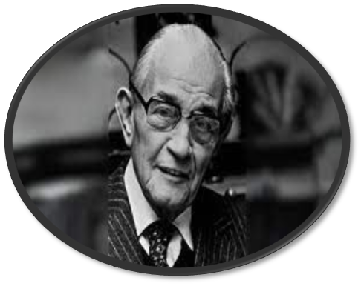
Remember: It’s not about them. It’s about us.
Allyship and political engagement across party lines are key.
“First they came for the socialists, and I did not speak out—because I was not a socialist.
Then they came for the trade unionists, and I did not speak out—because I was not a trade unionist.
Then they came for the Jews, and I did not speak out—because I was not a Jew.
Then they came for me—and there was no one left to speak for me.”
Martin Niemöller

Slide 39

The Way Forward: Brand Canada Narratives
39

Slide 40
Thank You
torontomu.ca/diversity
diversityinstitute@torontomu.ca
@TorontoMetDI
416-979-5000, ext. 556740
Copyright © Diversity Institute, 2024

Slide 41
Arial 24 pt. Bold Title Case
Header is in title case
This slide deck shows different layout options available to the DI team
Using pre-designed slide layouts will help ensure consistency between slides, accessibility and adherence to DI branding
Quotes can be added to the blue placeholder to add emphasis
Add text here for emphasis

Slide 42
Add a Title to Each Slide
Avoid walls of text, as they’re hard to read
Break up text-heavy elements over a few slides
Limit the number of bullet points: 6 to 8 is a good target
Use graphics to make a point and help people understand what you are saying, but they should be easy to understand at a glance and not require much processing

Slide 43

Include a Title on Each Slide for Accessibility Purposes
Do not use caps or italics for emphasis
Instead, use bolding
Caps are sometimes interpreted as acronyms by assistive technologies
No DI logo on pages with photos on the right-hand side

Slide 44

Title 24 pt. Arial, Bold Title Case
Text 18 pt. Arial

Slide 45

Arial 24 pt. Bold
Arial 18 pt. bold
Add text here
for emphasis

Slide 46



Sample Visual Slide
Panelist 1
Panelist 2
Panelist 3
Bio
Bio
Bio

Slide 47
Title Case, Arial, 30 pt., Bold
Optional subheading, arial, 20 pt. bold
This is a new section
Section title should match agenda entry
All slides in this section should incorporate the same colour band on the side to show the content is related
Avoid widow/orphans (lines with just one word)

Slide 48
Sample Graph
Notes:
Graphs should be drawn in PowerPoint or linked from excel when possible. In general, colour should not be the only way that information is communicated. There should be sufficient contrast between all bars for the information to be clear when printed in black and white. If there isn’t sufficient contrast, you can also differentiate bars by using a textured fill.

Slide 49

Lorum Ipsum
Make liberal use of photos and other visuals
They should convey meaning and match your content
Comms will provide resources for you

Slide 50

Arial 24 pt. Bold
Arial 18 pt.

Slide 51

Arial 24 pt. Bold
Arial 18 pt.
Add text here for emphasis

Slide 52



This Is a Sample of a Visual Slide
Business
Education
Innovation
Icons can be updated. Many options are provided at the end of the deck.
Change icon colour to match section: click on shape > format picture > fill > select colour.
You can add new icons or delete old ones depending on your slide needs.

Slide 53
Lorum Ipsum
A quote can be added in the pink placeholder to add emphasis
A stock photo or other visual could also be added to the pink placeholder
Add text here for emphasis

Slide 54
Title Case, Arial, 30 pt., Bold
Optional subheading, arial, 20 pt., bold
This is a new section
Section title should match agenda entry
All slides in this section should incorporate the same colour band on the left side

Slide 55
Sample Table
Info 1 | Info 2 | Info 3 | Info 4
1 | 1 | 1 | 1
2 | 2 | 2 | 2
3 | 3 | 3 | 3
Notes:
Colours and style can be updated in the table design tab.

Slide 56

Arial 24 pt. Bold
Arial 18 pt.

Slide 57

Arial 24 pt. Bold
Arial 18 pt.

Slide 58

Content Title Here
Interesting content
Make use of white space
Avoid blocks of text
You can add text here for emphasis. You can change the photo.

Slide 59
Black Section
Arial 20 pt.
Arial 18 pt.

Slide 60
Dark Teal Section
Arial 20 pt.
Arial 18 pt.

Slide 61
Dark Green Section
Arial 20 pt.
Arial 18 pt.

Slide 62
About the Diversity Institute
Diversity Institute (DI) founded in 1999
100+ full-time researchers and staff
250+ industry and community partners
$30 million+ in funding (over 4 years)
Committed to social justice but grounded in “the business case” for diversity and inclusion
Runs 7 incubation projects and sponsors several others
Named a “best practice” by UN PRME
Led by former TMU (formerly Ryerson) VPRI
Women Entrepreneurship Knowledge Hub (WEKH): 10 regional hubs; Network of 250 organizations; 100,000 + diverse women entrepreneurs
Future Skills Centre: $260m investment to strengthen Canada’s skills and employment ecosystem
Women in Technology (ORF-RE)
IRCC Innovative Service Delivery
DiversityLeads and 50/30 Challenge
OCC + “She-Covery”

Slide 63
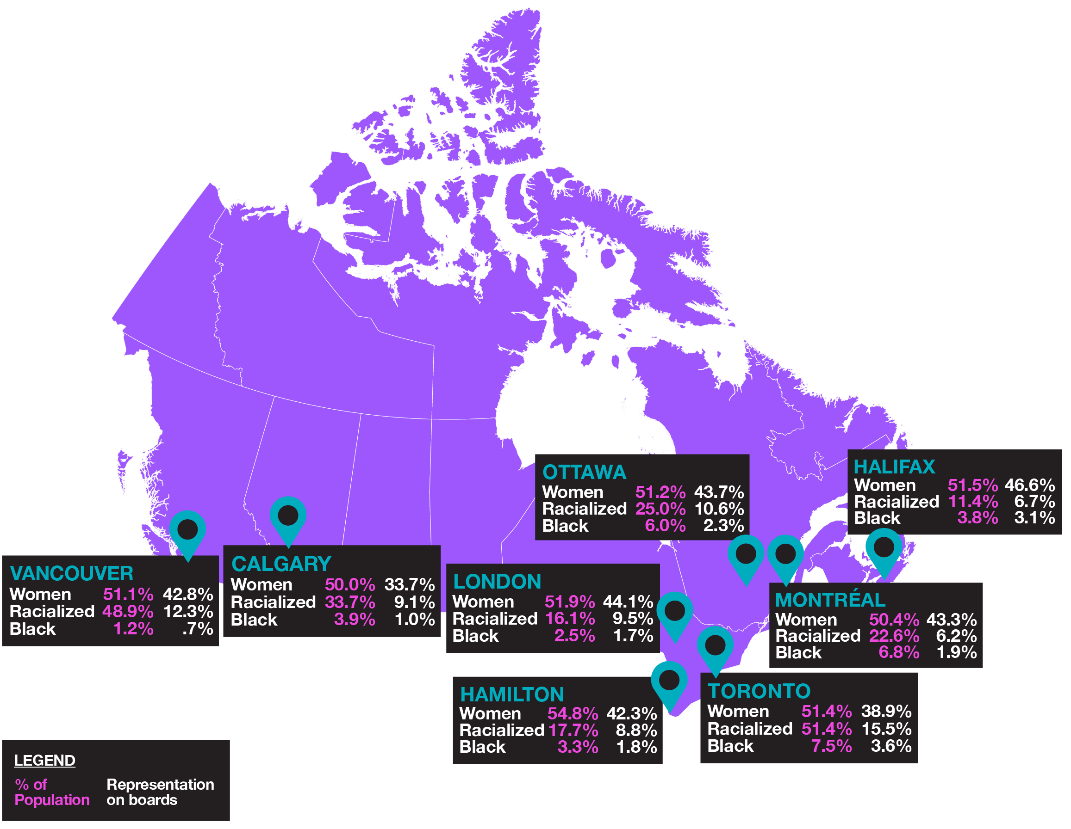
Diversity Leads (2011 – 2020)
63

Slide 64
The Ecological Model
Societal Level
Organizational Level
Individual Level

Slide 65

Diversity Assessment Tool (DAT)
The Diversity Assessment Tool
Governance, Leadership, and Strategy
Human Resources Processes
Values and Culture
Measuring and
Tracking EDI
Diversity Across the Value Chain
Outreach and Expanding the Pool
Notes:
KATLYNN

Slide 66


Diversity and Inclusion Across the Value Chain
Primary
Activities
Inbound
Logistics
Operations
Outbound
Logistics
Marketing
& Sales
Service
Value
Procurement
Technology Development
Support
Activities
Human Resource Management
Firm Infrastructure

Slide 67





Benchmarking
Outreach & Expanding the Pool
Example of an Organization with
Level 4 Average
Governance & Leadership
Levels
1
Minimal & Regulatory Compliance
5
4
2
3
Value Chain
2
1
Measurement & Tracking
3
Foundational Demonstration
4
Advanced Implementation
5
Strategic Integration
Culture
HR Practices
Notes:
Advanced implementation (Level 4 average)
Governance and leadership: level 5
HR: 4
Measurement: 4
Culture: 5
Value chain: 3
Pipeline: 4

Slide 68

The 50 – 30 Challenge
Encourages organizations to advance gender parity (50% women and non-binary people) and increase diversity (30% other equity-deserving groups) on boards and/or in senior leadership roles
Organizations of all sizes across sectors can participate, including large corporations, small and medium-sized enterprises, nonprofits (including post-secondary institutions and health care organizations), and agencies, boards and commissions
DI is one of five ecosystem partners selected to promote the Challenge

