Slide 1
An environmental NGO perspective on “The ISO 26000 Social Responsibility Standard After Ten Years and the UN Sustainable Development Goals: Finding the Linkages”
Carolyn Schmidt, ECOLOGIA
March 23, 2020
(Online) Ryerson University’s Institute for the Study of Corporate Social Responsibility

Slide 2
ISO 26000 Guidance Standard
The 7 Principles
How to Apply the Principles
Accountability
Transparency
Ethical behaviour
Respect for stakeholder interests
Respect for the rule of law
Respect for international norms of behavior
Respect for human rights
Top management and core business model
Stakeholder identification; two-way communication
Application along the supply / value chain
Reporting and verification
Apply to all 7 Core Subjects

Slide 3
Holistic Integrated Approach
Interdependence
Community Involvement and
Development
Human
Rights
Consumer Issues
l
Organizational
Governance
Labour Practices
Fair Operating Practices
The Environment

Slide 4
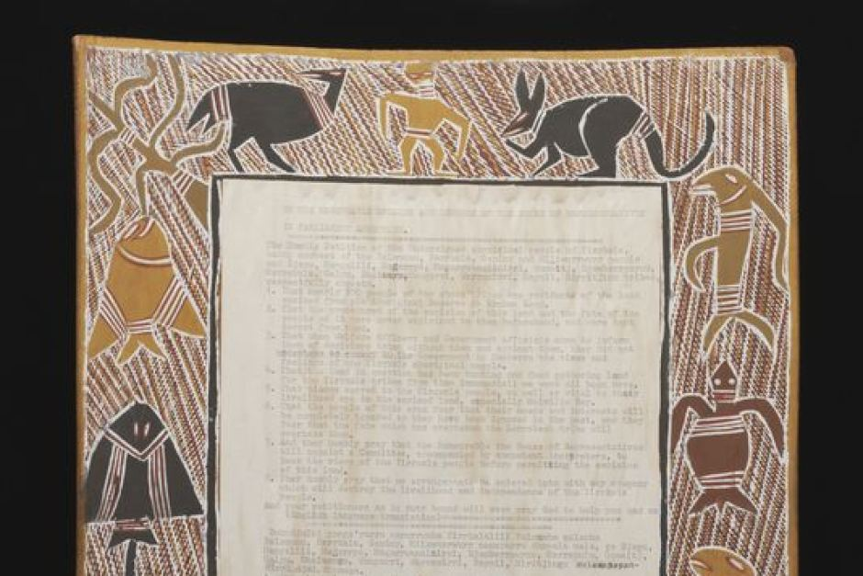
Indigenous peoples’ connections to the earth and other living being – bark petitions
Yolngu, 1963, N.T. Australia
Ojibwe, 1849, United States

Slide 5
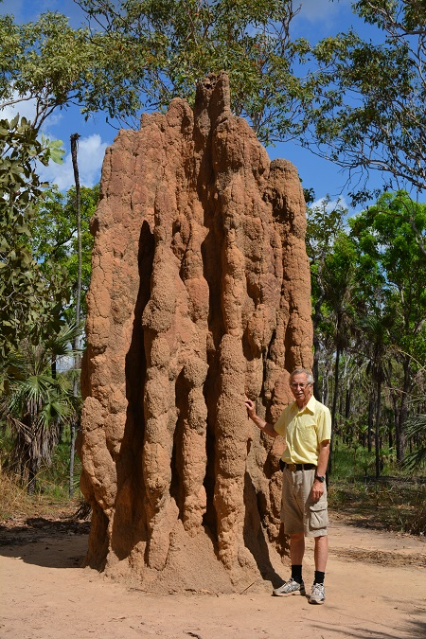
Bauxite mining land restoration 1969 - 2005
(Northern Territory, Australia)
German biologist + Yolngu community - hired by mine owners
Soil protection – bacteria, root fungi, termites
Native plants and seeds
Succession – grasses, insects, termites (12 kinds). Bees (after 8 years). Earthworms (after 16 years). Wallabys. Trees, including eucalyptus (clan totem). Edible native plants.
NO: nitrogen fertilizer (kills root fungi needed by trees)
NO: cattle (Yolngu wanted biodiversity and food sources).

Slide 6
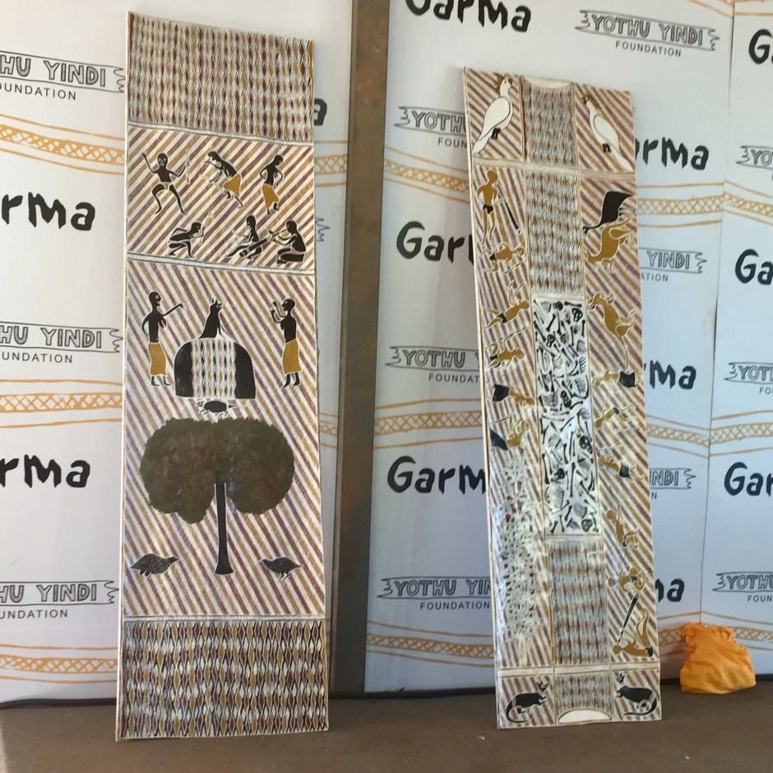
Bark paintings
reaffirming the value of environmental
and cultural sites
on Yolgnu land
part of legal compensation case vs. Rio Tinto, filed 2019
Note: resilience vs. forest fires & TEK land management

Slide 7
“Metis” = practical knowledge, possessed by local people, of what works in their particular place
METIS is:
Informal
Flexible; responsive to changing conditions
Resilient
Long-term
Self-reliant
Community-based
Sustainable
METIS is NOT
Reducible to specific granular items such as Key Performance Indicators (KPIs)
Easily transferable from one place to another
Privately owned
Managed by top-down chain of command

Slide 8
CONCLUSION
Resilience needed in face of unexpected threats
Current global system unsustainable (ecologically, economically)
ISO 26000 actually provides tools that all can use to restructure our economic systems to become more resilient and more fundamentally committed to human and environmental rights
Needs motivation to change away from short-term perspective and short-term profits
Needs respect for metis – local wisdom – and true multi-stakeholder involvement

Slide 9

Thank you for your attention ! (References on next two slides) Carolyn Schmidt Program Director, ECOLOGIA Vermont, USA www.ecologia.org

Slide 10
References
“Garma: Gove Peninsula traditional owners to launch compensation case over bauxite mining”. Laura Gartry and Steph Zillman, Australian Broadcasting Corporation, 6 Aug 2019. https://www.abc.net.au/news/2019-08-03/gove-traditional-owner-to-launch-compensation-mining-claim/11381034
Land Rehabilitation in Gove”. Rio Tinto Website, January 28, 2020. https://www.youtube.com/watch?v=a1aT-jXWqTk
Margonelli, Lisa. Underbug: An Obsessive Tale of Termites and Technology. New York: Scientific American / Farrar, Straus & Giroux, 2018.
Scott, James C. Seeing Like a State: How Certain Schemes to Improve the Human Condition Have Failed. New Haven: Yale University Press, 1998.

Slide 11
References, continued
Termite Mounds, Australia. My Thatched Hut. 2016. https://mythatchedhut.com/termite-mounds-australia/
"We Wish to Remain Here": Chief Buffalo and the Fight for Ojibwe Homelands. Chippewa Valley Museum, Wisconsin, USA https://www.cvmuseum.com/about-us/news/38-changing-currents-feature-no-2/

