Slide 1
Introduction to Outcomes Finance
Jordan Gildersleeve, MaRS Centre for Impact Investing
April 16, 2014

Slide 2
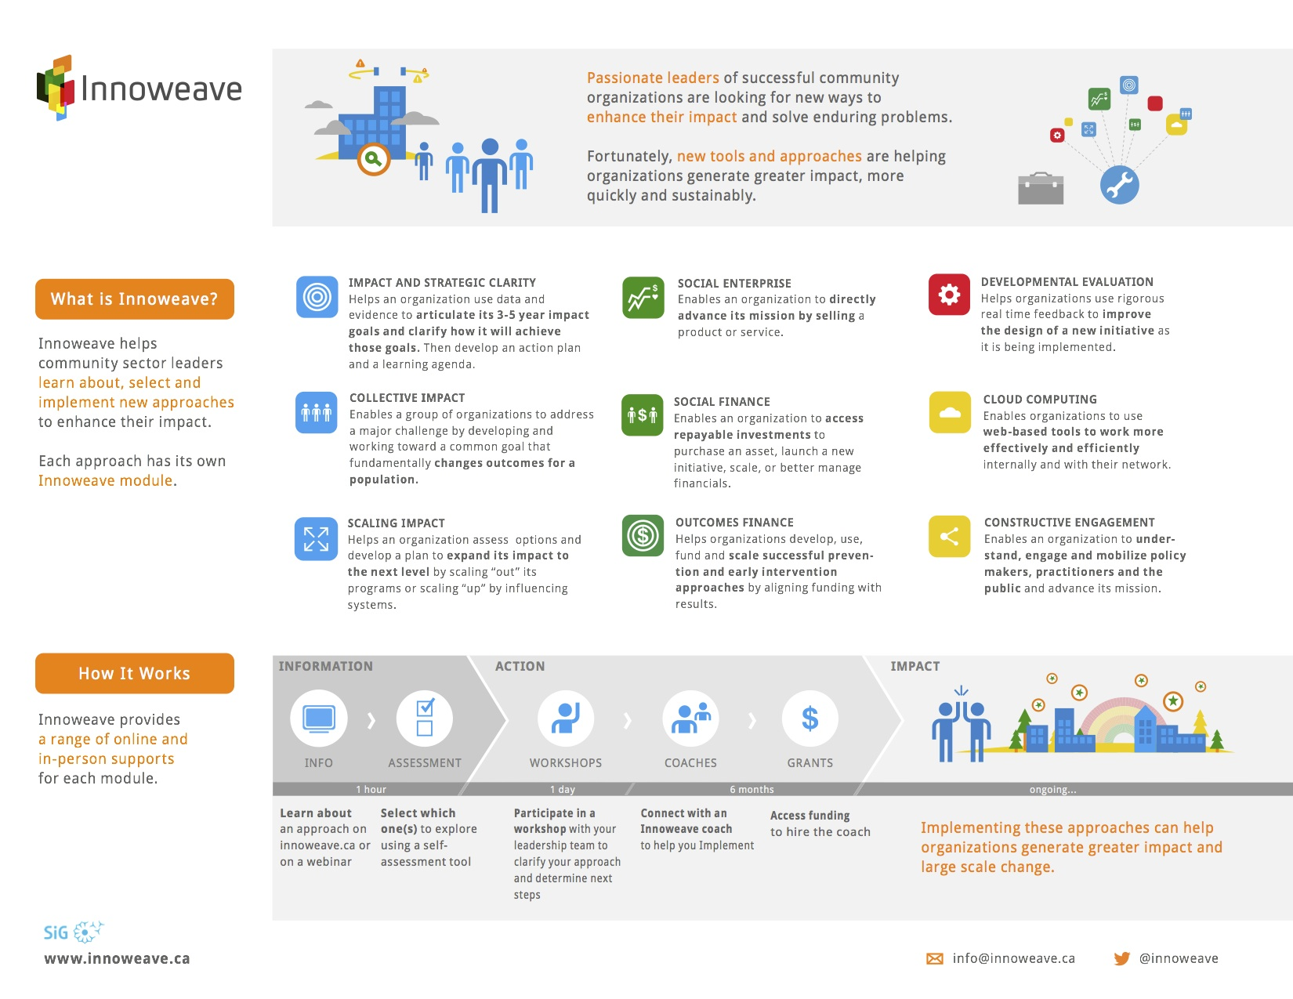
2

Slide 3
Webinar Topics
3
Introduction to Outcomes Finance
The Social Impact Bond Model
SIB Examples
  The Peterborough Case Study (UK)
  The Roca Case Study (Mass, US.)
Workshop Overview

Slide 4
What is outcomes finance?
4

Slide 5
5
What do we mean by outcomes finance anyway?
Revenue for organizations based on the delivery and measurement of positive social outcomes for individuals, families, and communities.

Slide 6
6
This is a fundamental shift
This represents a shift away from a revenue model that funds outputs and is driven by cost reimbursement to…
… revenue for organizations on the basis of the positive value of the outcomes they achieve.

Slide 7
7
Examples of outcomes vs. outputs
Outputs / activities |  | Outcome
Hours of job training services, number of counseling sessions |  | Reduced rate of reoffending
Hours of addictions treatment, number of participants in program |  | Reduced instance of homelessness
Hours of training, number of potential employers engaged |  | Increased employment
Number of social workers, number of families in program |  | Reduced number of children in foster care

Slide 8
8
How can an outcomes focus help address your target social issue?
Focus
Flexibility
Innovation
Collaboration

Slide 9
9
How can outcomes and finance be linked?
Achieving outcomes can open opportunities for other sources of revenue from results focused funders:
Venture philanthropy
Pay for success contracts
Evidence-based government funding
Notes:
VP – More due diligence / proactive involvement in the organization you’re giving to, agreement on what you are going to produce
PFS – Using in house $ to finance and then have someone pay for outcomes (e.g., gov’t paying for each person hired)
EDGF – Same as above, but the gov’t is the payer

Slide 10
10
How is this related to Social Impact Bonds?
Social Impact Bonds are emerging as one outcomes finance tool to attract private capital to provide bridge finance for early/prevention interventions.
It is one model in this larger shift of focusing on outcomes – one that has garnered interest of governments, non-profit organizations, and investors around the world.

Slide 11
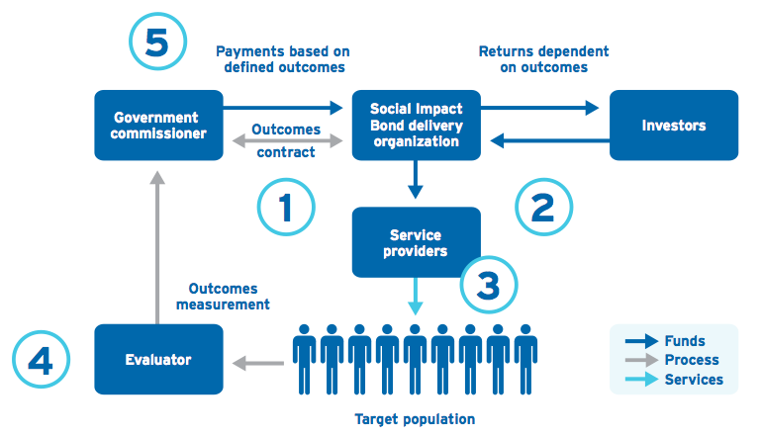
11
The “basic” SIB model
Source: MaRS Centre for Impact Investing, November 2013, “Social Impact Bond Technical Guide for Service Providers”.

Slide 12
12
Donor Funding vs. Government Funding vs. Outcomes Finance
 | Donor funding | Government funding | Outcomes Finance
Performance-based payment mechanism | Limited relation to performance / outcomes | Limited relation to performance / outcomes | Investors paid for achieved outcomes
Scalability potential after program successfully executed | Limited | Limited | High
Funding time horizon | Short to medium term | Medium or long-term | Medium to long-term
Service providers’ costs funded upfront | Yes | Yes or No | Yes
Number of delivery partners involved | Single to few | Typically single | Few to many
Flexibility in service delivery | Yes or partial | No; activities are prescribed | Yes – goal is outcome achievement
Requirement to include 3rd party impact validation | Not important | Not important | Important

Slide 13
13
Risks involved with Outcomes Finance
Structure
Sole focus on program outcomes within term of outcomes finance arrangement (e.g. social impact bond)
Measurement
Not controlling for externalities
Creating perverse incentives
Stakeholders
Commissioner assessment of value of outcomes may vary
Economic benefits may be split across multiple government/private entities
Large number of stakeholders leading to agreement challenges on key issues

Slide 14
14
Five characteristics of a suitable intervention
Preventive approach
Quantifiable outcomes
Innovative intervention
Track record of success
Ability to scale
Notes:
. Preventive approach → e.g., A program that is aimed at reduced the rate of re-incarceration vs. a program aimed at providing nutritious food to inmates
Quantifiable outcomes → e.g., Reducing the number of kids going into foster care vs. helping improve the livelihood of at-risk children
Innovative intervention → e.g., Roca model vs. [eg of standard/mandatory/proven government program]
Track record of success → e.g., At home se coir?
Ability to scale → e.g., SNAP program with licensing model

Slide 15
15
There are a small number of active SIBs globally
UK (14)
Recidivism
At-risk Youth
Homeless-ness
Children in care
Netherlands (1)
Youth employment
USA (3)
Early Child
Ed.
Recidivism
Ex-offender
employment
Australia (2)
Children in care
Note: As of Jan, 2014
Notes:
There are 21 active SIBs around the world; however, it is estimated that there are over 100 SIBs are in the global development pipeline

Slide 16
16
Example I
Peterborough Case Study
Target population
Male prisoners, at least 18 y.o., serving short-term sentences (<365 days), released from HMP Peterborough. 3 cohorts of 1000 men each.
Time frame
7 year service period plus data matching and verification.
Measure
Number of reconviction events for offences committed in the 12 months following release from HMP Peterborough.
Target
10% reduction in number of reconviction events for individual cohort, or 7.5% reduction across the 3 cohorts combined.
Comparison
Similar group of short-sentenced male prisoners across the UK – the cohort will be matched with up to 10 comparators for each individual.
Intervention model
Pre-release work, through the gate service and 12 months support in the community upon release. Support with accommodation, benefits, health and well being, education, training & employment.
Notes:
- The Peterborough SIB was the first pilot implemented in September 2010 working with prisoners released from HMP Peterborough and aiming at reducing their re-offending rate by 10% one year from release.
- First performance results are expected in Spring 2014. Investor return is capped at 13%.

Slide 17




17
Example II
Roca Case Study: The Partners
Context: The Commonwealth of Massachusetts released a Request for Responses (RFR) for juvenile offenders and recidivism
The Service Provider
The Commissioner
The Intermediary
The Advisor
Source: Third Sector Capital Partners. (April 5th, 2013). “Preparing for a Pay for Success Opportunity”.
Notes:
.

Slide 18
18
Example II
Roca Case Study: Scoping & Design
Total population of youth aging out of justice system.
6050 Expected Incarcerations (55%)
Total population in Geographic Reach
2541 Expected Incarcerations (55%)
11,000
Higher Risk of Reoffending
923 Expected Incarcerations (60%)
4620
Participants to be served
700 Expected Incarcerations (60%)
Successful Completion
0 Incarcerations
525
1538
58 Incarceration Expulsions
58
1166
Ineligible & Dismissed (Attrition)
262 Actual Incarcerations (45%)
583
Source: Third Sector Capital Partners. (April 5th, 2013). “Preparing for a Pay for Success Opportunity”.
Notes:
. Target Population: “High-risk” youth, ages
17 to 24. Select individuals with the highest propensity to become incarcerated as demonstrated by established assessment tools.
Counterfactual: Among the targeted population, a 60% counterfactual likelihood of becoming incarcerated within four years was assumed.
Cohort Size: 900 individuals.
Program Period: Six years (four years of service
delivery and two years follow-on evaluation).
Targeted Outcome: Program participants avoid recidivism for 48 continuous months after being released from the juvenile justice system. A recommendation was made to consider using “bed days of incarceration” as an alternative metric.
• Government Success Payments: $50,000 paid per foregone incarceration, defined as two years out of prison post-aging out. Payments would begin two years after initiation of program delivery, which was estimated to
be the time that impact could be detected between incarcerations expected and those actually observed in the Roca population. This payment level would have the potential to generate $18 million in Pay for Success payments.
Counterfactual:
Historical Comparison of “Hot
2. Comparative Site Counterfactual
3. RCT
All rely on Public Administrative Data > Low Cost, Reliable, Credible.

Slide 19
19
Example II
Roca Case Study: Expected outcomes
For the population benefitting from the program, expecting a reduction from 540 incarcerations to 180
Social
Potential public savings of between $9.4 - $23.4 million over the six- year project based on historical costs and performance outcomes
Financial
Source: Third Sector Capital Partners. (April 5th, 2013). “Preparing for a Pay for Success Opportunity”.
Notes:
.

Slide 20
20
Setting up success: Important capabilities
Culture and systems for using measurement approaches to evaluate preventive program performance
Multi-year track record of success in setting and achieving challenging outcome metric targets
Business models and executives with collaborative service delivery capacity and experience
Institutional capacity to support scaling up and time horizon requirements of multi-year contract
Multi-year planning, budgeting and execution expertise to manage upfront capital
Board support for new business model capacity demands, resource commitment and risks
1
2
3
4
5
6
Notes:
…to operate in an outcomes based environment:

Slide 21
21
Innoweave Outcomes Finance Workshop
Develop an understanding of what outcomes-based financing means for your community organization
Explore some key questions for your organization, including:
What positive outcomes are we generating?
How will we measure these outcomes?
What are the reduced societal costs (or value of societal benefits) associated with these outcomes?
Assess readiness for outcomes financing, including identification of delivery and tracking capabilities, expertise, and partnerships
Set out next steps in developing an outcomes finance strategy

Slide 22
22
Innoweave Outcomes Finance Workshop details
Who: Organizational teams of 3-4
When: May 28th, 2014 from 8:30am - 4:30pm
Where: MaRS Discovery District, 101 College Street, Toronto, ON
Deadline: Applications are due April 25th, 2014. Space is limited. Successful applicants will be notified by May 1st, 2014.

Slide 23
23
Next steps
Identify potential outcome-based programs
Complete brief self assessment on Innoweave.ca
Apply to attend the workshop by April 25th
  Visit Innoweave.ca/en/workshops/upcoming-workshops
  Email info@innoweave.ca

Slide 24
24
Staying in touch
Jordan Gildersleeve, MaRS Centre for Impact Investing
e: jgildersleeve@marsdd.com
t: 1.647.299.3645
w: impactinvesting.marsdd.com

Slide 25

25
Thank You
Innoweave.ca
info@innoweave.ca

