Slide 1
I M M I G R A N T F U T U R E S 2 0 2 0
Making the Case for Your Immigrant Future

Slide 2
Today’s Presentation
Our Demographic Challenge
How Immigrants Boost the Economy
About the Immigrant Futures Project & Framework
Initiating a Whole of Community Approach
Community Stakeholders & Assets

Slide 3
Our Demographic Challenge
2016 Census: Over __% of people in the [enter region] workforce were over the age of 55.
There are not enough young people coming through the education system to meet the demand of the current labour market, let alone provide the workforce for future economic growth.
Number collecting CPP up __% since 2008.
Number in the workforce over the age of 55
up __% since 2010.
Number in the workforce under the age of
55? In decline since 2010.
Over __% of entrepreneurs are over 55.

Slide 4
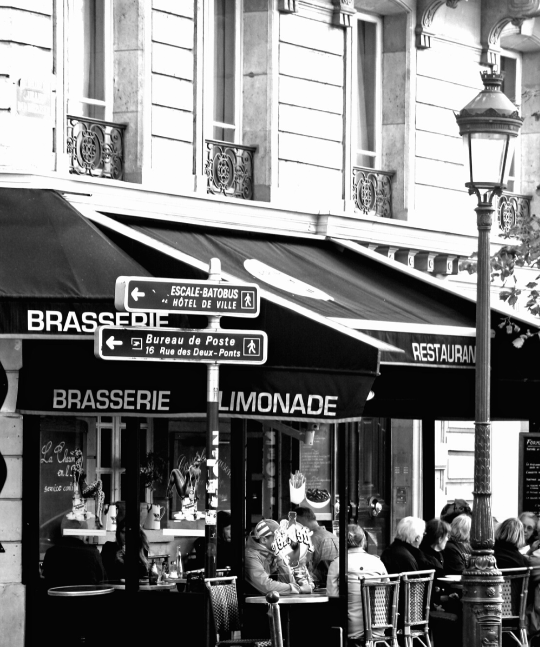
How Immigrants Boost the Economy
In the Greater Moncton area for example, every 1,000 immigrant families with average household income contribute:
$71 million in household spending each year
$13 million on housing costs
$12 million on transportation
$8 million on food
$20 million in tax revenue

Slide 5
Immigrants positively shape the social, cultural, and economic fabric of community life through their contribution of ideas, perspective, and knowledge.

Slide 6
About the Immigrant Futures Project & Framework
Immigration is a critical component to economic growth
The Immigrant Futures Project explores the challenges and opportunities of immigrant attraction and retention in small, medium and regional communities in Canada in an age of global migration.
With a focus on the receiving community the Immigrant Futures Framework aims to leverage the active participation of all residents in welcoming and retaining newcomers.

Slide 7
The Immigrant Futures Framework employs a four step model:
1
2
3
4
harness municipal leadership
raise awareness and participation across the community
mobilize diverse stakeholders
develop practical tools that help design a specific city strategy
The outcome of this approach is tailor-made to the needs and assets of each city.

Slide 9
Initiating a Whole of Community Approach
We adopt a whole of community approach to the design of an inclusive economy. It requires strong leadership and multi-stakeholder engagement across a wide field of action.
It takes the community at large to engage in a planning process that is open, inclusive and speaks to the long-term health and wellbeing of every resident.

Slide 10
Community Stakeholders & Assets
Local leaders can initiate a community planning strategy by engaging in a simple exercise.
Community asset mapping is the process through which local leaders identify and take inventory of social and physical assets in the city spanning from major industries to cultural groups, and local leaders.

Slide 11
No “One Size Fits All” Solutions
Do an Asset Mapping exercise so you know the stakeholders and infrastructures you already have in place
Be flexible – develop your tailormade approach
Mobilize your stakeholders and make sure they feel they have ownership of the planning and implementation

Slide 12
This slide deck is informed by David Campbell’s presentation on immigration and the economy made at our Moncton, NB community consultation on March 18, 2019.
Many thanks for his contributions to the project.

