Slide 1
TMU’s ‘Women in the House’ Program in the Faculty of Arts
Information Session with
Tracey Raney and Peggy Nash

Slide 2
Goals of the Program
Boost the leadership capacities of young women leaders
Introduce you to women leaders from different fields
Offer you learning and networking opportunities related to women’s participation in the democratic process
Help develop professional skills & opportunities that will benefit you beyond the classroom
Provide you with first-hand experiences of what it’s like to be a woman leader in politics

Slide 3
Winter 2023 Course: *This is a course for credit* In-person class every Monday 1-4 PM; regular attendance is expected Most weeks have weekly readings with discussion; other weeks we will have invited guests or the trip to Queen’s Park/Parliament Hill

Slide 4
Sample of Activities & Assignments
Professional Development Workshop (activity)
Panels with women leaders (activity)
MP Shadowing (activity)
Reflection paper (on readings) (graded)
Leadership Speech (graded)
Class participation (graded)
Intersectional Policy Brief & Paper (graded)

Slide 5
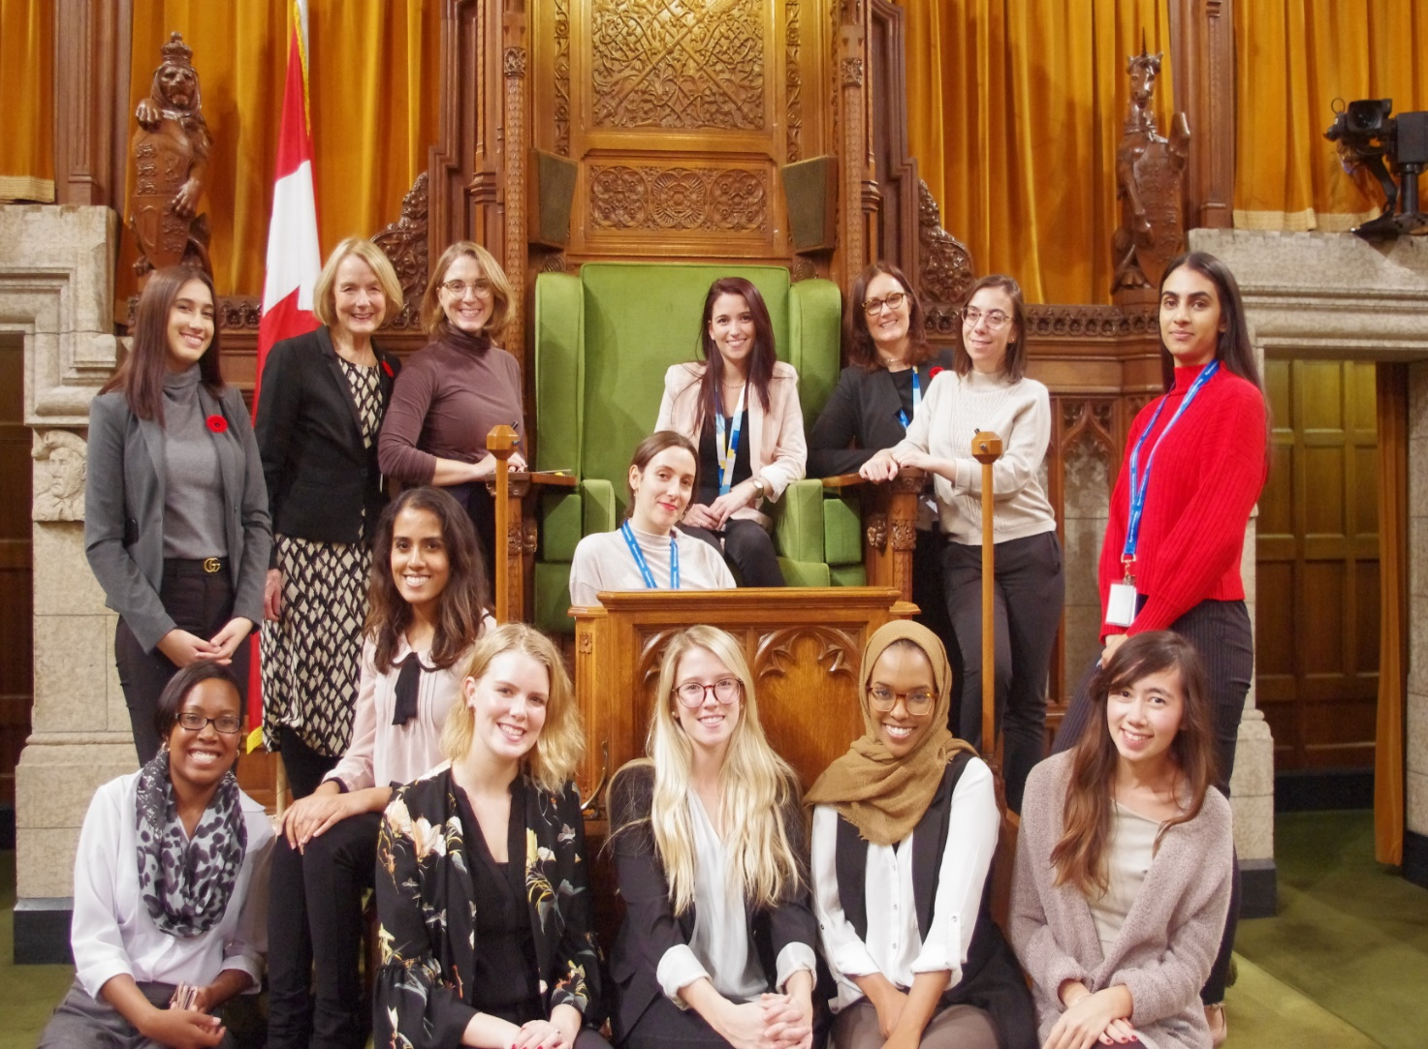
TMU ‘Women in the House’ students in the House of Commons
*Image shared with permission

Slide 6
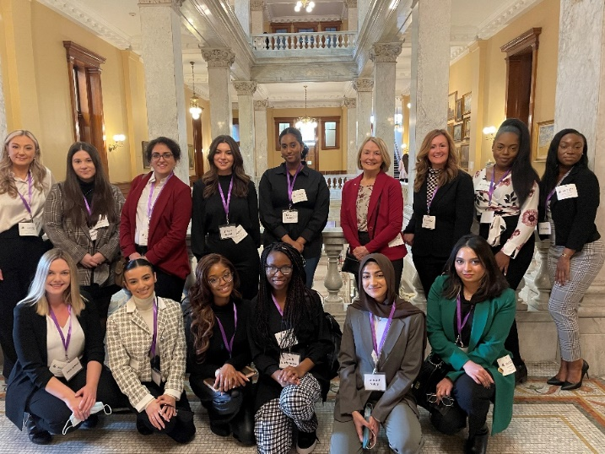
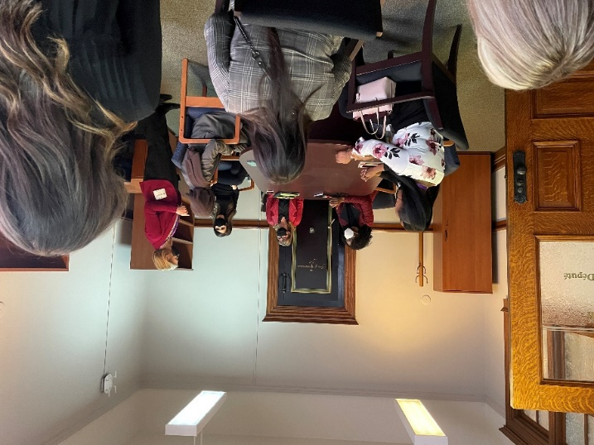
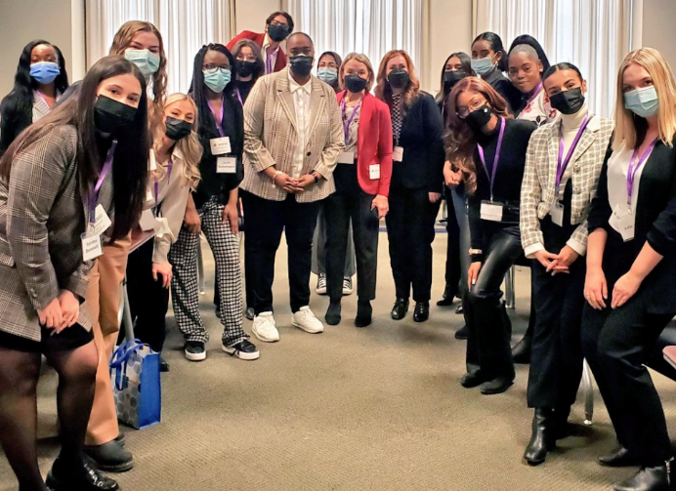
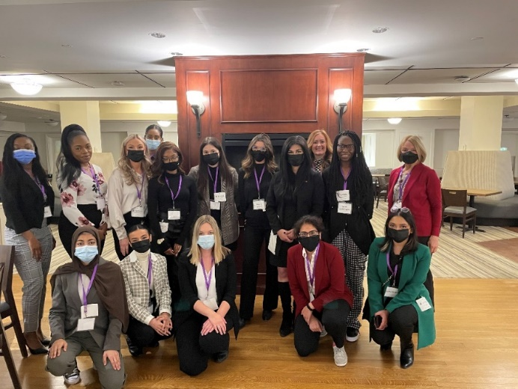
Queen’s Park Visit – March 2022
*Images shared with student permission

Slide 7
Trip Dates for 2023: Queen’s Park: February 27th Parliament Hill: March 6th to March 8th

Slide 8
Competitive process; total number of students accepted is rolling and depends on the number of applications we receive Submit your application by December 2nd 5 PM; link to applications on our website Open to students from various faculties who identify as women & have a GPA of 3.0 or higher in their third year or higher of undergraduate or who are MA students All applicants will be notified within 2 weeks of the deadline; you will be asked to let us know if you accept. Please remember that if you accept and then drop the course, you will be denying another student the opportunity to take the course You will need to consent to all security and health requirement of travel and legislatures (ie. you will need to be fully vaccinated and may be req’d to wear a mask) You will need to consent to shadow and engage with politicians from every major party Once accepted, undergraduates will be registered in POG 494. Once accepted, MA students will need to seek permission from their program to take the course as a directed study
Application Process

Slide 9
Finances
If you are accepted into the program, students are requested to pay a $50.00 administrative fee (with a financial waiver possible)
Once accepted, students are requested to apply for funding within the university (ie. student course unions). In Arts, the Society for Arts, Social Sciences and Humanities might provide funding

Slide 10
Questions?
Tracey Raney: traney@ryerson.ca
Peggy Nash: Peggy.nash@ryerson.ca
Find us at:
Website: https://www.torontomu.ca/arts/students/undergraduate/tmu-women-in-the-house/
Twitter: @RUWomeninHouse
Instagram: RUWomeninHouse

